Slide 1
Navigating the generational waters
Generational Differences in the Workplace
Dr. Drew Dooley

Slide 2
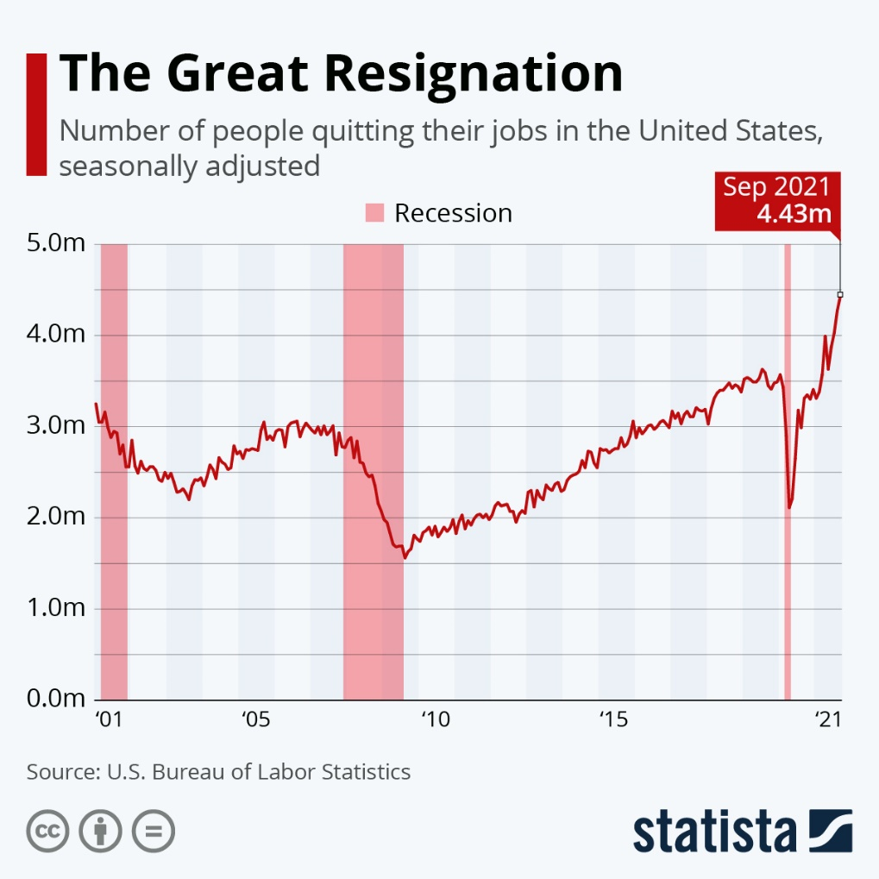
The big quit
The GREAT resignation
In 2020 22 million jobs were lost

Slide 3
Worker shortage
EDUCATION 4.4% (1,584,000)
RETAIL 6% (3,120,000)
HEALTH CARE 8% (1,280,000)
HOSPITALITY 9% (1,181,700)
CONSTRUCTION 350,000

Slide 4
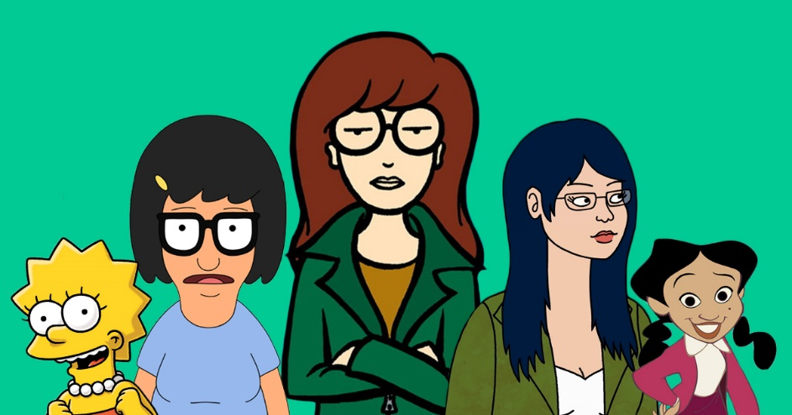
1/3 of women employed before the pandemic have not returned
Child/Parent care
Family
Want more control over their life
Entrepreneurs
2.3 million fewer women in workforce today

Slide 5
55% of working Americans plan to look for a new job in 2022
70% Black
67% Hispanic
47% White
61% of working Americans will change jobs to have more control over their schedule

Slide 6
What do workers want?
1 in 3 Americans want at least partial remote work opportunities (pre-pandemic 1 in 67 jobs were remote. Today 1 in 7 jobs are remote)
56% want workplace flexibility
53% want higher pay
47% want job security
68% prefer hybrid workplace model

Slide 7
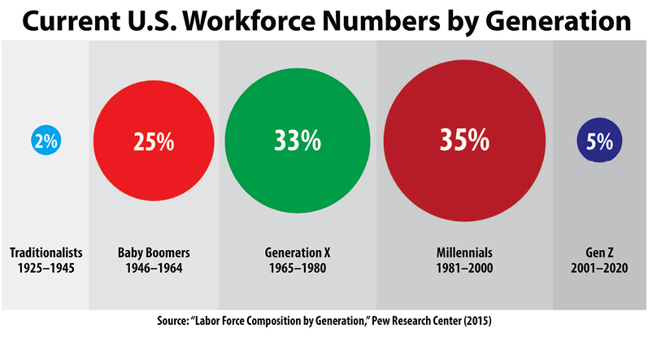
5 generations in the workplace

Slide 8
Defining Factors
WHO raised you
WHERE you were raised
WHAT events were happening after age 10

Slide 9
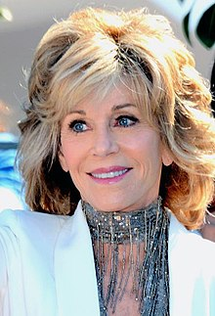
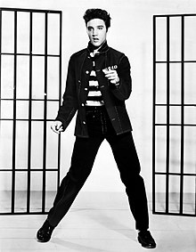
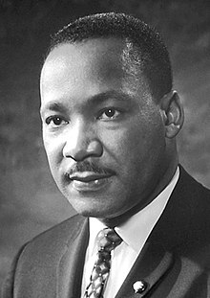
Silent Generation 1926 - 1945 (77-96 yo)
Nuclear family. Distinct gender roles and expectations.
Fiscally frugal and politically conservative
Overly cautious. Resist change.
Loyal and patriotic
Duty before pleasure
Education was a privilege
Privacy was everything
2% of workforce

Slide 10
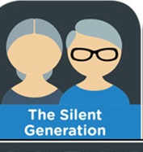
Silent Generation 1926 - 1945 (77-96 yo)
Duty before pleasure
Overly cautious, resist change
Loyal, patriotic, religious
Nuclear family
Clearly defined gender roles
Children should be seen, not heard
Keep up appearances – Don’t let the neighbors know!

Slide 11
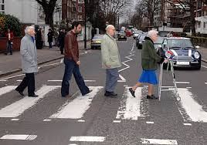
The Baby Boomers
1946-1964
58-76 years young

Slide 12
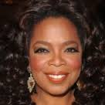
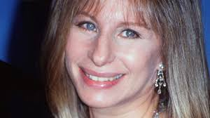
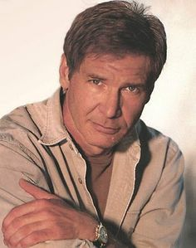
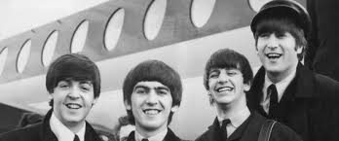
Baby Boomers 1946-1964 58-76 y.o.
End of WWII and Great Depression
Changing roles for women
Improving economy
Ciivil Rights movement
Korean and Vietnam War
JFK/MLK/RFK assassinations
Rock-n-Roll to Disco
Nixon/Watergate
25% of Workforce

Slide 13
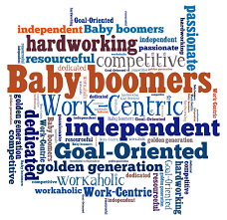
Baby Boomers 1946-1964 58-76 y.o.
3 MILLION Boomers (as compared to 1 million in pre-pandemic times) have not returned to the job market
Strong stock market and soaring house prices give stable income people more options
Risks of going to work are higher for older people
Employers aren’t doing enough to lure people out of retirement
During the Pandemic

Slide 14
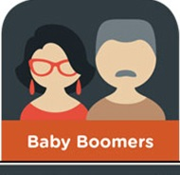
Baby Boomers 1946-1964 58-76 y.o.
Ageism
Unstable
Inept with technology
Only 14% prefer working remotely
Too close to retirement
Too slow
Too expensive
49% above age 55 consider competitive pay and benefits as a deal breaker
Employers reluctant to re-hire Boomers

Slide 15
Baby Boomers 1946-1964 58-76 y.o.
Financially secure
Focused
Competitive
Goal oriented
Team player
Disciplined
Strong work ethic
Question authority…a little
Characteristics

Slide 16
Baby Boomers 1946-1964 58-76 y.o.
Workaholics– 60-80/hr. work week
Desire high quality
Loyal
Follow chain of command
Face-to-face or email
Will use technology, but not go-to
Desire respected job title
Leaders and mentors
In the Workplace

Slide 17
Boomers 1945-1964 (58-76)
As Employers offer:
Honesty
Crediblity
Clear expectations
Training
Personal Relationships/Connection
Personalization (job title)
Use as mentors

Slide 18
Generation X
1965 – 1980
42 – 57 years young

Slide 19
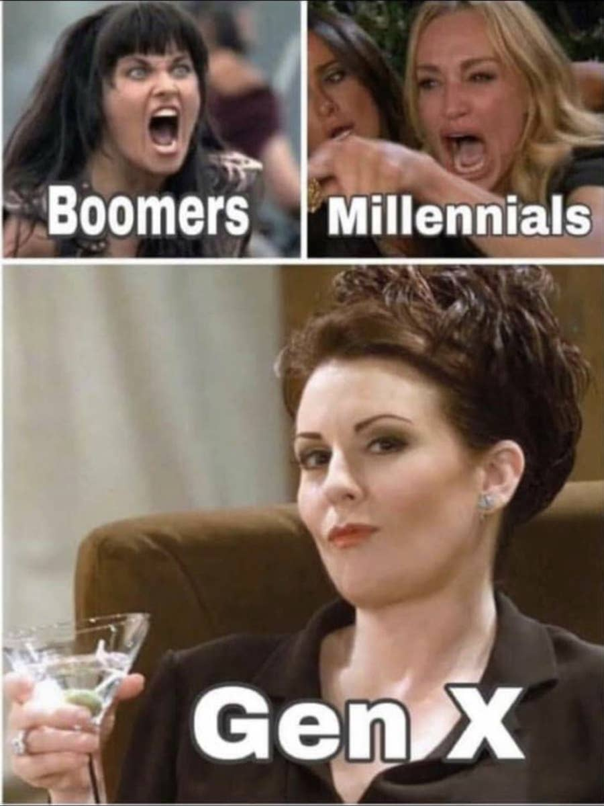
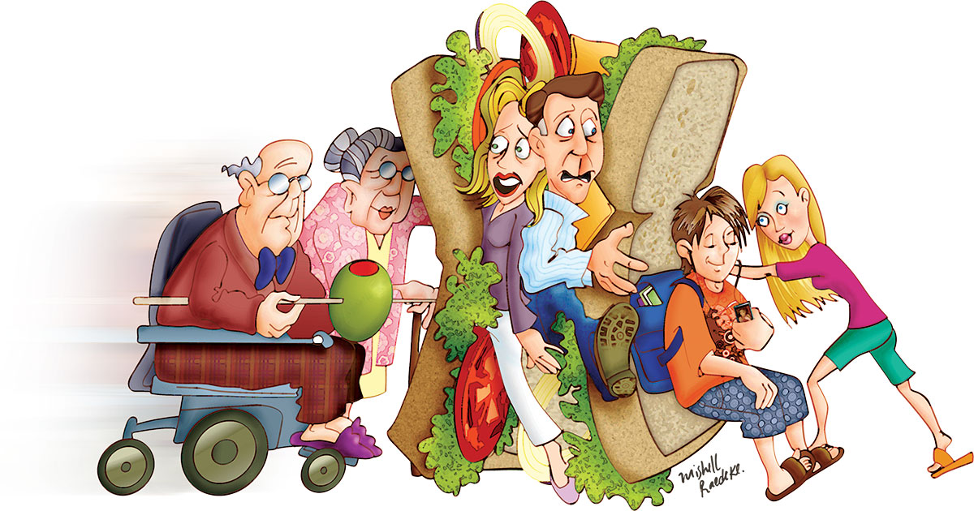
Generation X 1965-1980 (42-57 y.o.)
Sandwich Generation

Slide 20
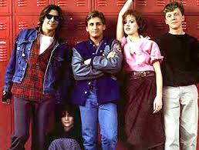
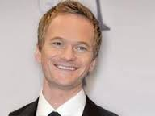
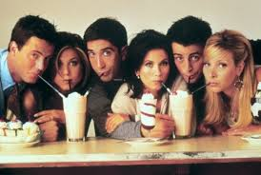
Generation X 1965-1980 (42-57 y.o.)
National Events
Vietnam escalates and ends
Worst recession in 40 years
Watergate - Nixon resigns
Political assassinations
Roe v. Wade – Women’s rights
Highest divorce rate ever
AIDS
Introduction of personal computer

Slide 21
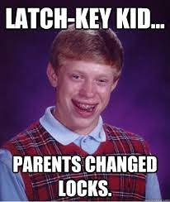
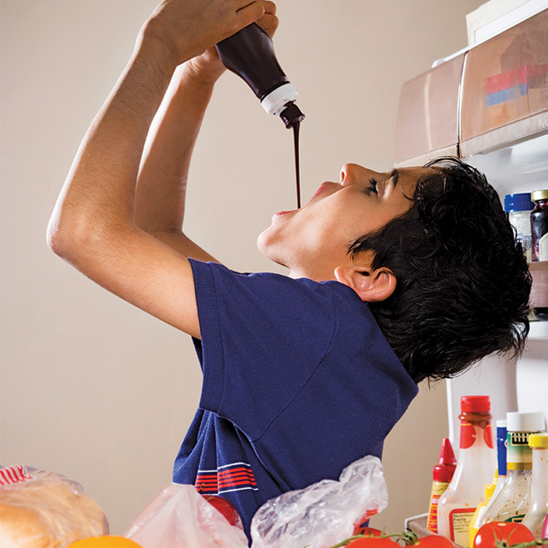
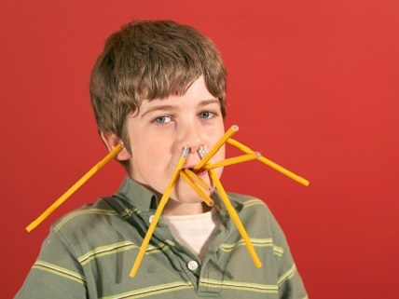
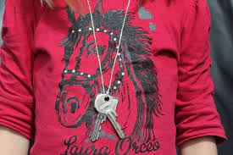
Generation X 1965-1980 (42-57 y.o.)
Latch key kids

Slide 22
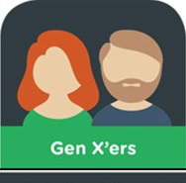
Generation X 1965-1980 (42-57 y.o.)
Characteristics
Independent Learners
Demand work/life – balance
Want to have fun at work
Survivors
Adapt easily to change
Flexible, but untrusting
Will challenge status quo
Lack tact and diplomacy
Innovative and creative
Trust No One

Slide 23
Generation X 1965-1980 (42-57)
Finances as result of pandemic
¼ saw a decrease in income by 50%
18% lost their job
45% unprepared for unexpected costs and over half (53%) had to dip into emergency cash reserves
Want to save for retirement, but have huge drain on income due to care for family

Slide 24
Generation X 1965-1980 (42-57 y.o.)
In the Workplace
Desire flexibility
Expect Work/Life balance
45% Want to work remotely
Prefer to work independently
Desire good benefits & competitive pay
Use email, text
Direct, clear communication – No B.S.
Strong leaders
Meetings hold little value – prefer email

Slide 25
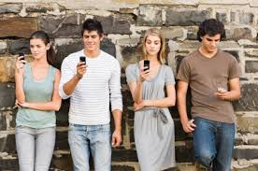
Millennials
1981-1995
(27-41 yo)

Slide 26
Millennials 1981-1995 (27-41 y.o.)
Indulged by parents – “Special” - Trophy kids
LOVE to work in groups
Technologically dependent – socially inept
See adults as peers
Delayed adulthood
Highly impatient
Were never taught how to deal with failure
Desire/crave immediate feedback
Use social media as a social guide
Highly diverse – last with Caucasian majority
47% have a college degree
Characteristics

Slide 27
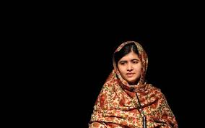
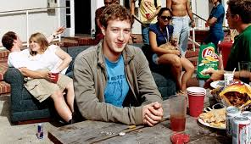
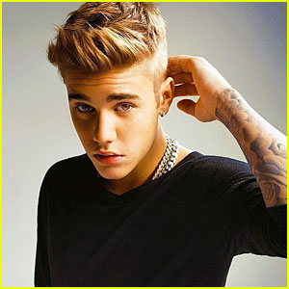
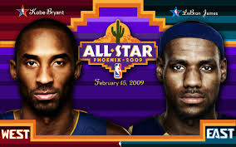
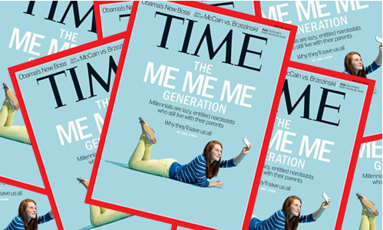
Millennials 1981-1995 (27-41 y.o.)
First space shuttle launched
Challenger explodes
Fall of Berlin Wall
Exponential growth of the Internet
Personal computers in homes and schools
MTV
1st female Supreme Court Justice
A Nation at Risk
AIDS
9/11
National Events

Slide 28
Millennials 1981-1995 (27-41 y.o.)
Walkman/cassettes
Personal computer (Oregon Trail)
Answering machine
Internet
CD’s
MP3
Flip phone
Max Headroom
Atari/PacMan
Nintendo
Technology

Slide 29
Millennials 1981-1995 (27-41 y.o.)
Twitter
Instagram
Tumbl’r
Pintrest
Facebook
Texting
Emoji’s
Indeed
YouTube
TikTok
Venmo
Social Media

Slide 30
Millennials 1981-1995 (27-41 y.o.)
Reality TV
MySpace/Facebook/Instagram/ Twitter
Smart technology
24/7/365 Worldwide connection
Online shopping
Uber/ Lyft
Door delivery systems
Amazon/Google/Apple/Microsoft
Starbucks
Created

Slide 31
Millennials 1981-1995 (27-41)
Pandemic
Most impacted generation – pivotal time in life – delayed adult milestones (again)
Highly dissatisfied with options before them. Want to redesign the workplace.
Report reduced productivity, less connected, less informed about company vision
Crave social connection beyond Zoom.
Aspire to work for a socially conscious employer

Slide 32
Millennials 1981-1995 (27-41 y.o.)
Need constant feedback
Desire work with a social impact
Lines between professional and personal are blurred
Different perception of office protocols
47% Desire remote and flexible work schedule
Open to having a mentor
80% prefer on the spot recognition over formal reviews
69%believe regular office attendance is unnecessary
Prefer text over email
63% will switch jobs in 2022
In the Workplace

Slide 33
By 2025
By 2025 Millennials will make up 75% of the active workforce

Slide 34
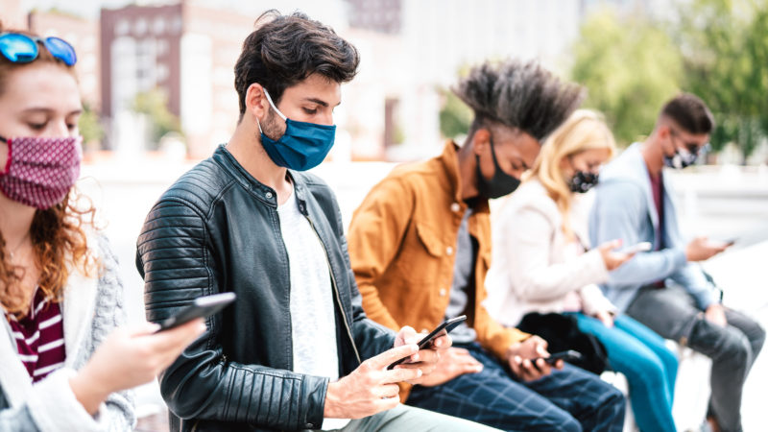
Generation Z
1996-2009
(13-26 yo)

Slide 35
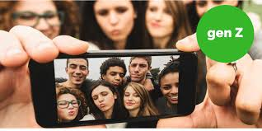
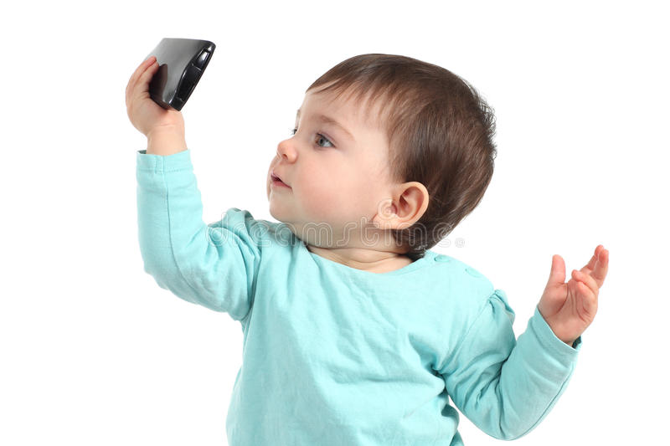
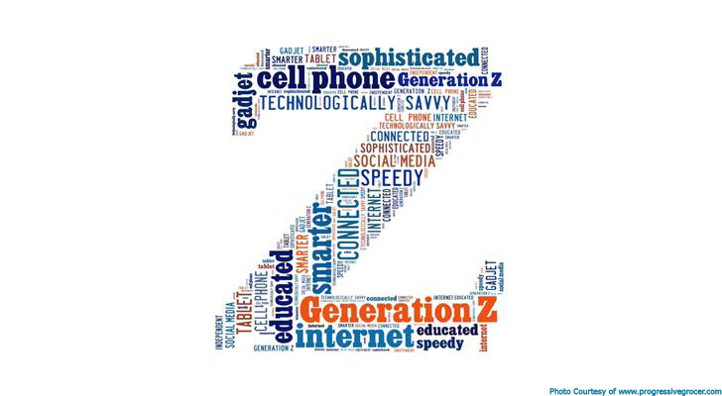
Generation Z 1996-2009 (13-26 y.o.)
National Events
War in Iraq and Afghanistan
1st Hispanic Supreme Court Justice
Global warming / climate change
Technology- exponential growth
1st African American President
Hurricane Katrina, Sandy, Maria, etc.
Legalized same-sex marriage
Many states legalize marijuana use
2020 Pandemic

Slide 36
Generation Z 1996-2009 (13-26 y.o.)
Google Glass
Virtual Reality, Augmented Reality, and iOS technology
Smart devices
Drones
3D, 4D Printing
Artificial Intelligence
Self driving vehicles
Digital voice assistants
Streaming everything
Always connected
Technology
1st True Digital Natives

Slide 37
Generation Z 1996-2009 (13-26 y.o.)
Characteristics
You Tube Generation
Cautious spenders, conservative
1st true Digital Natives
6 second attention filter
Most diverse generation ever
Technologically saturated (perpetually “on”)
55% will be University educated (compared to 33% Millennials, 25% Gen X)
85% research online, 33% watch online lessons to educate themselves

Slide 38
Generation Z 1996-2009 (13-26)
Finances / Workplace
Second highest job loss rates of any generation 19% (almost 1 in 5)
High rates of unemployment 10% (20-24yo), 15% (teens out of HS)
42% want to return to physical workplace
Suffering from “last hired, first fired” syndrome
48% considering changing careers because of pandemic
Pandemic created a major impact on lifetime earning potential and ability to develop on-the-job skills

Slide 39
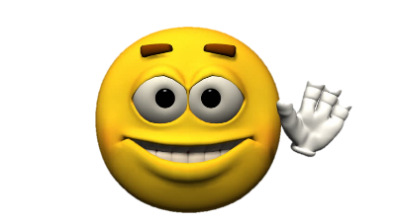
Generation Z 1996-2009 (13-26 y.o.)
As Employees
Highly motivated – need mentoring
81% aspire to be a leader
53% prefer to communicate in-person
Expect to work for up to 15 companies in lifetime
93% say company impact on society affect decision to work there
45% find Boomers most difficult to work with
To find employment: 59% use Instagram, 56% use Snapchat, 17% use Tumblr

Slide 40
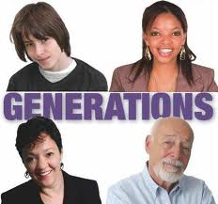
In review…
Silent Generation:
Dependable, Tactful, Straightforward, Loyal
Want satisfying work and opportunities to contribute
Baby Boomers:
Optimistic, Competitive, Workaholic, Team-oriented
Provide with specific goals and deadlines; put them in mentor roles; offer coaching-style feedback

Slide 41
In review…
Generation X:
Flexible, Informal, Skeptical, Independent
Need immediate feedback, flexible work arrangements, work-life balance, opportunities for personal development
Millennials:
Competitive, Civic and Open-minded, Achievement Oriented
Want a personal connection, flexible schedule, immediate and frequent feedback

Slide 42
In review…
Generation Z:
Global, Entrepreneurial, Progressive, Less Focused
Offer opportunities to work on multiple projects at the same time, work/life balance, allow them to be self-directed and independent
Show you care
Be authentic
Be Flexible
Listen

Slide 43
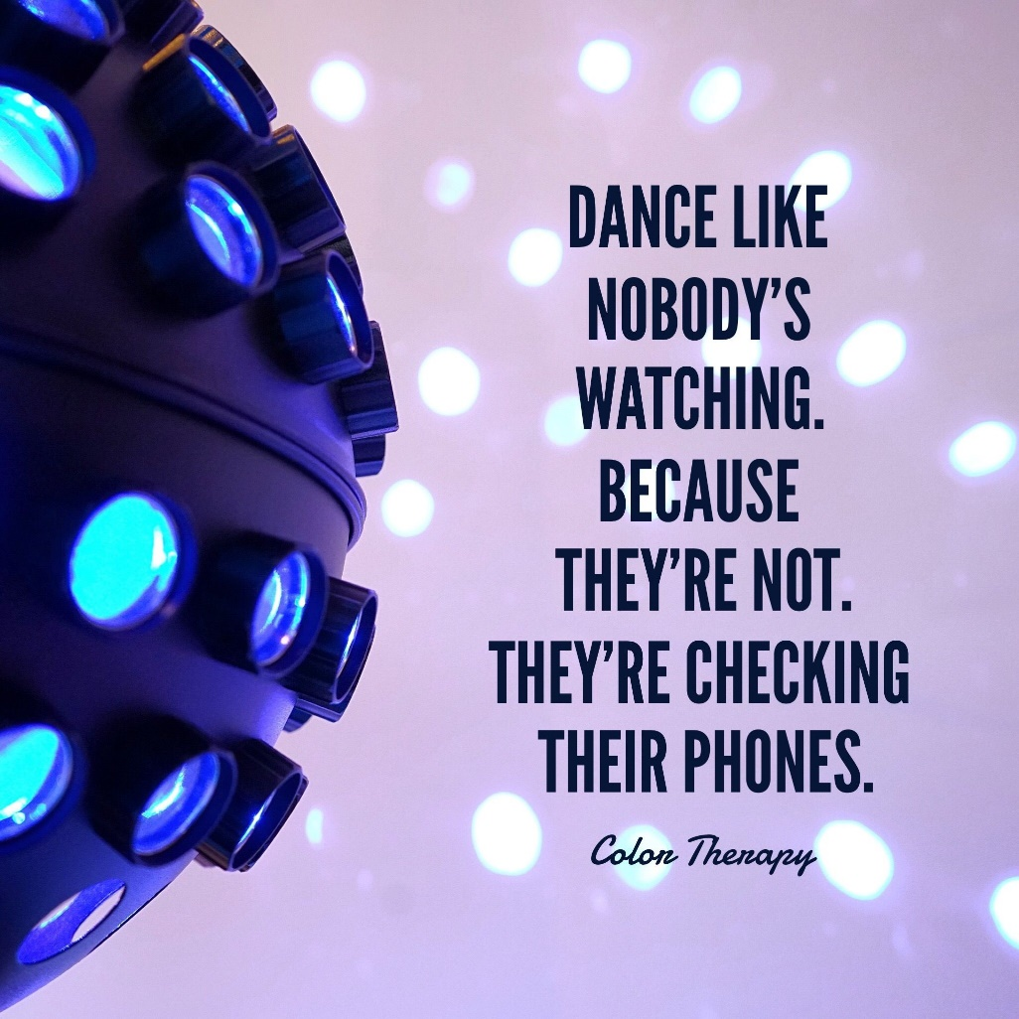
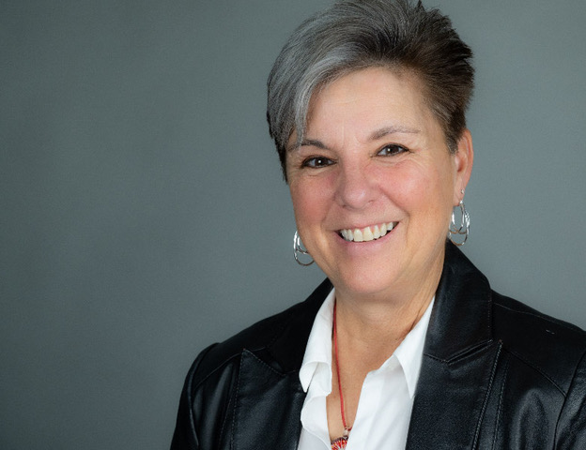
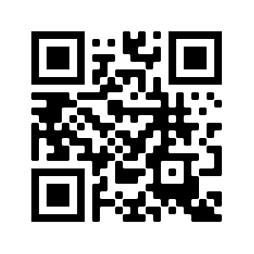
Thank you!
Dr. Drew Dooley
(505) 363-8676
drew@visionrizing.com
www.visionrizing.com

