Slide 1
State of New Mexico
Wildfire 2022

Slide 2
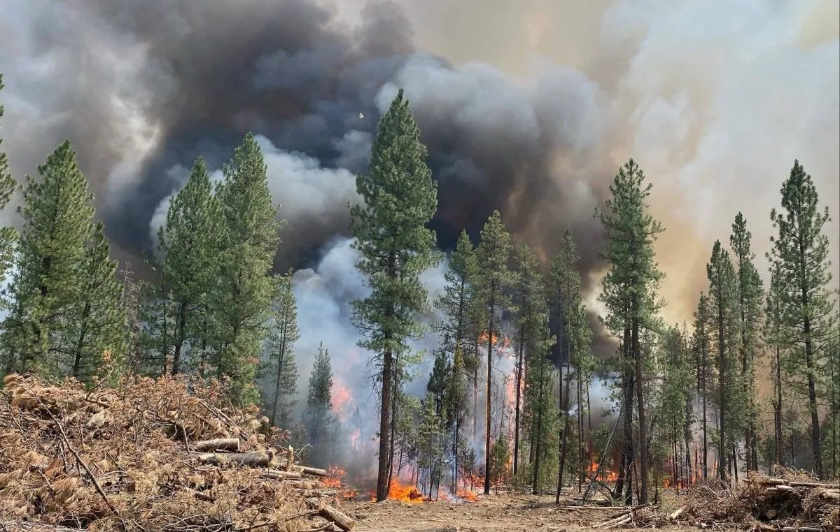
Start of Wildfire Season
March 29 – US 380 – No issues
April 6 – Hermits Peak – Power cut to cellular
April 7 – Overflow
April 11 – Big Hole
April 12 – Nogal Canyon, Mc Bride, SEOC Activated

Slide 3
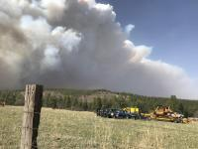
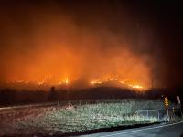
Fires keep coming
April 17 – Cooks Peak
April 19 – Calf Canyon – Cellular, TV, Radio, PS radio burned
April 20 – Buckhorn
April 22 – Hermits Peak / Calf Canyon 60,173

Slide 4
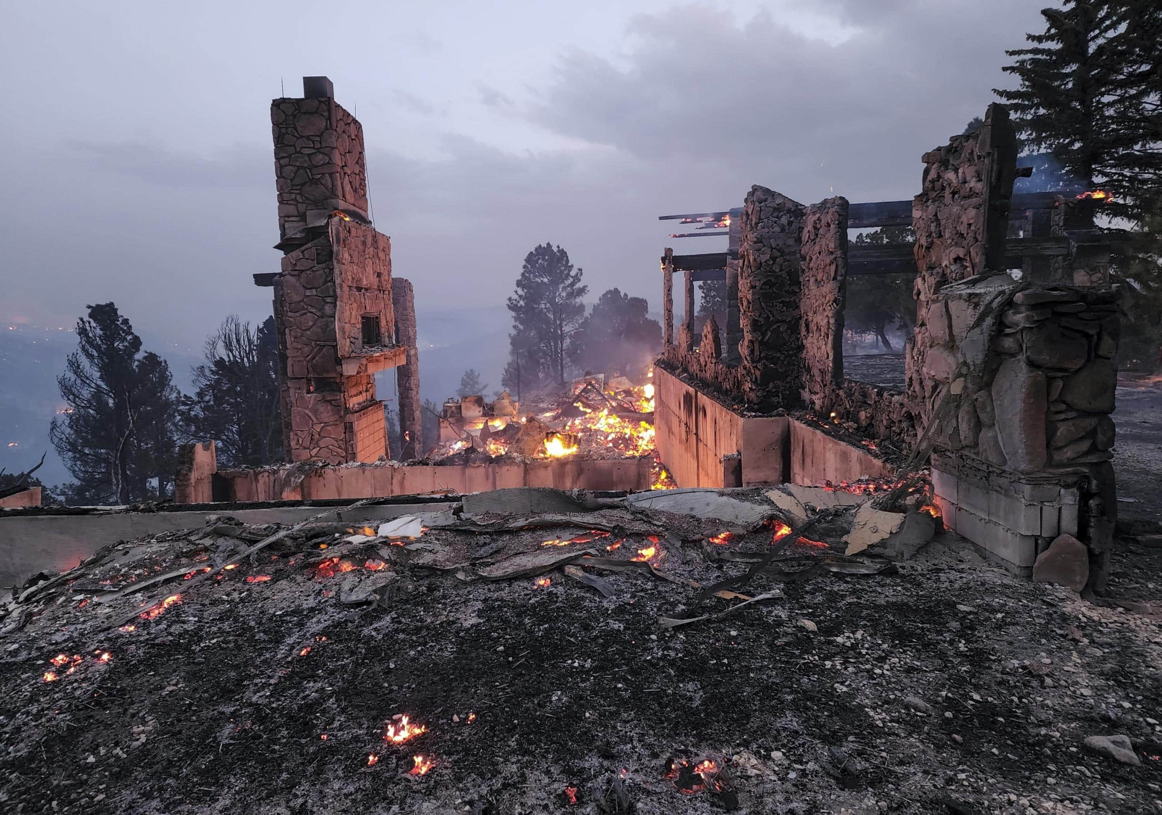
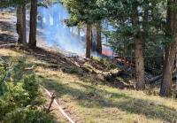
Winding Down
April 22 – Cerro Pelado
May 4 – Federal Declaration Issued
May 18 – HPCC 301,971 acres 34%
June 26 – HPCC Contained 341,471 acres 85%

Slide 5
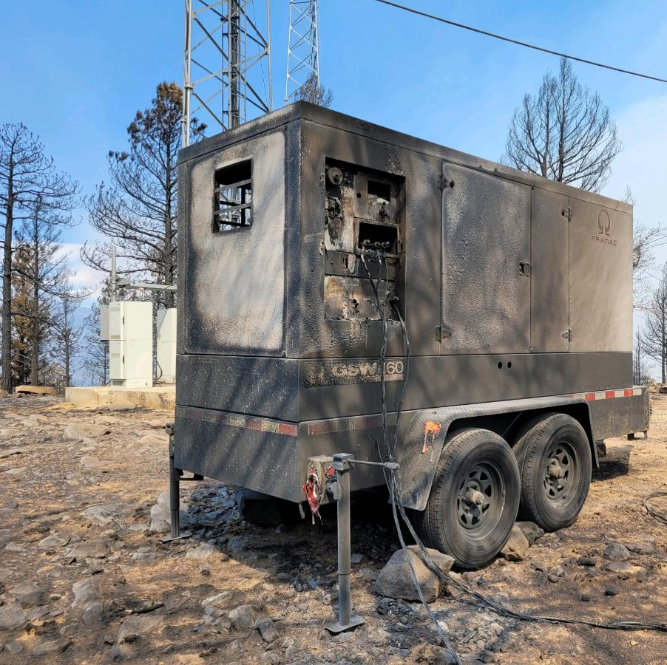
Infrastructure impacted
June Request for Generator for Cellular tower
5 days later burn over
3 cellular sites
1 Fiber hub site
1 TV Station
1 Radios Station
1 County public safety system

Slide 6
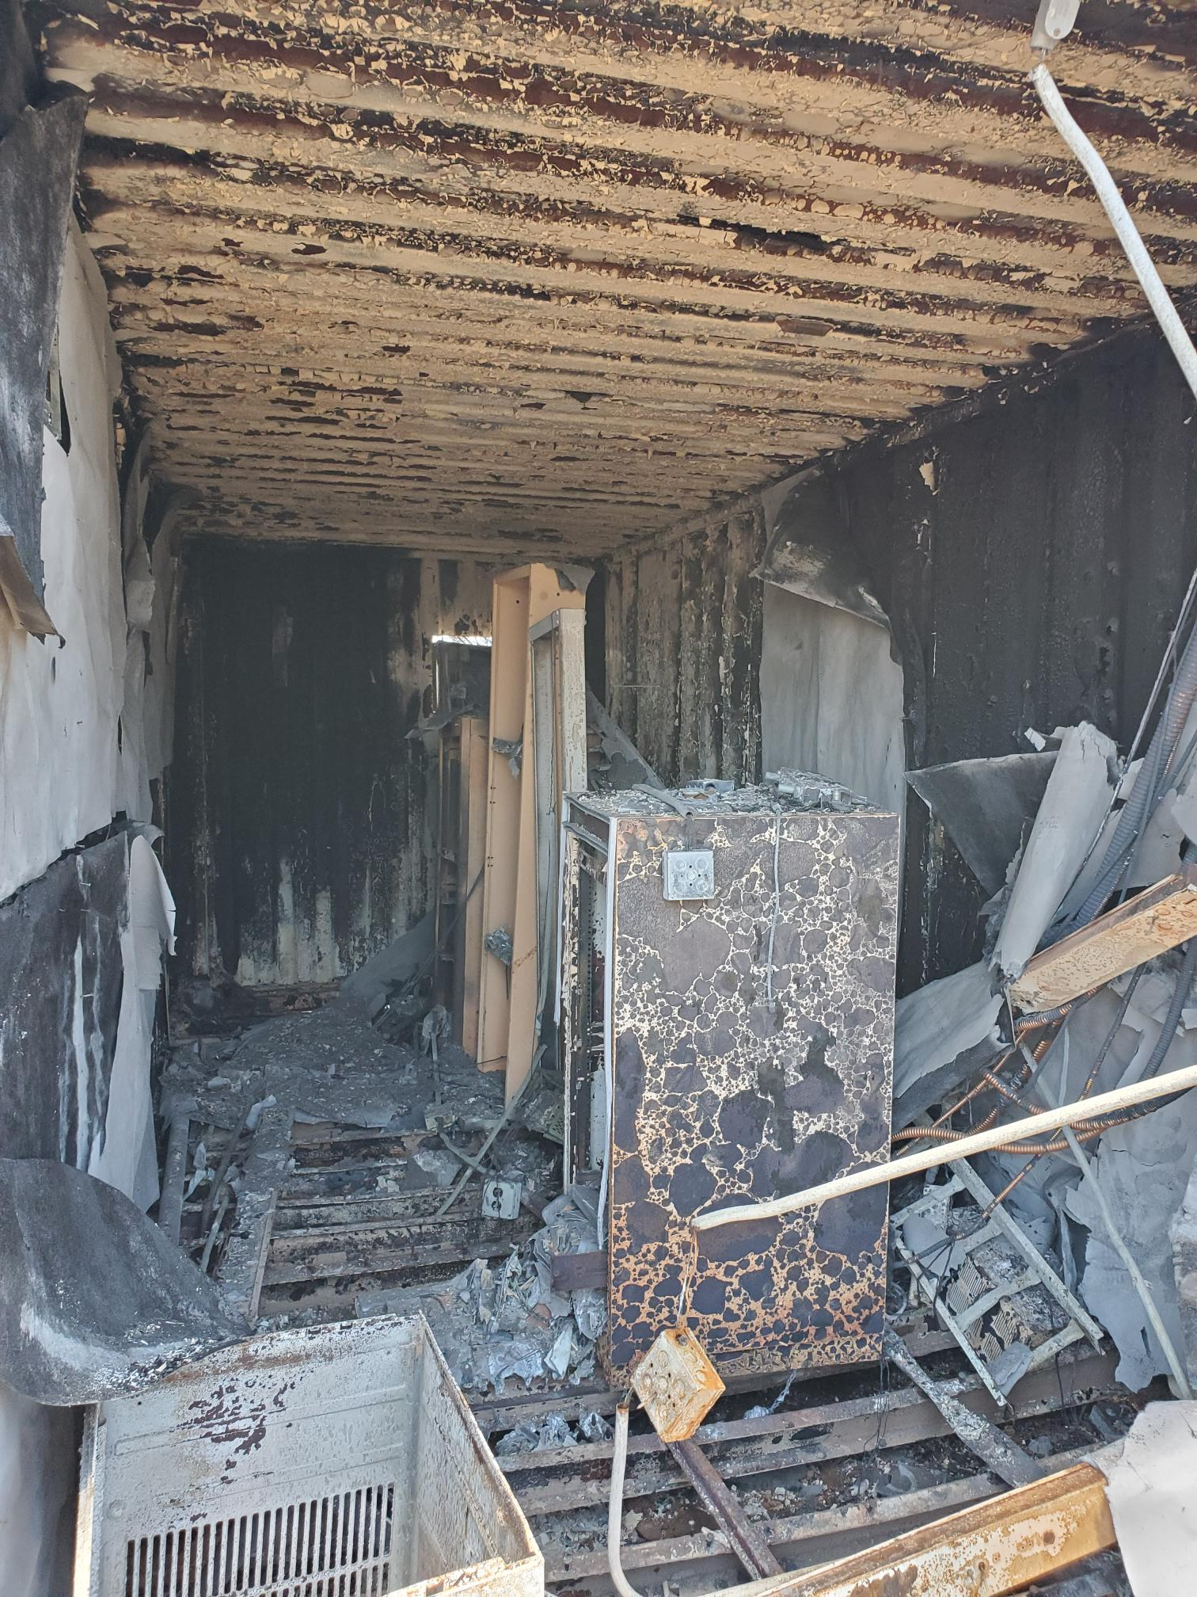
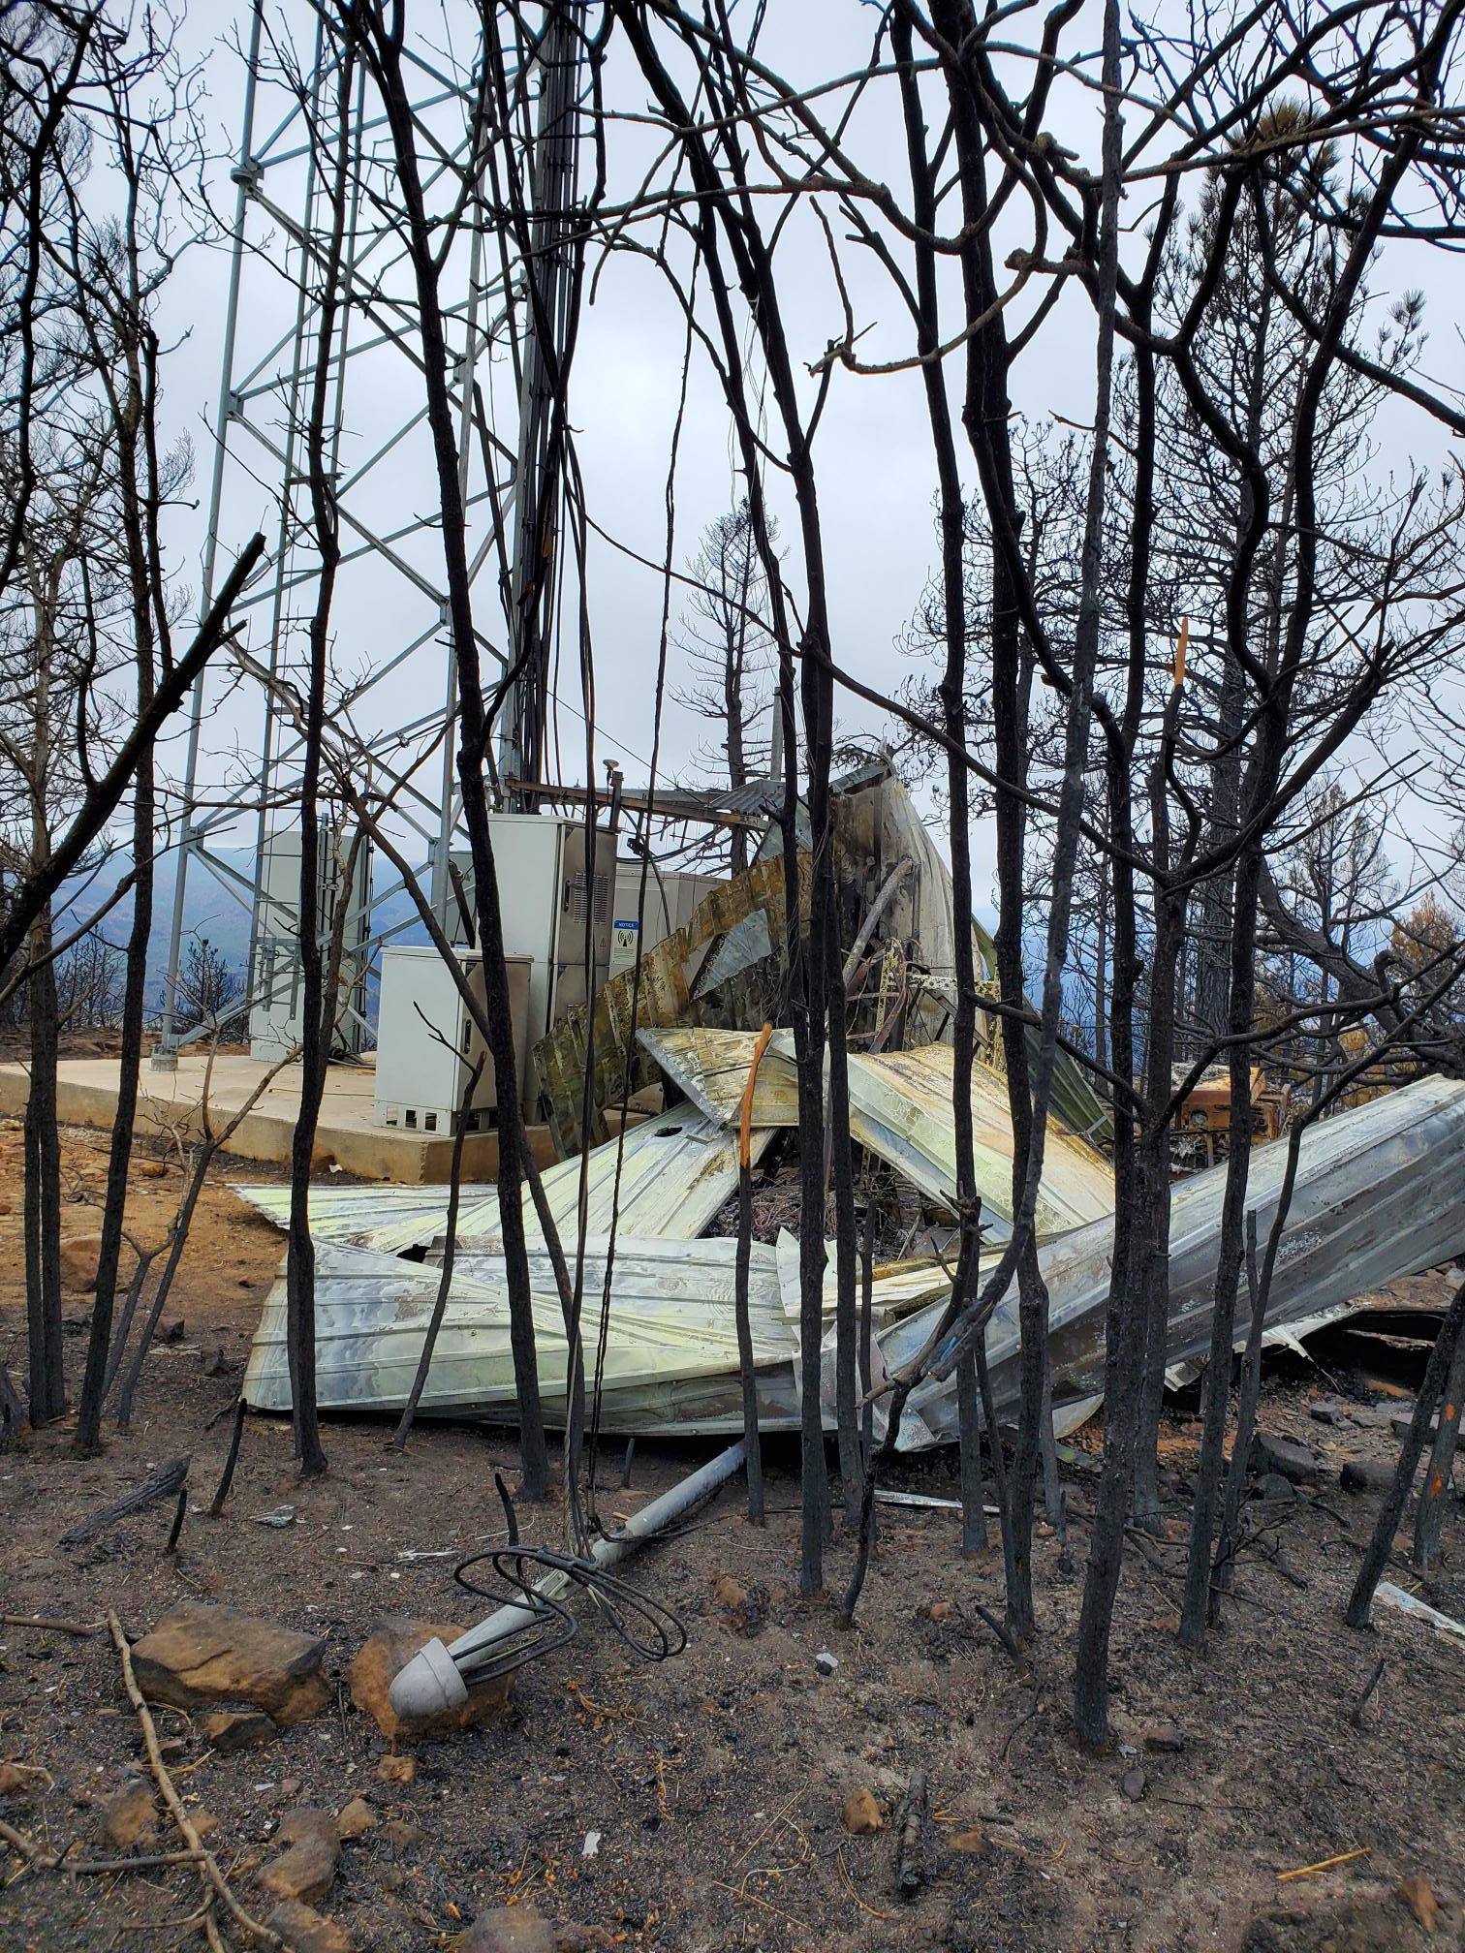
TV, Radio station and Fiber and Cellular

Slide 7
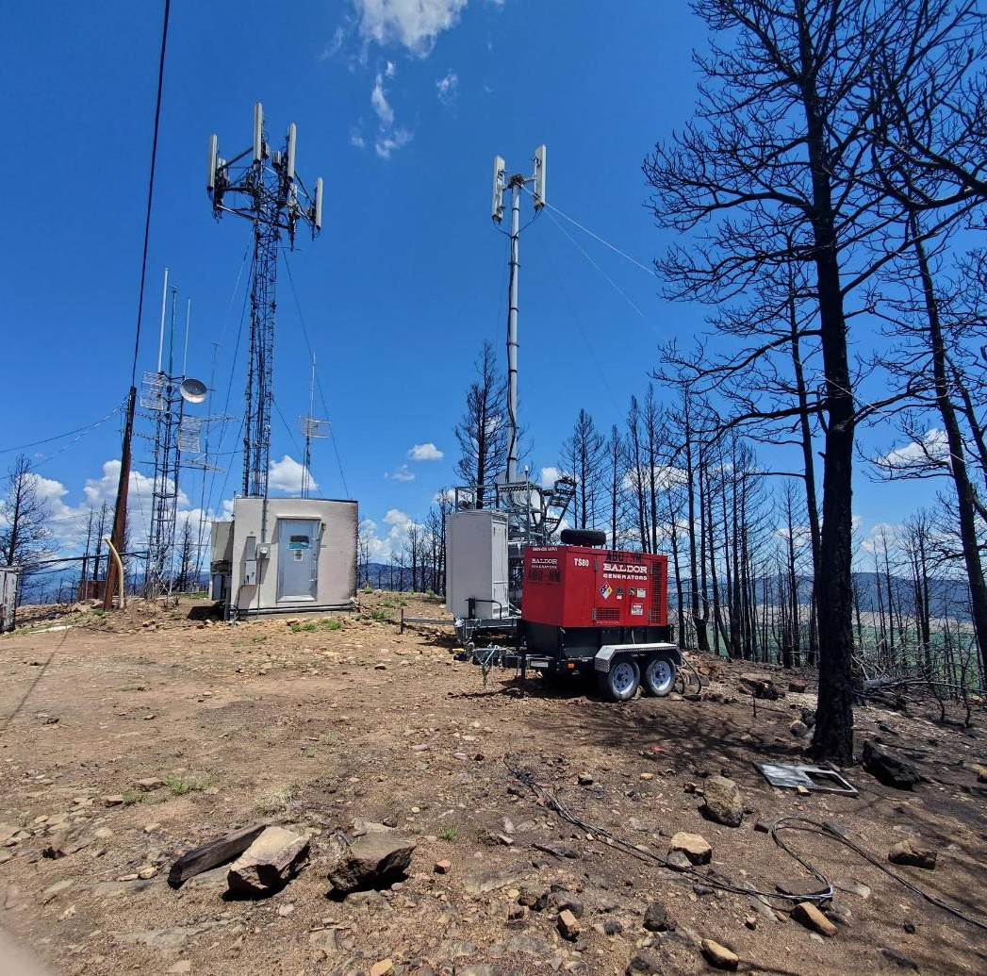
Communications Mora Site
Containers damaged
Coax Melted
Antennas burned
Power cables to all sites gone

Slide 8
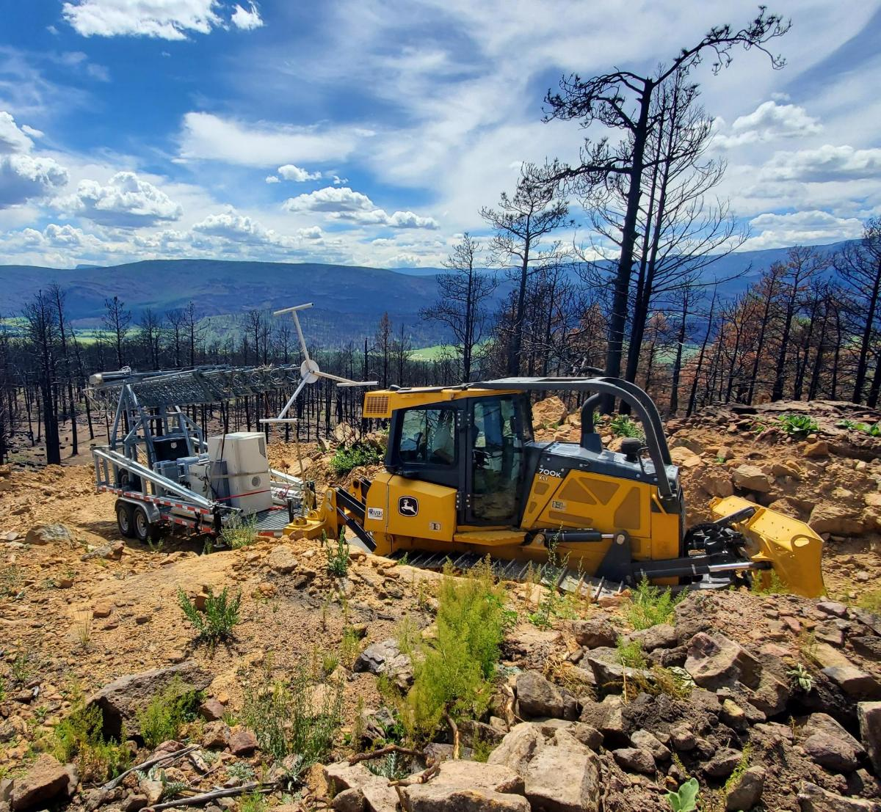
Communications support
Cellular COW had to be placed by a Dozer
Had to fuel generators every other day
Road became hazardous

Slide 9
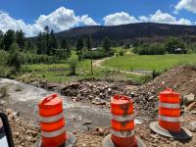
Monsoon Season Starts
June 16 – Monsoon flow reaches New Mexico
June 17 – Widespread Flooding in Mora and San Miguel County
June 27 – Over 300,000 sandbags deployed
July 20 – Extreme Flooding three deaths

Slide 10
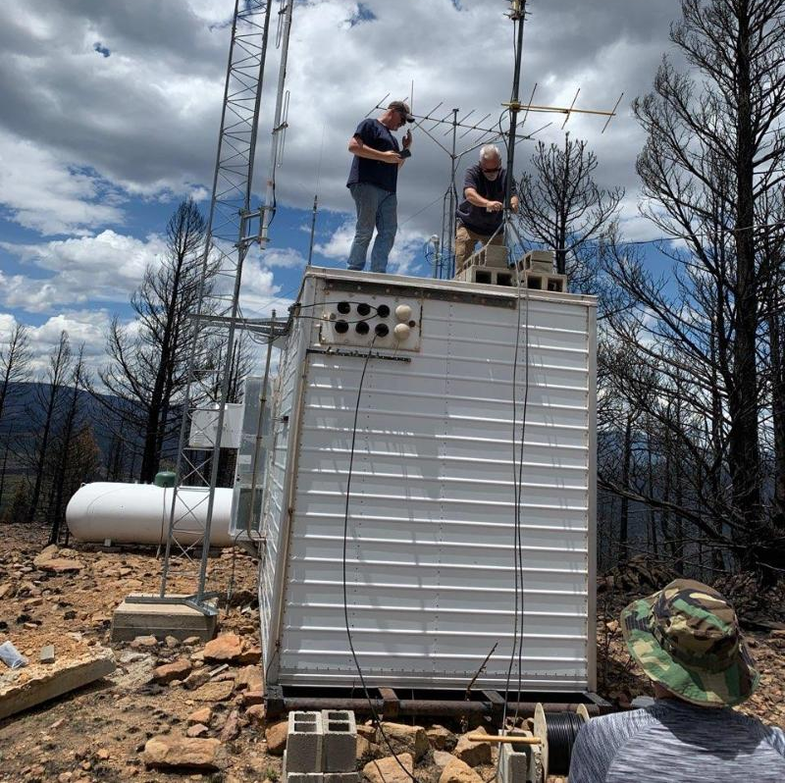
To the Rescue FEMA MERS
Cellular down
Landline down
TV down
NO IPAWS or WEA
1 AM Radio station 92 miles away
NO NOAA Weather radio
MERS put up a temporary NOAA Retrans staion

Slide 11
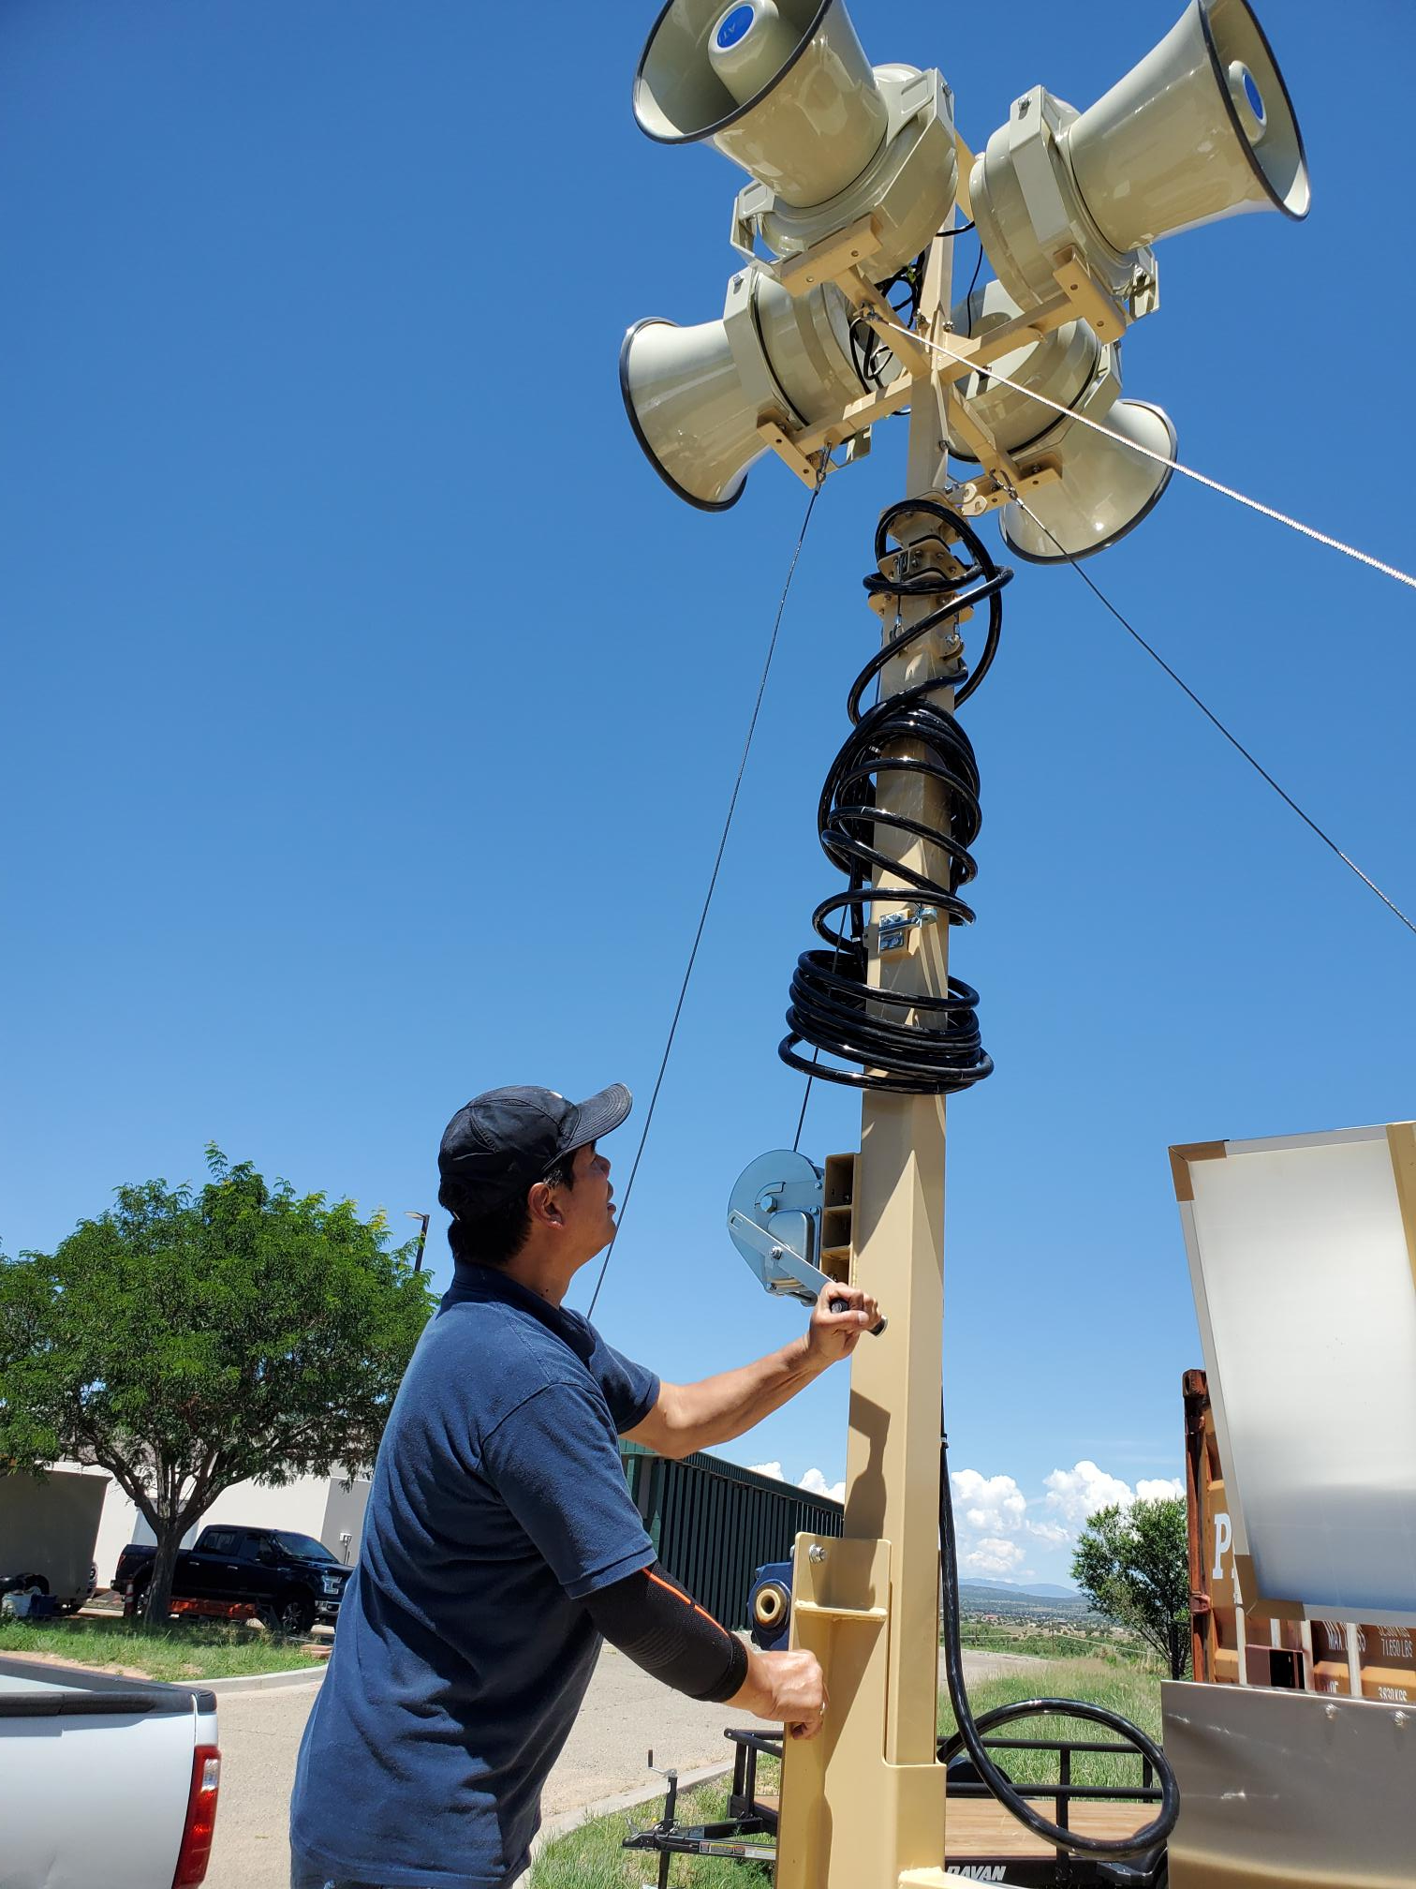
Loud Noise Makers
12 Siren Trailers
Sirens are 20 feet in the air
Trailer can be pulled with quarter ton vehicle
Solar powered
Running on FirstNet to activate
Helicopter with loudspeaker was denied

Slide 12
Blue 2, Salt, South Fork Fire’s
Power was lost
Poles and cable burned
Fiber burned
Coordinate with all users
Portable Power
Fuel for power
Access to locations
Safety plans
Safety training

Slide 13
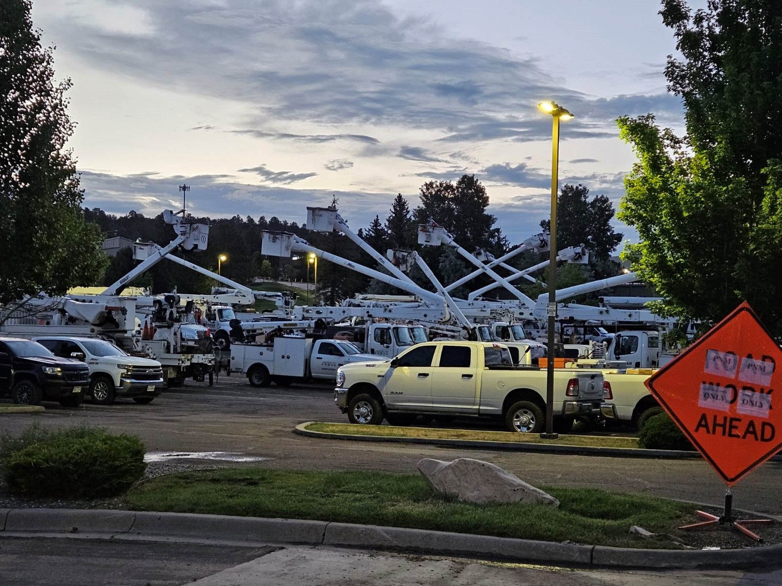
Critical Infrastructure
Multiple power company support
Multiple trained staff
Staged equipment

Slide 14
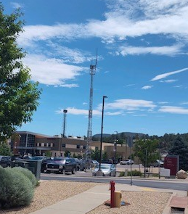
Digital Communications
NM DoIT Radio site
  Ruidoso Downs
Motorola Radio site
  Mescalero

Slide 15
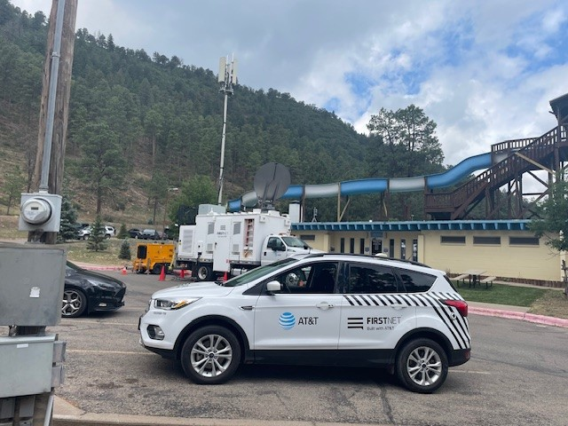
Back Haul With FirstNet
Voice and Data support

Slide 16
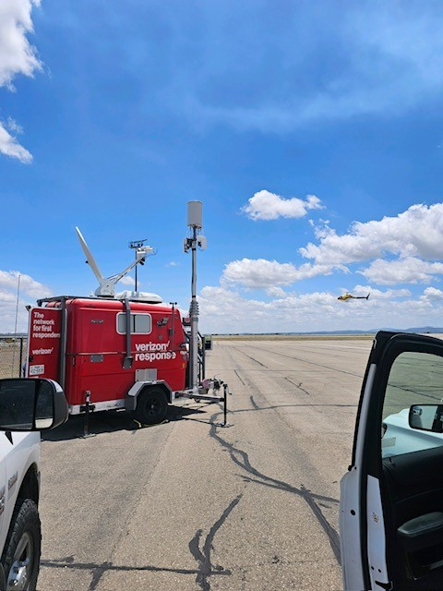
Back Haul With Verizon
Voice and Data

Slide 17
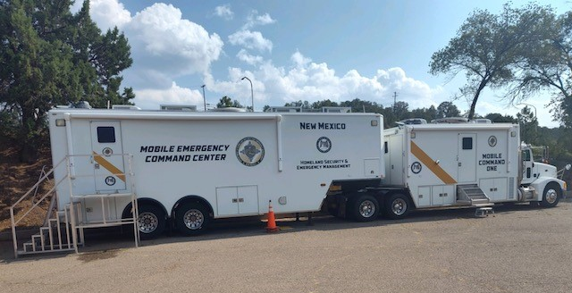
Mobile Command
Cellular
Starlink
Television
Radio communications

Slide 18

Thank you for your time
Wynn Brannin
NM SWIC
505-476-9678
Wynn.brannin@dhsem.nm.gov

