Slide 1
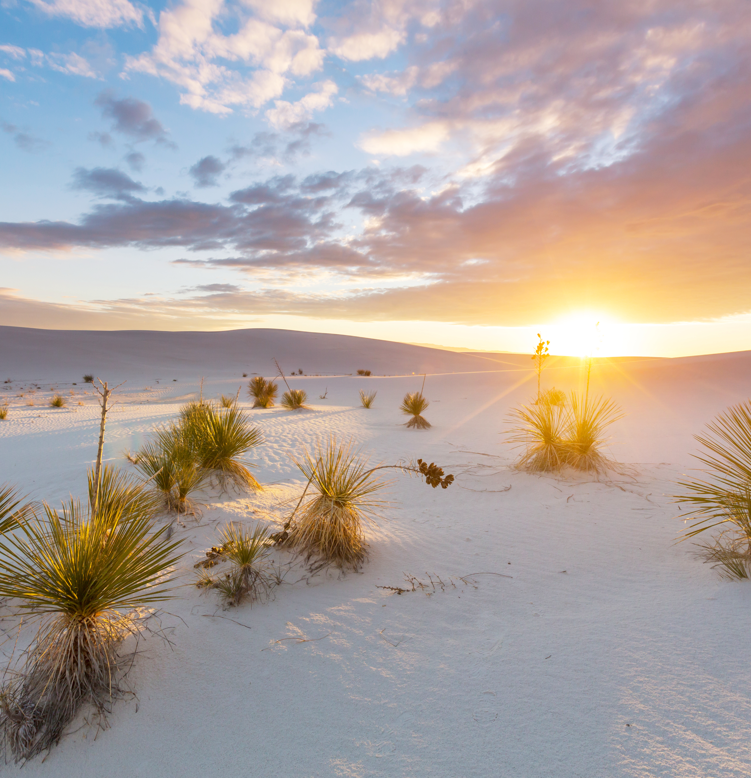
Cooperative
Education
Understanding New Mexico’s Rural Electric Cooperatives

Slide 2
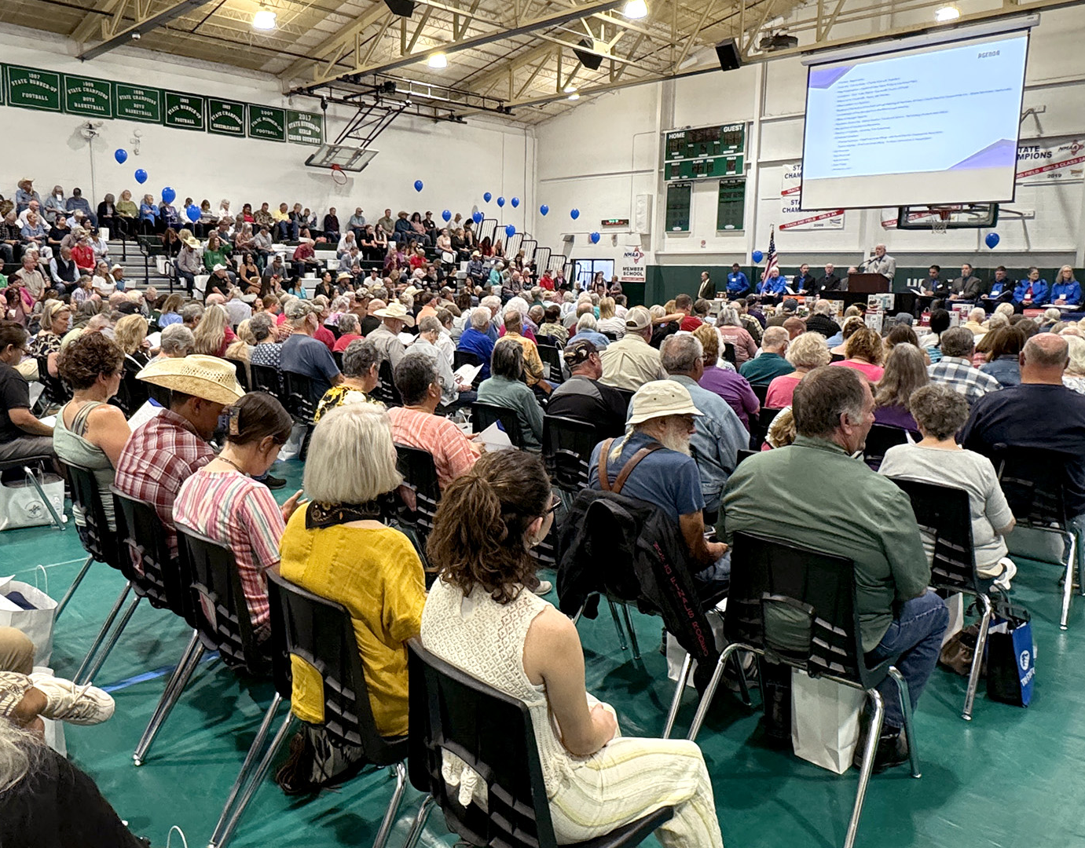
What is an electric cooperative?
Empowering Communities
Non-profit
Member-owned and member-governed utility
Elected board of directors
Provides electricity to its members in rural and underserved areas where investor-owned utilities do not operate
Each member has an equal say in the cooperative's decisions
Otero County Electric Cooperative Annual Member Meeting August 3, 2024

Slide 3
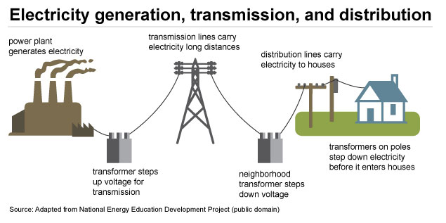
Power Delivery
G&T Cooperatives
Generate and purchase
energy for our Distribution Cooperatives
Own the transmission lines delivering electricity
to Distribution Cooperatives through long-term power
contracts
Work with Distribution Cooperatives to obtain local
renewable energy mix, including behind-the-meter
energy generated by cooperative members
Distribution Cooperatives
Own the infrastructure that delivers power to their
members

Slide 4
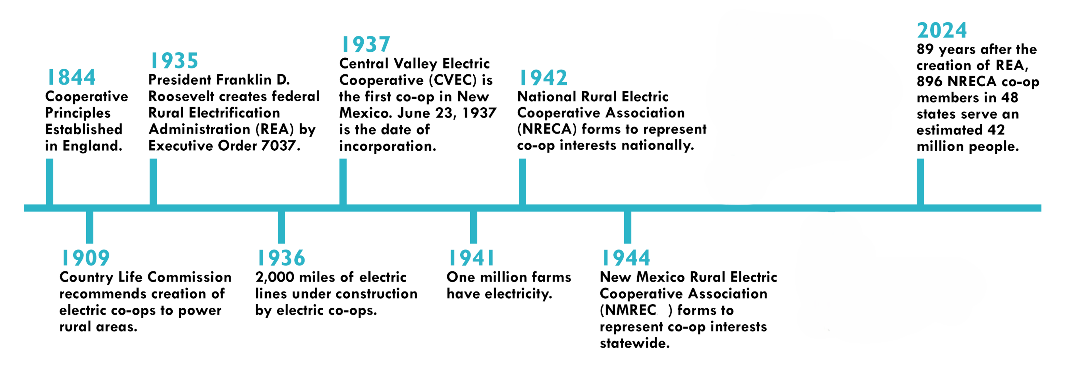
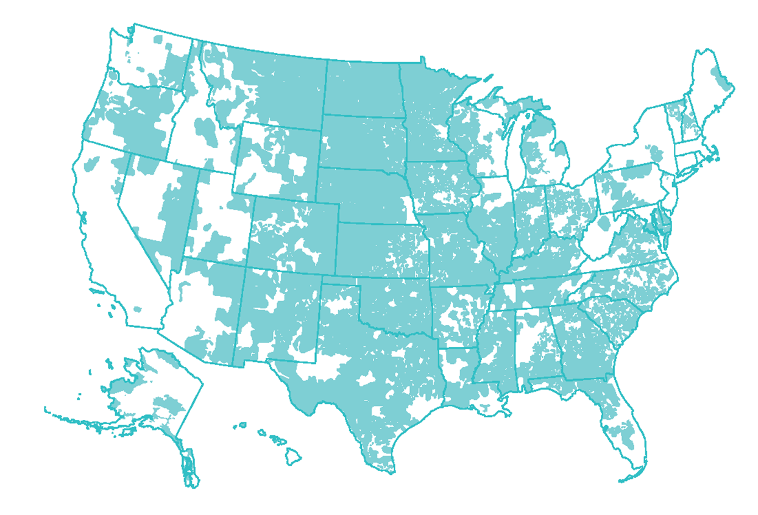

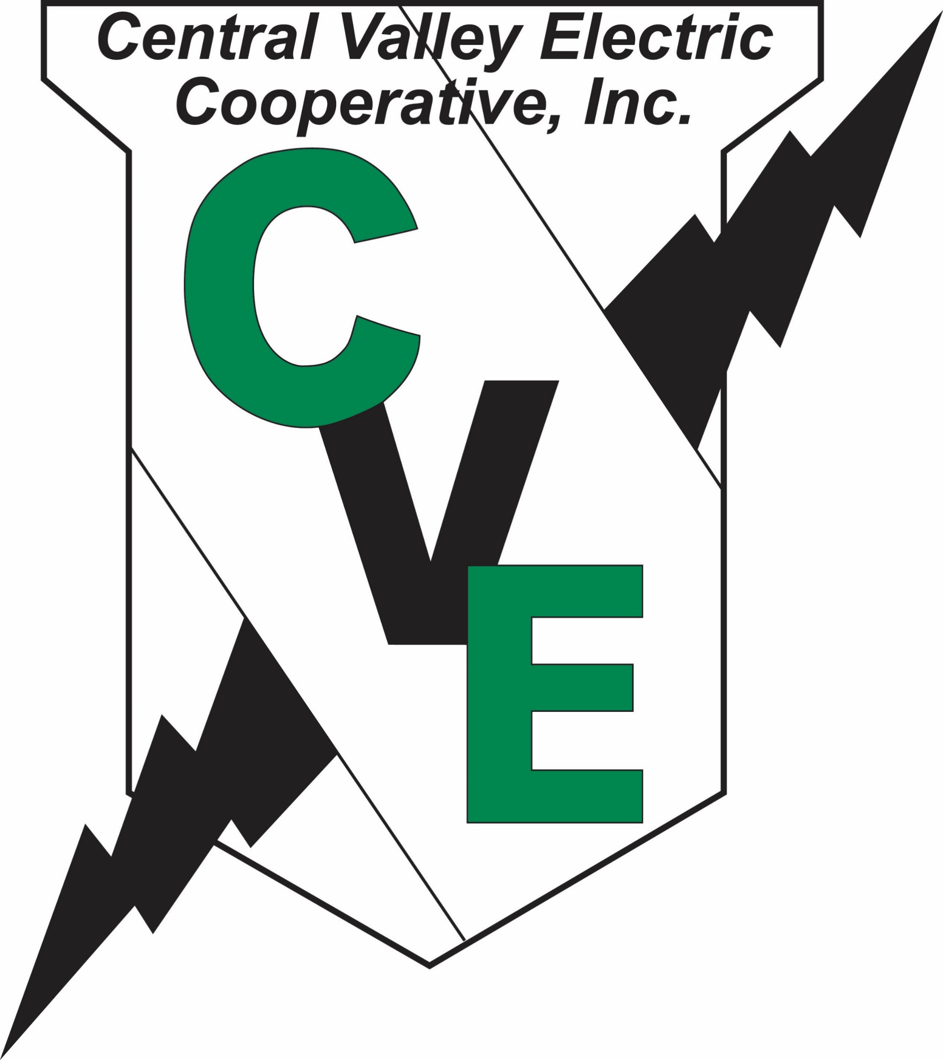

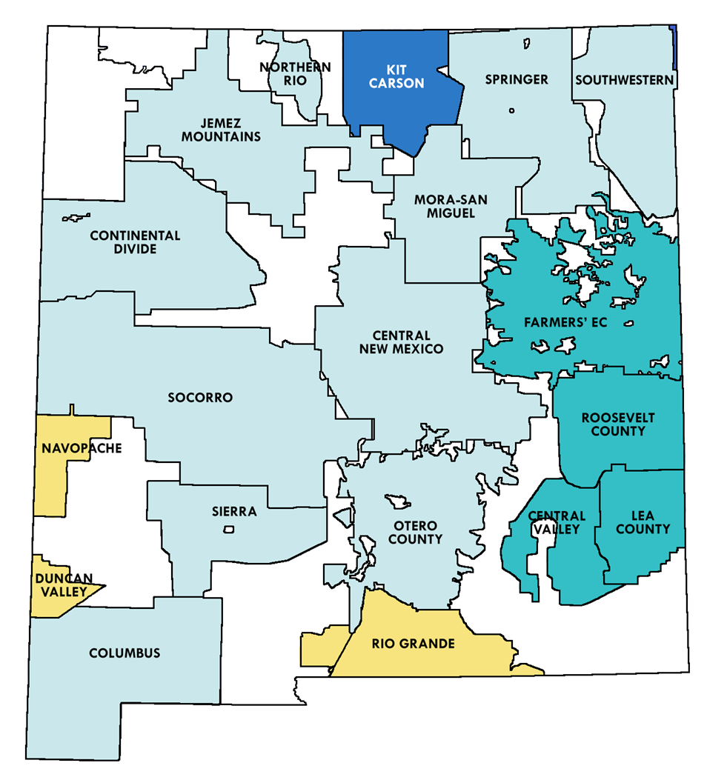
Electric Cooperative History

Slide 5


WHERE ARE ELECTRIC COOPS IN NEW MEXICO?
NMREC Member Cooperatives
NMREC Associate Member Cooperatives
Non-NMREC Member Cooperative
G&Ts Cooperatives Operating in NM
Tri-State Generation & Transmission Association
Western Farmers Electric Cooperative
Arizona Generation & Transmission Cooperatives

Slide 6
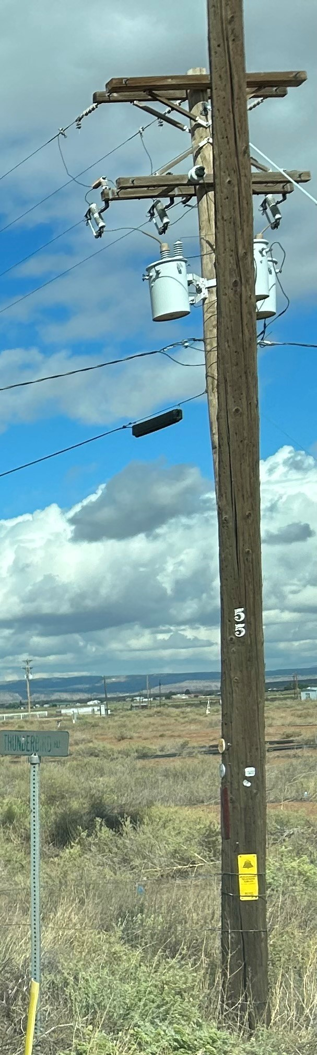
Cooperative Statistics
Serve close to 450,000 New Mexico residents
Operate over 61,000 miles of power line
Distribute over five million megawatt hours of electricity
every year
Service areas are in 32 out of 33 New Mexico counties
Average four meters per mile
Provide over 1,100 quality jobs
22% population in poverty compared to 17% for NM
and 13% for the US

Slide 7
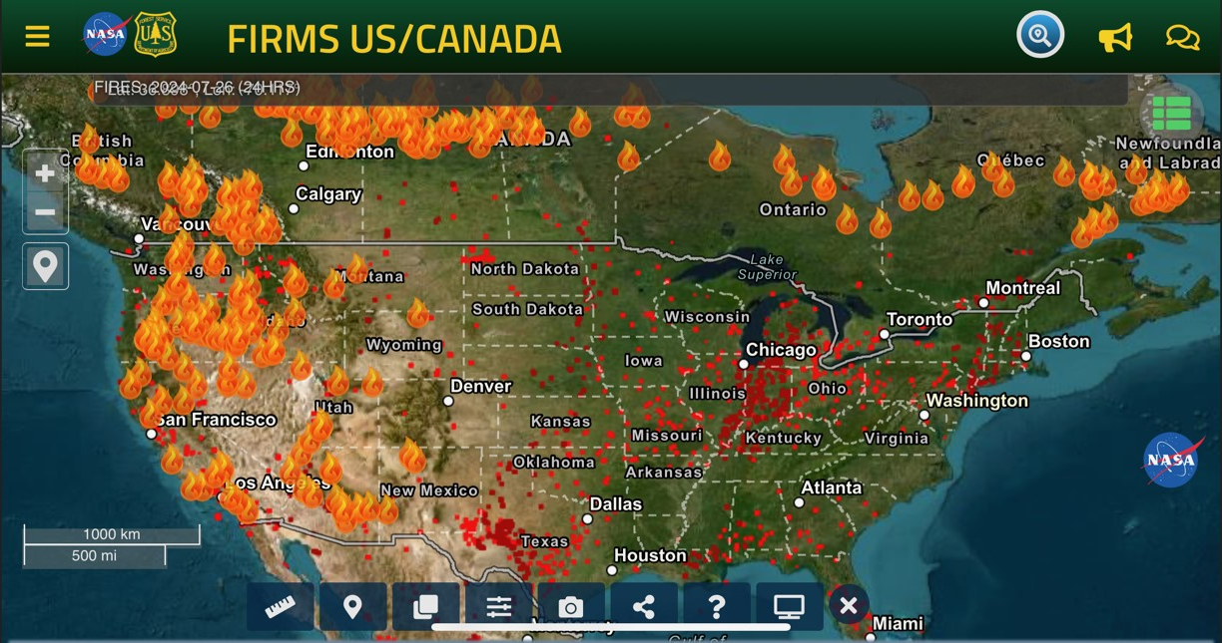

Slide 8
Wildfire Mitigation
Goals:
  Protect electric infrastructure
  Reduce fuels that could ignite wildfires, impacting people and property
  Work with agencies, private landowners, environmental advocates, etc. to ensure responsible land management

Slide 9
Concerns
Wildfire Liability
Federal – Strict Liability
Funding for Infrastructure -System Hardening, Vegetation Management, etc.
Loss of Insurance or increase in cost for insurance premiums, decreased coverage
Need for increased fuels reduction
Recognition as community owned assets

Slide 10
Electric Coop Initiatives
Expanding and accelerating current maintenance and vegetation management activities
Strengthening systems by shortening spans, replacing wood with steel, undergrounding where possible, and removing danger trees outside of ROWs
Fire retardant coating, pole sheaths, relocating lines outside of forests where possible
Wildfire Mitigation Planning
Applying for grants

Slide 11
THANK YOU
Charise Swanson, Chief Executive Officer
cswanson@nmelectric.coop
505-660-5122

