Slide 1
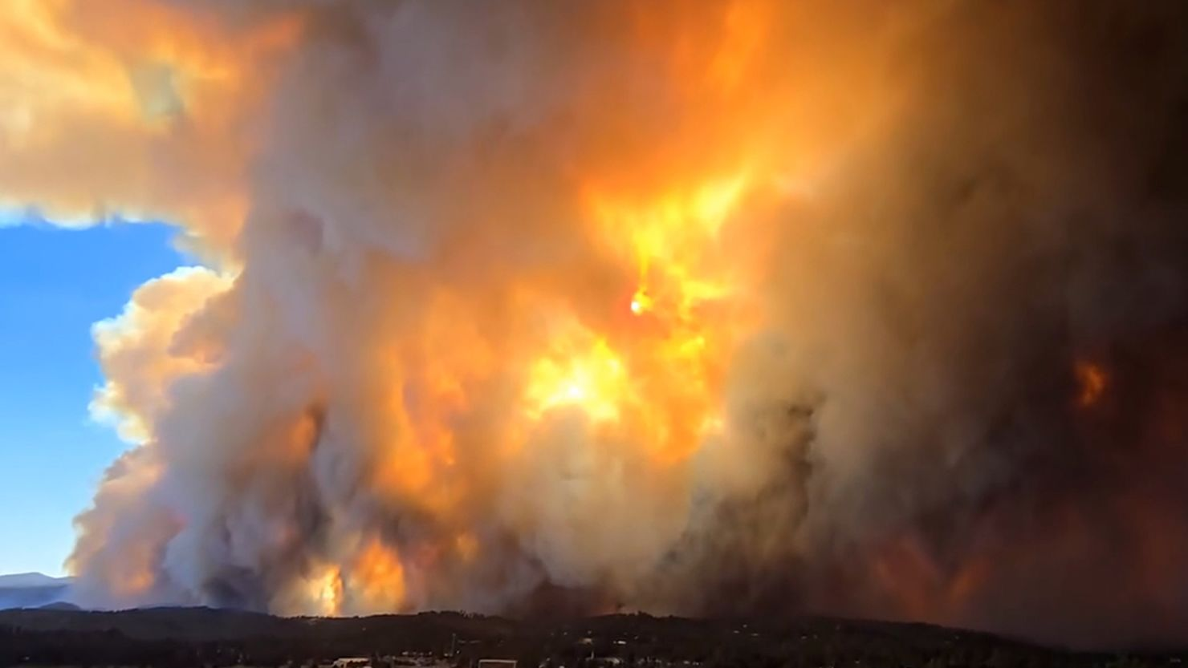
South Fork Fire Ruidoso NM

Slide 2
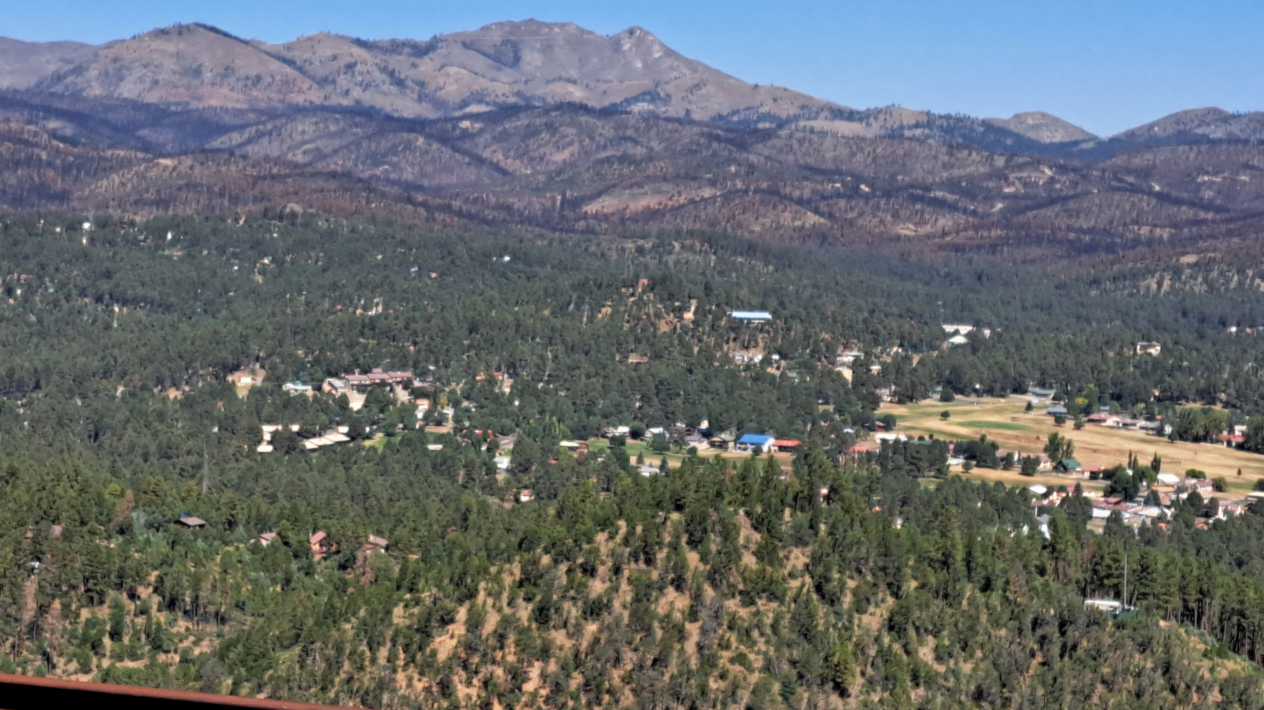

Slide 3
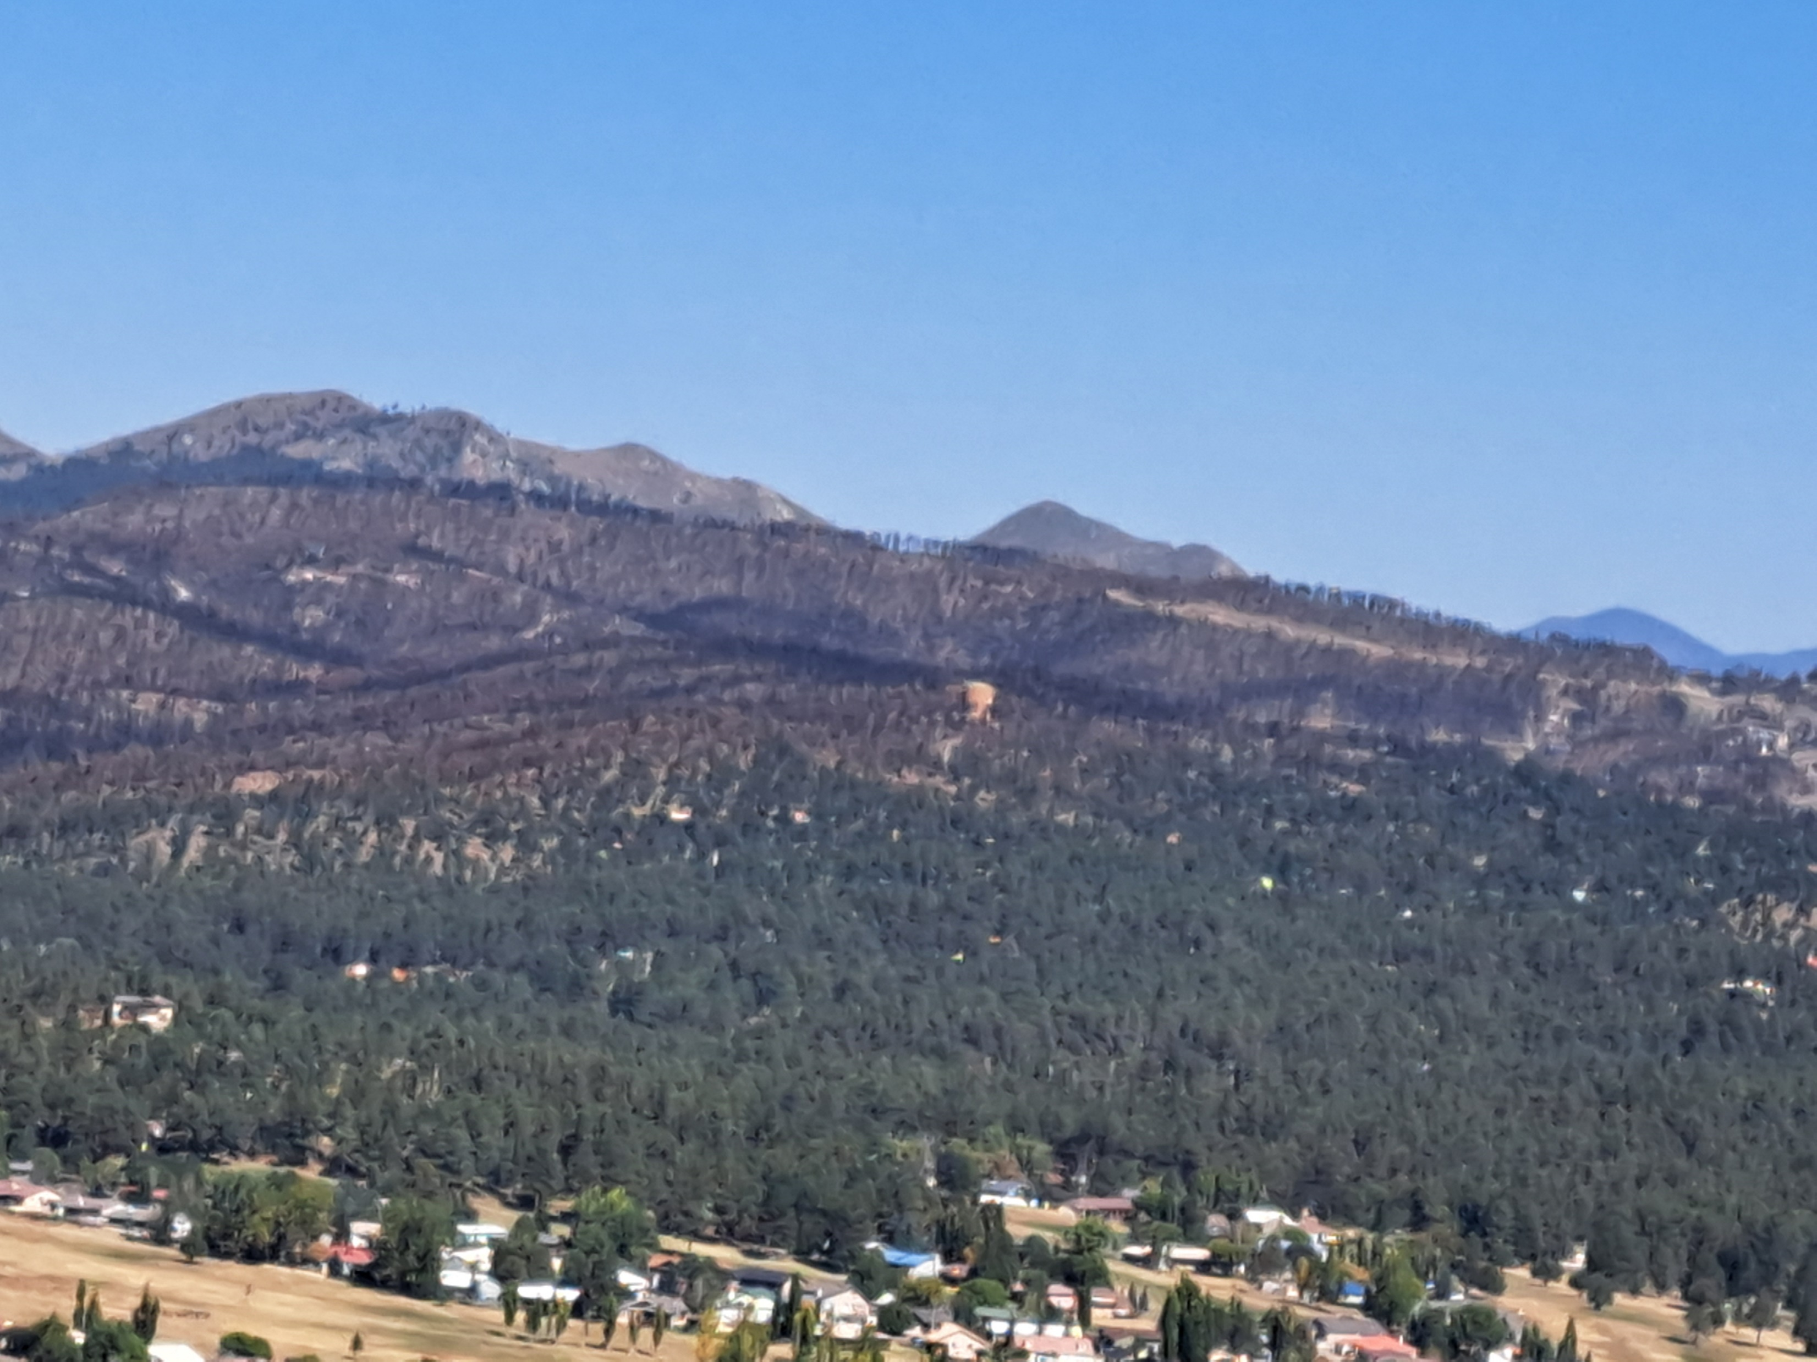

Slide 4
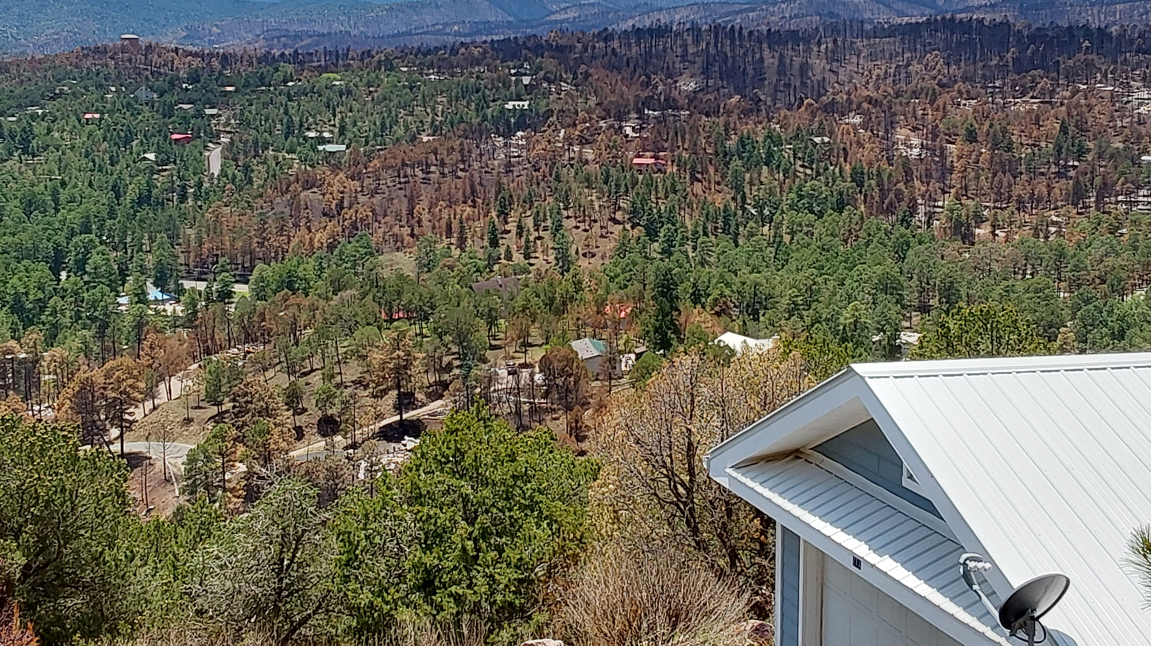
Crown Fire
Ground Fire
Ground Fire
Ground Fire
Ground Fire

Slide 5
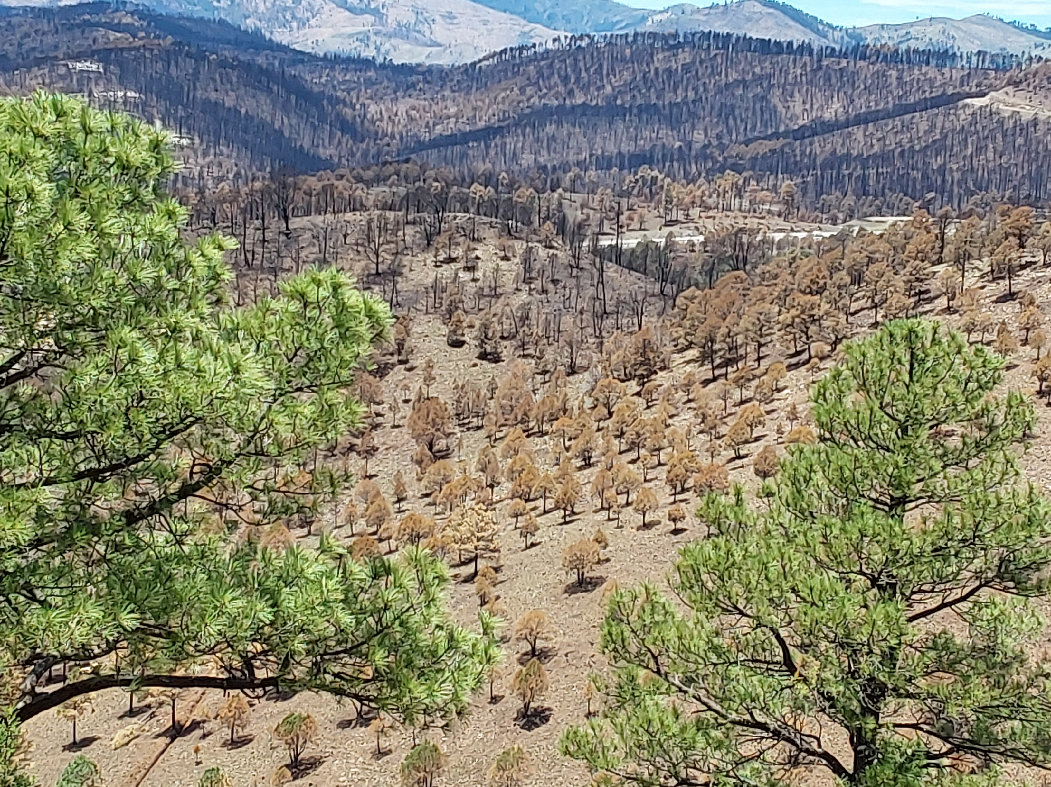
Crown Fire burns tops of trees and produces fire brands that can travel a mile or more.
When treetops burn they produce a lot of embers called ember wash.
Severe heat creates soil that is easily washed with heavy rain.
Ground Fire burns under trees.
Create no large fire brands.
Understory produces embers that travel shorter distances.
Moderate heat does not create soil that washes easily

Slide 6
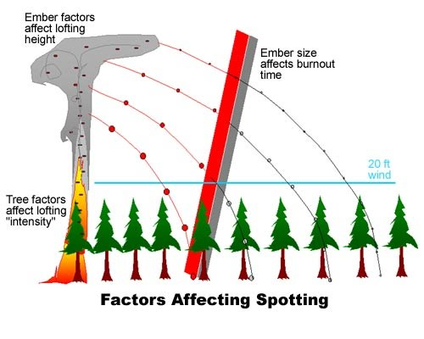

Slide 7
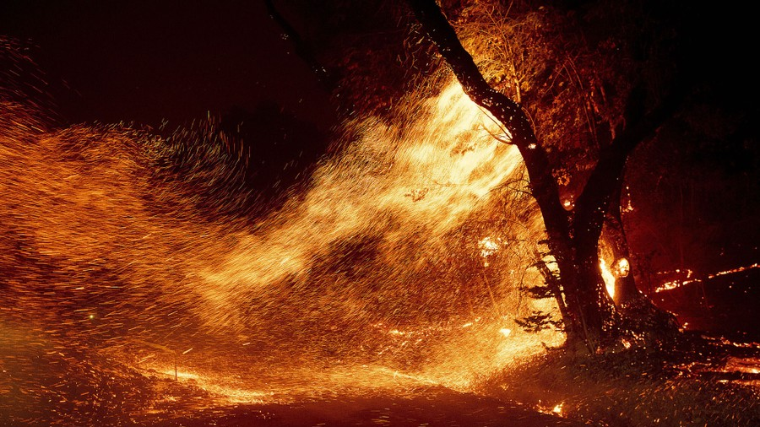
Ember Wash

Slide 8
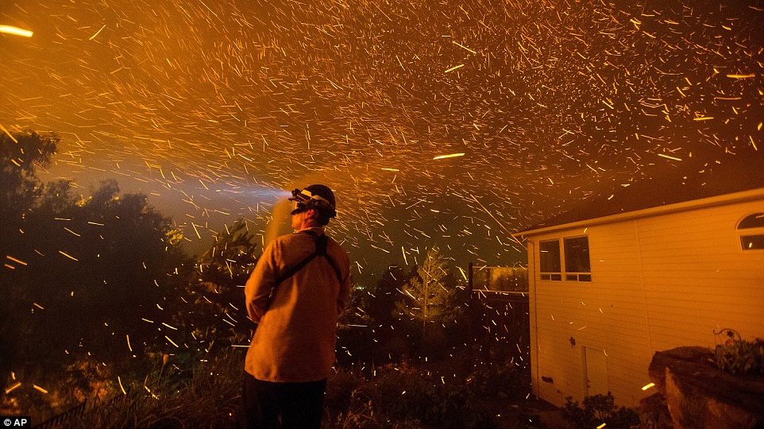

Slide 9
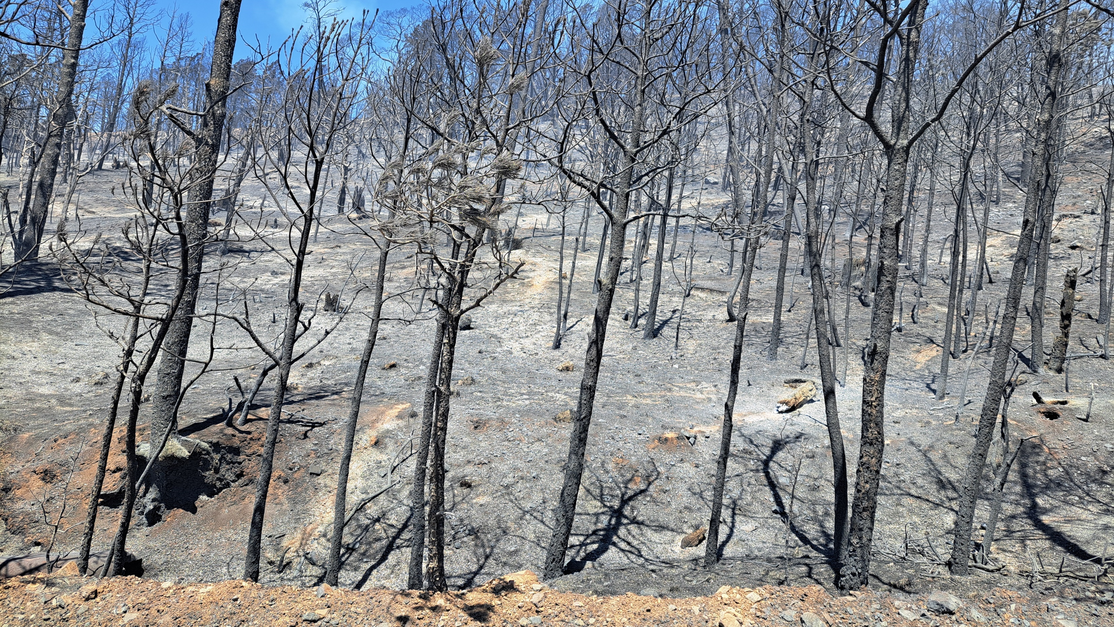
Crown Fire – Maximum Heat

Slide 10
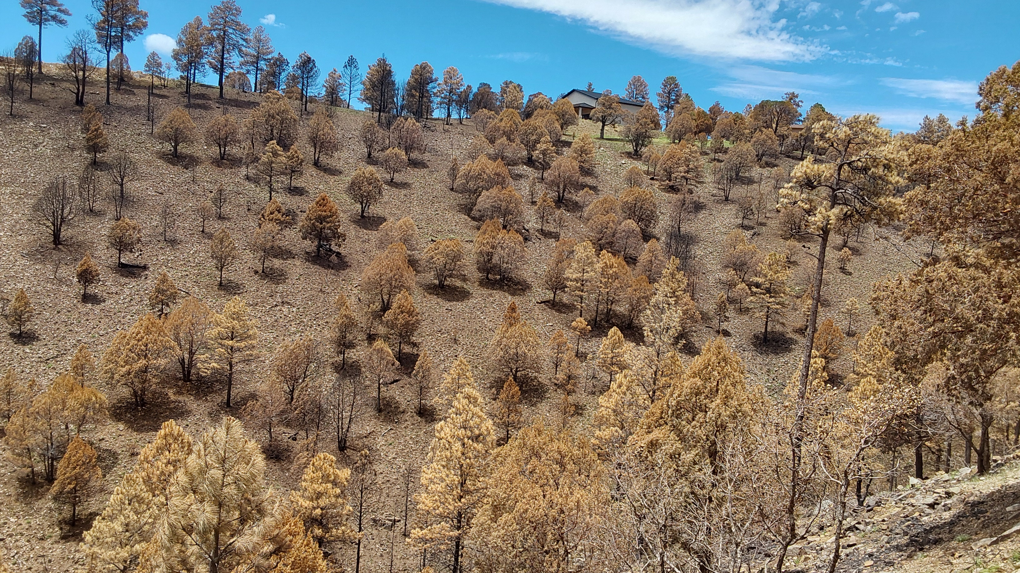
Ground Fire burned where trees had been thinned burned uphill to house that had defensible space survived the fire.

Slide 11
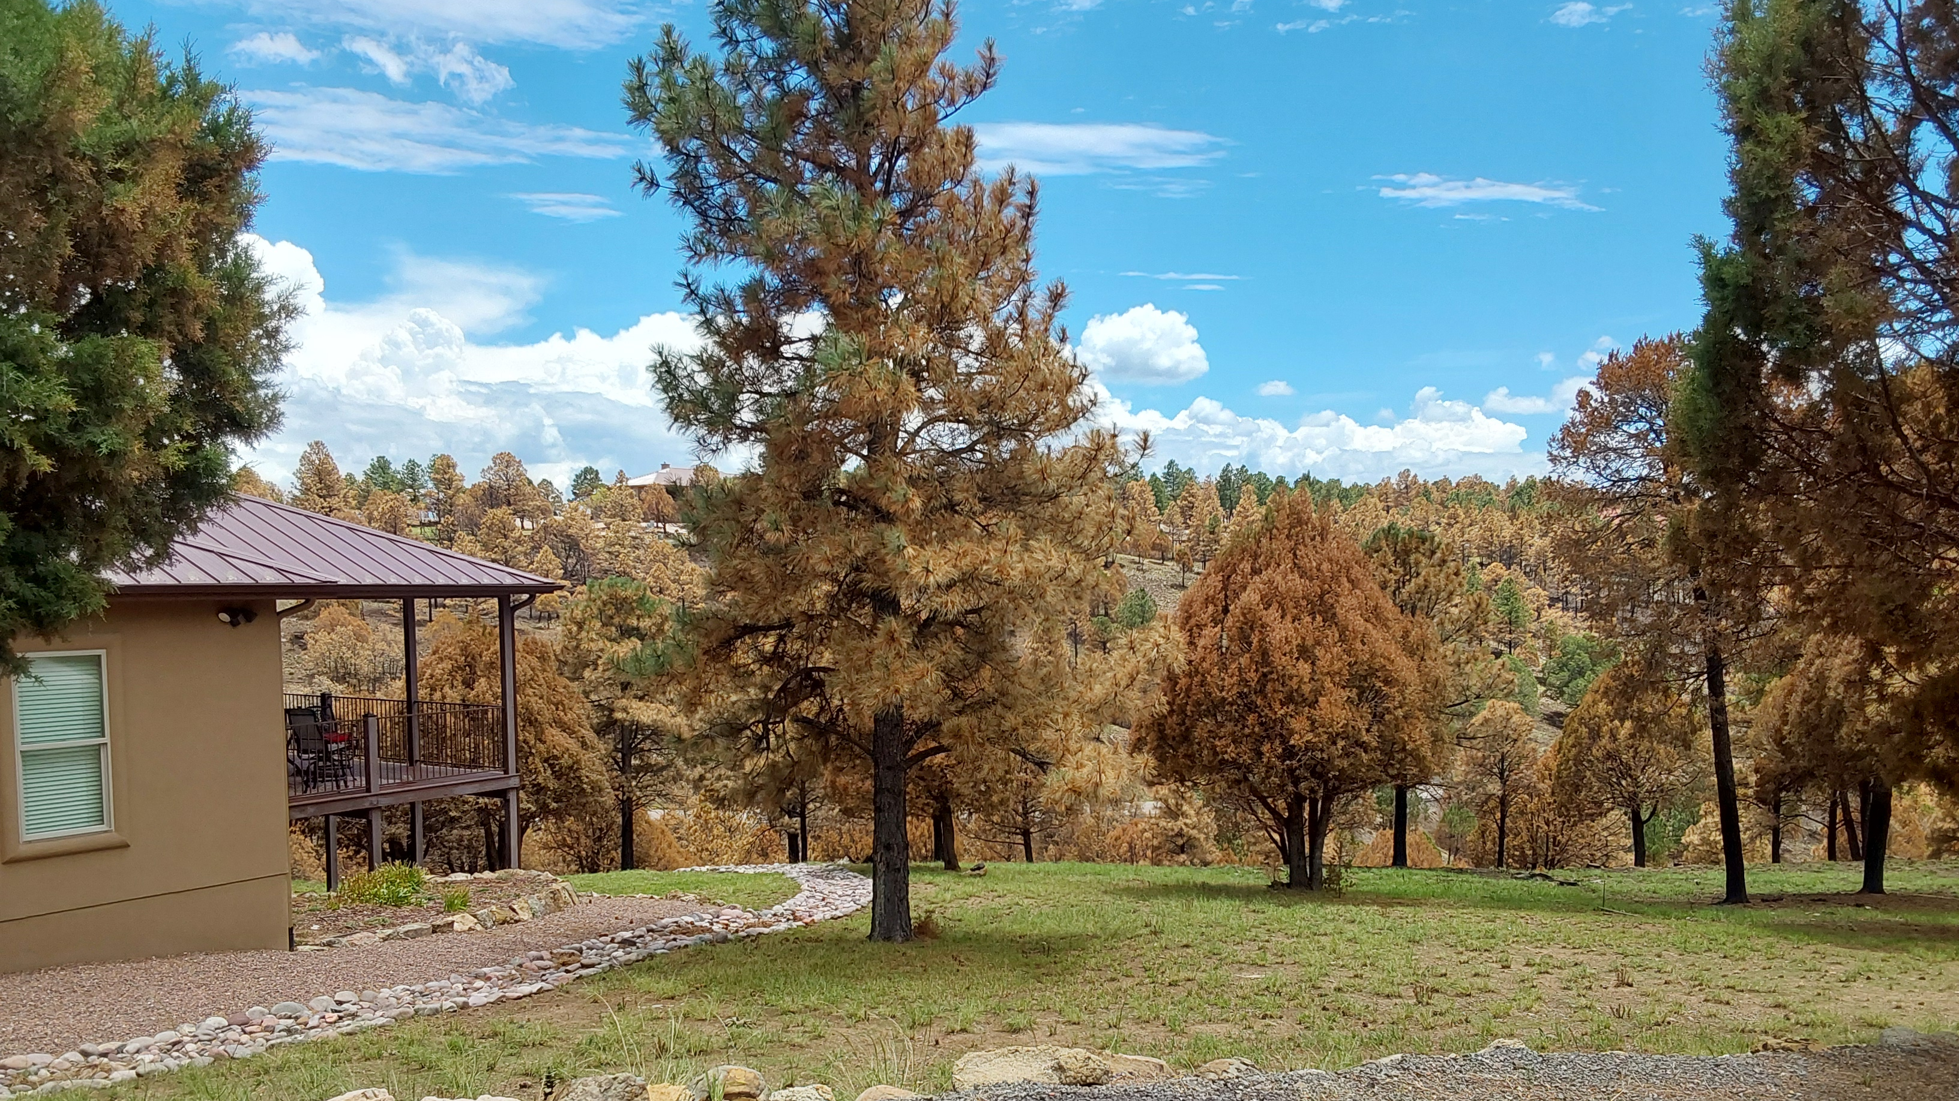
Home with defensible space survived
Ground fire. No erosion with rain.

Slide 12
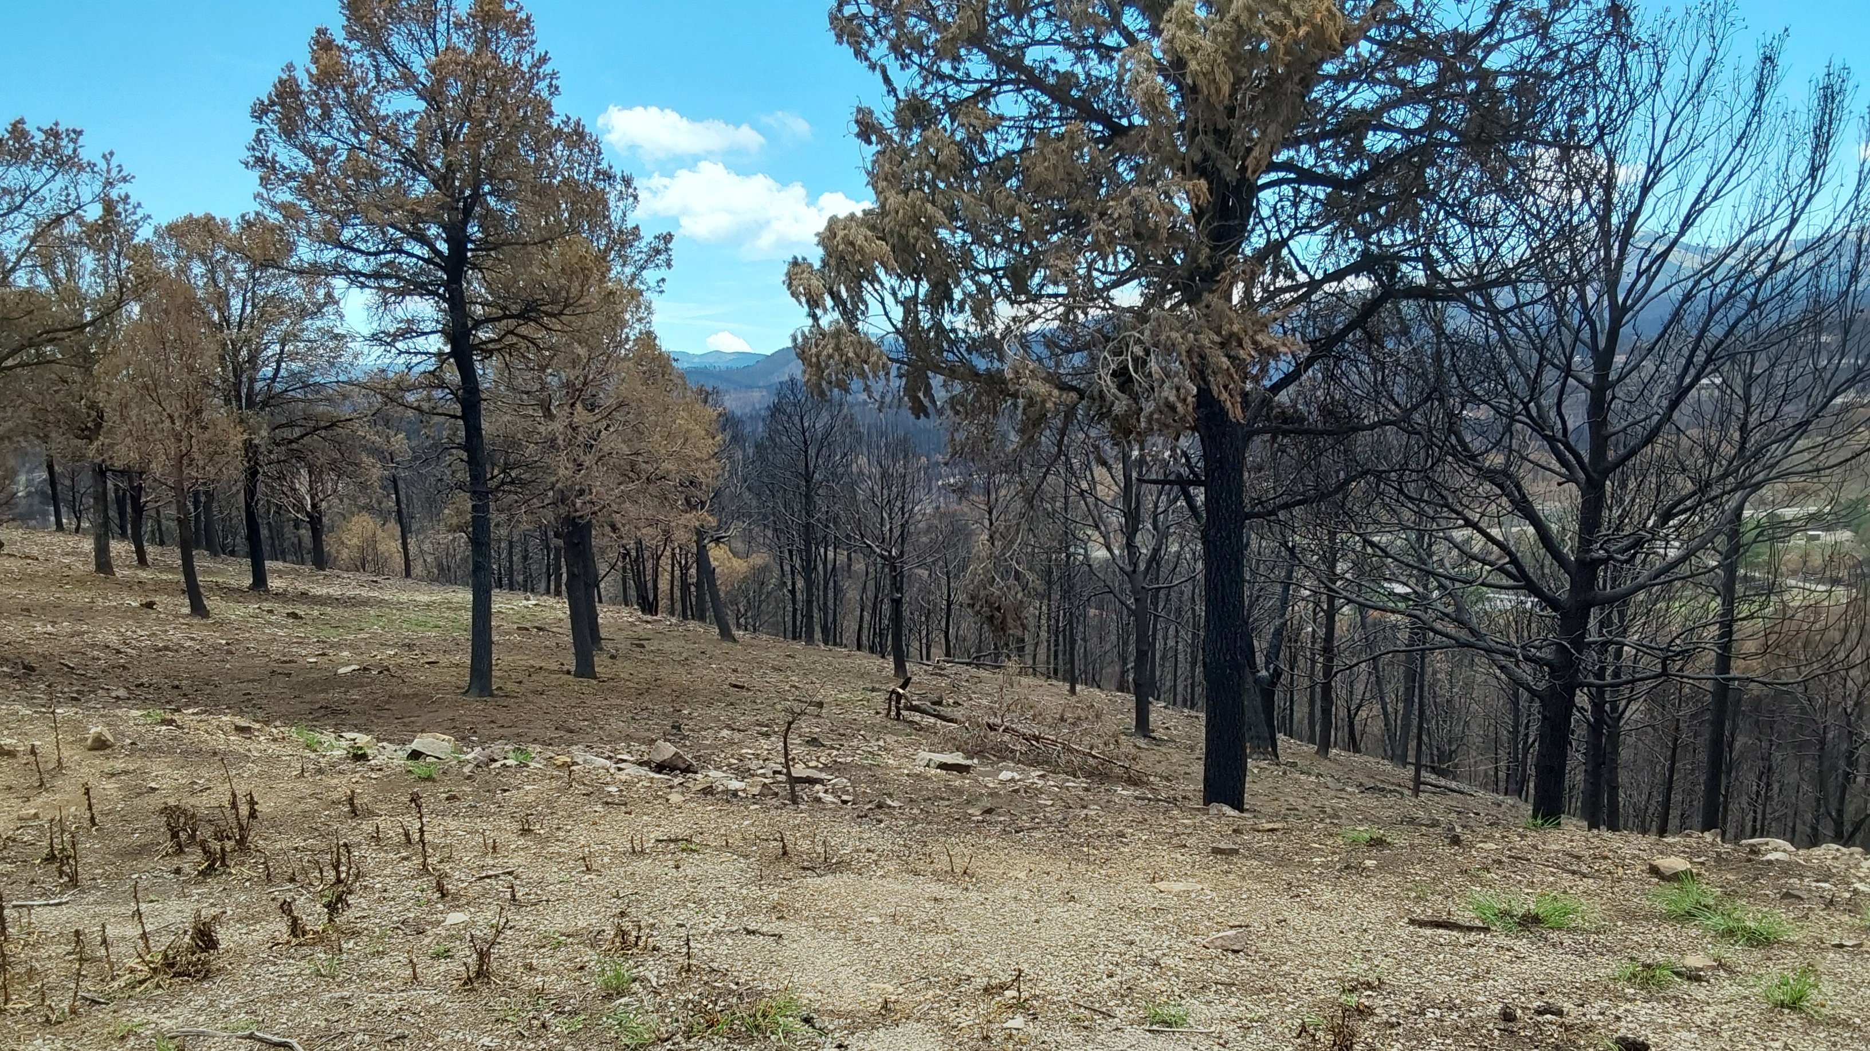
Thinned last year,
No understory.
Thinned 11 years ago, understory
Had grown back.

Slide 13
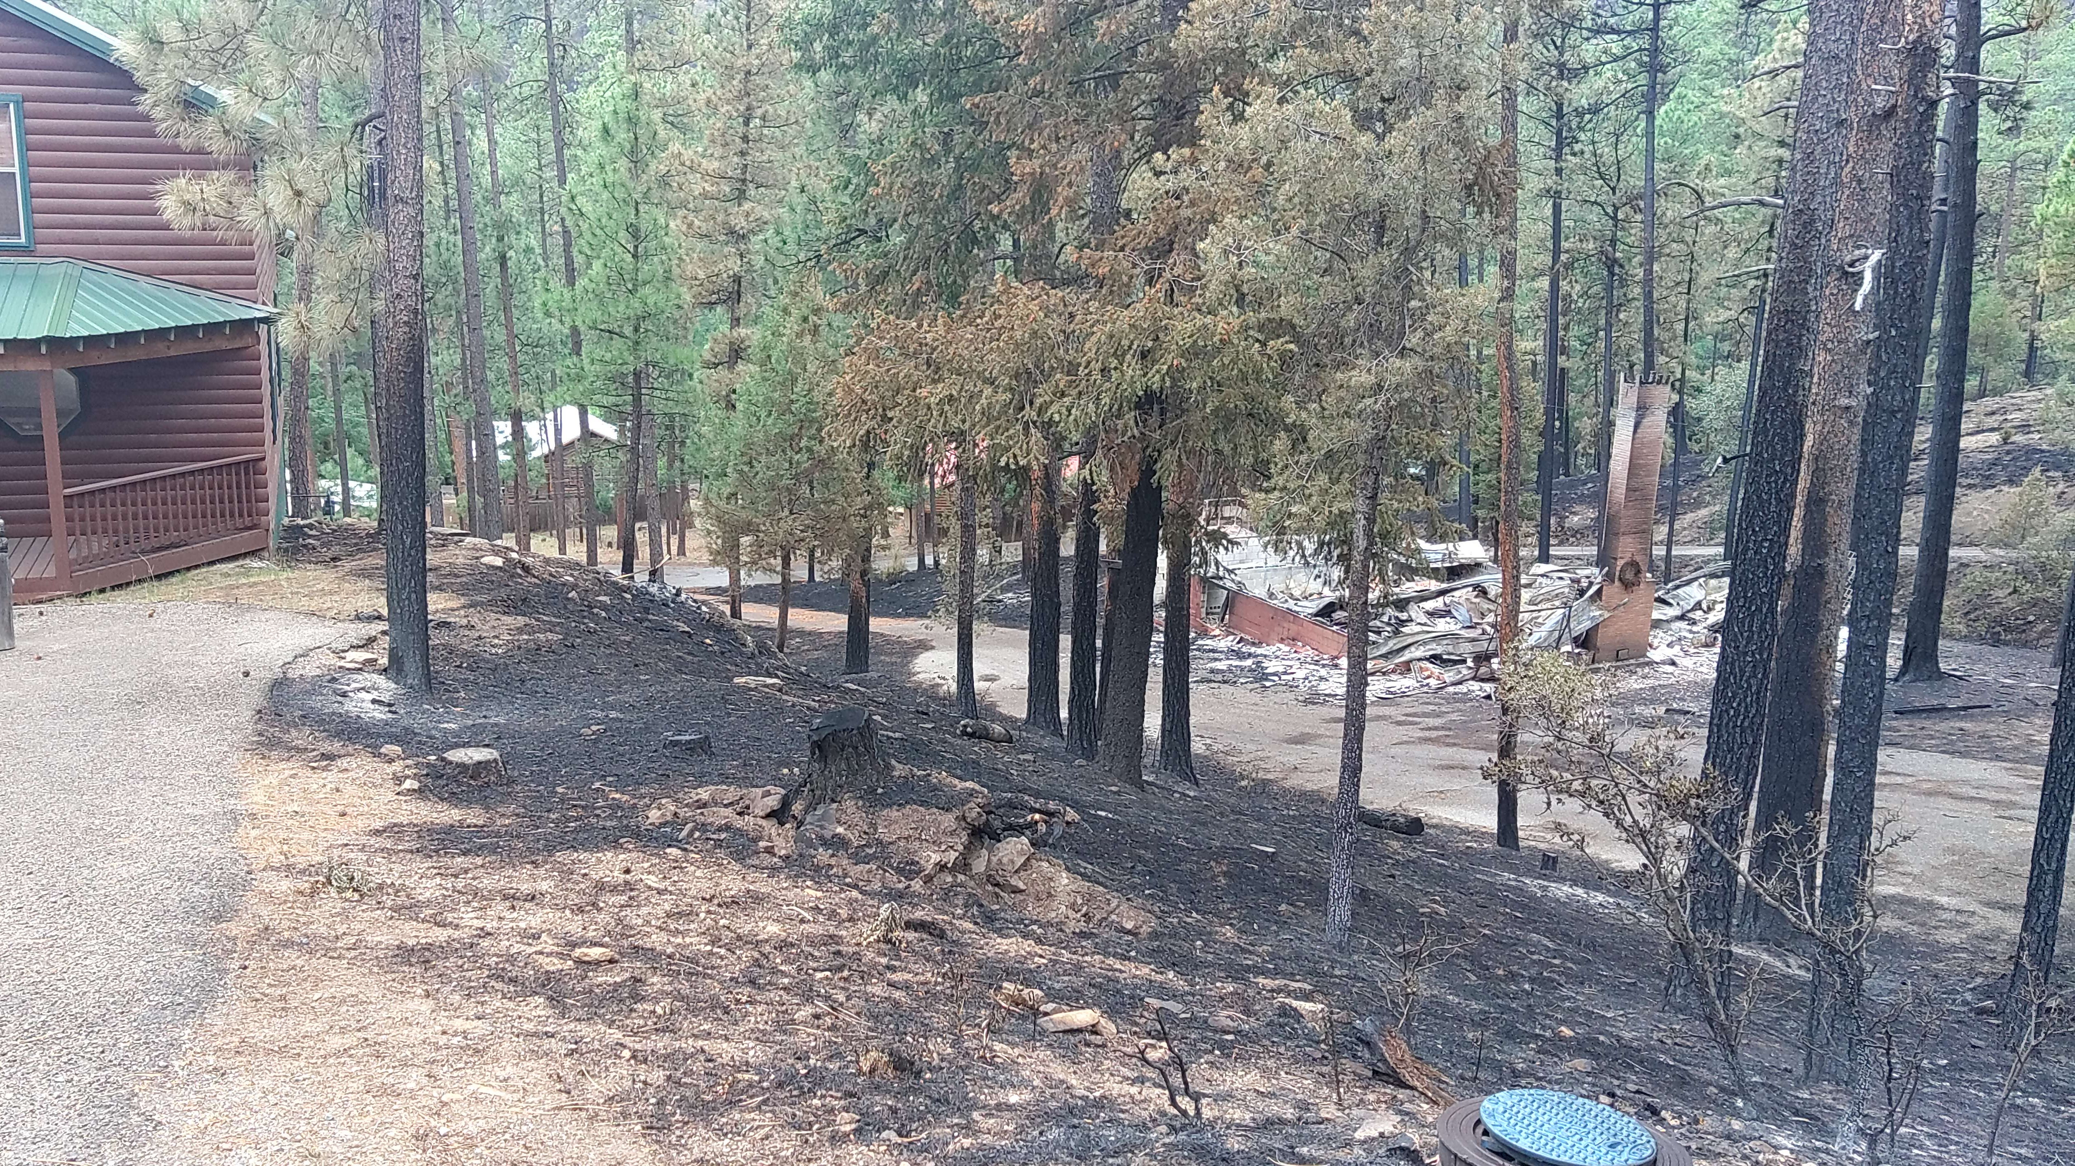
Note green trees, one house burned, one not touched
Meets Ordinance spacing standards.

Slide 14
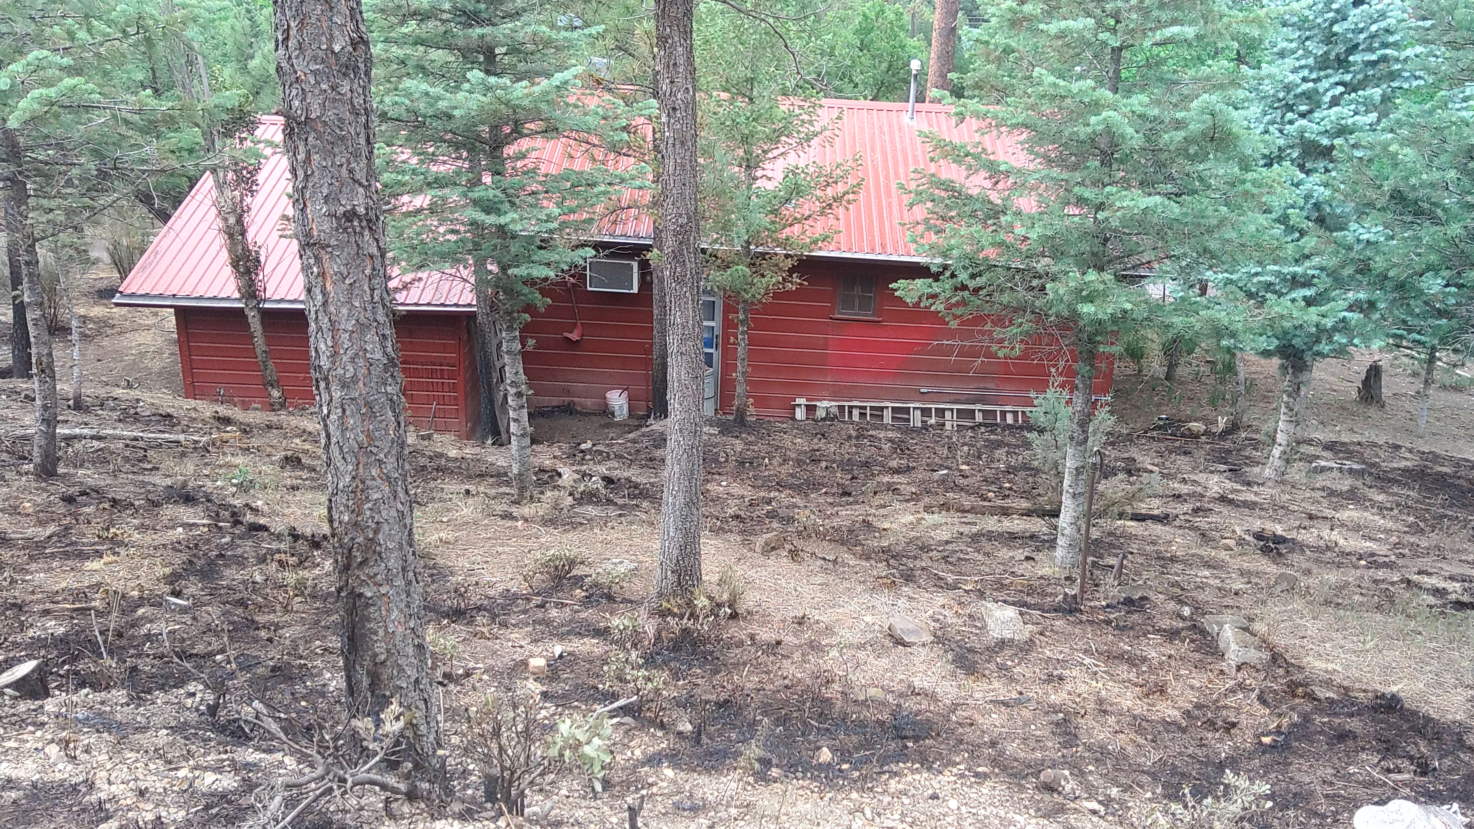
Proper tree spacing, ground fire
House survived.

Slide 15
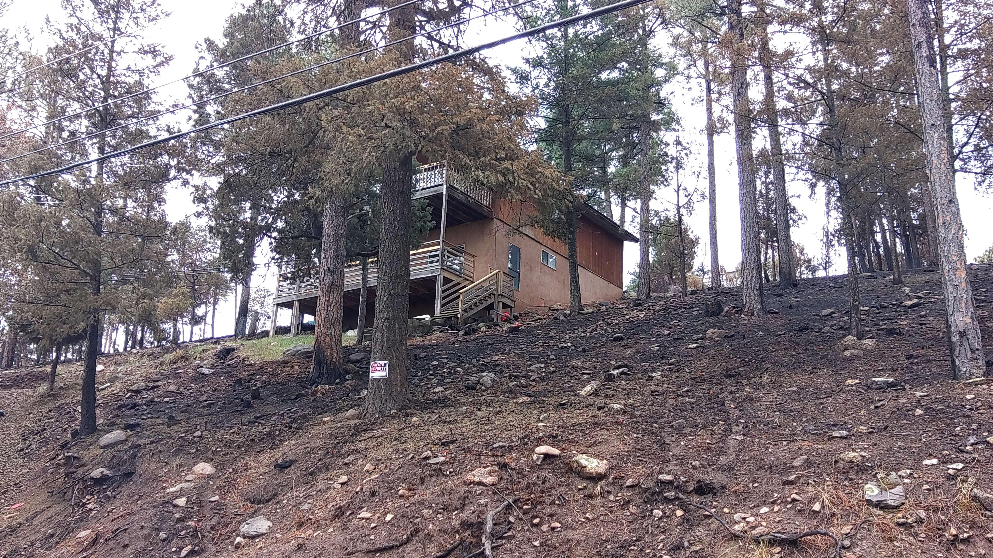
Proper tree spacing, no ladder fuels.
Home hardening = House survived

Slide 16
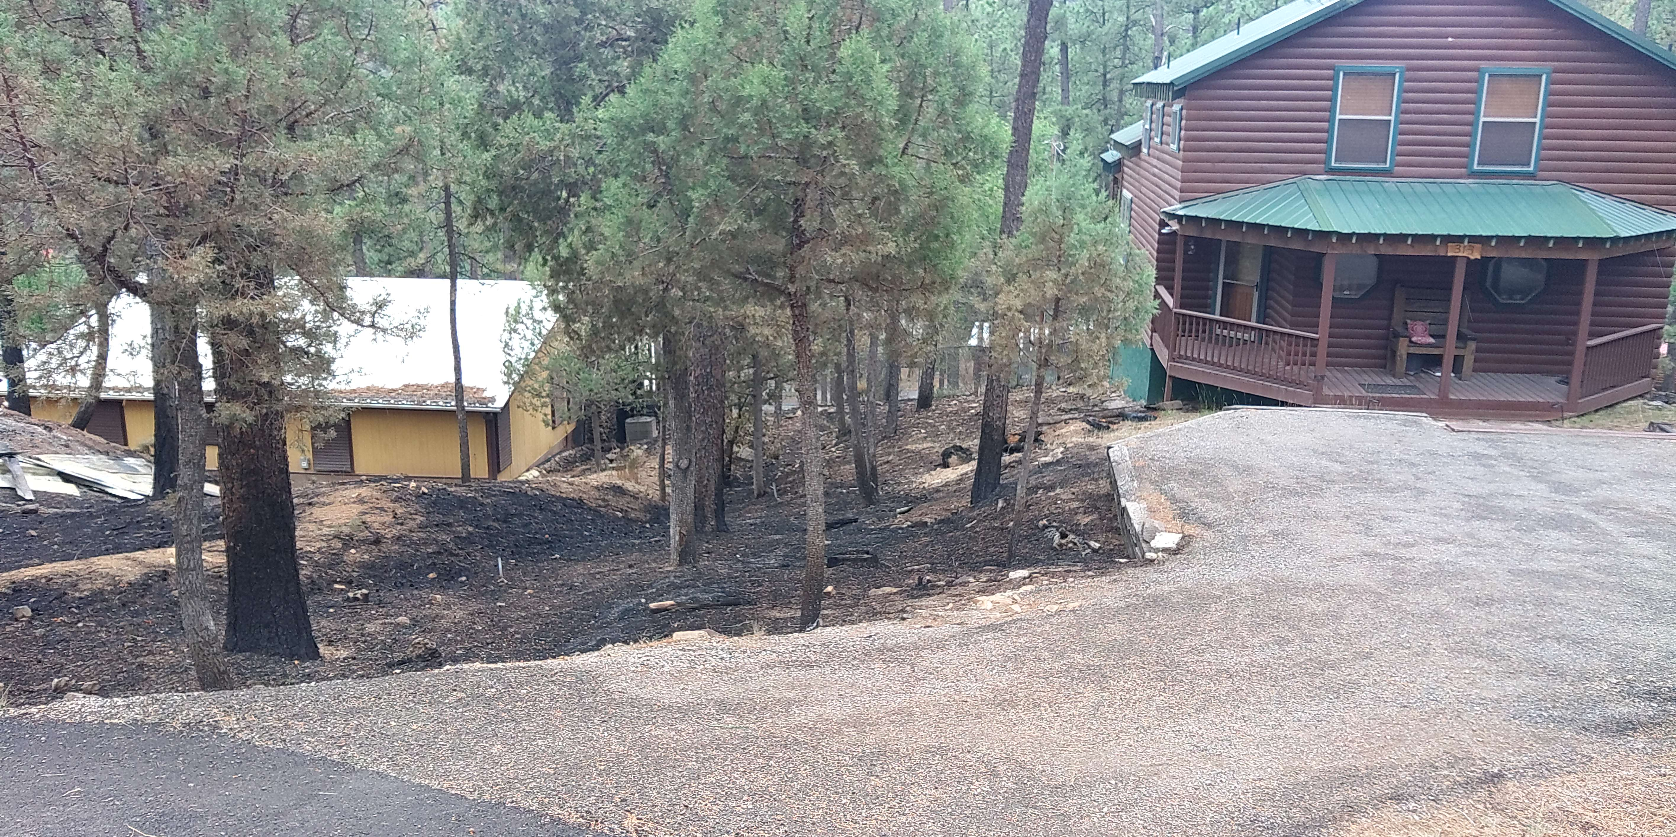
To harden your home to wildfire :
Use ignition-resistant siding, roofs, decks, attic vents, eaves, and windows.
Avoid storing combustible materials on or under decks.
Remove vegetation and flammable mulch to create a five-foot buffer zone around the home.
Clean gutters and roofs of debris.
Replace the roof with metal, clay, or tile.
Install metal gutters.
Upgrade to dual-paned windows with one pane of tempered glass.
Home hardening can be applied to new construction or for retrofitting an older home

Slide 17
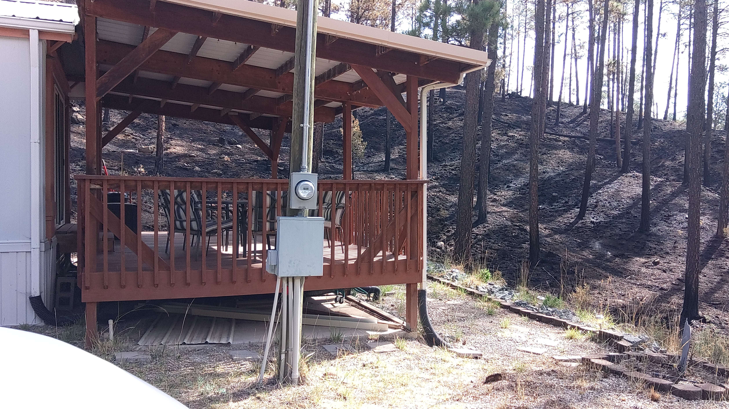
Thinned 6 years ago, Forest and House Survived

Slide 18
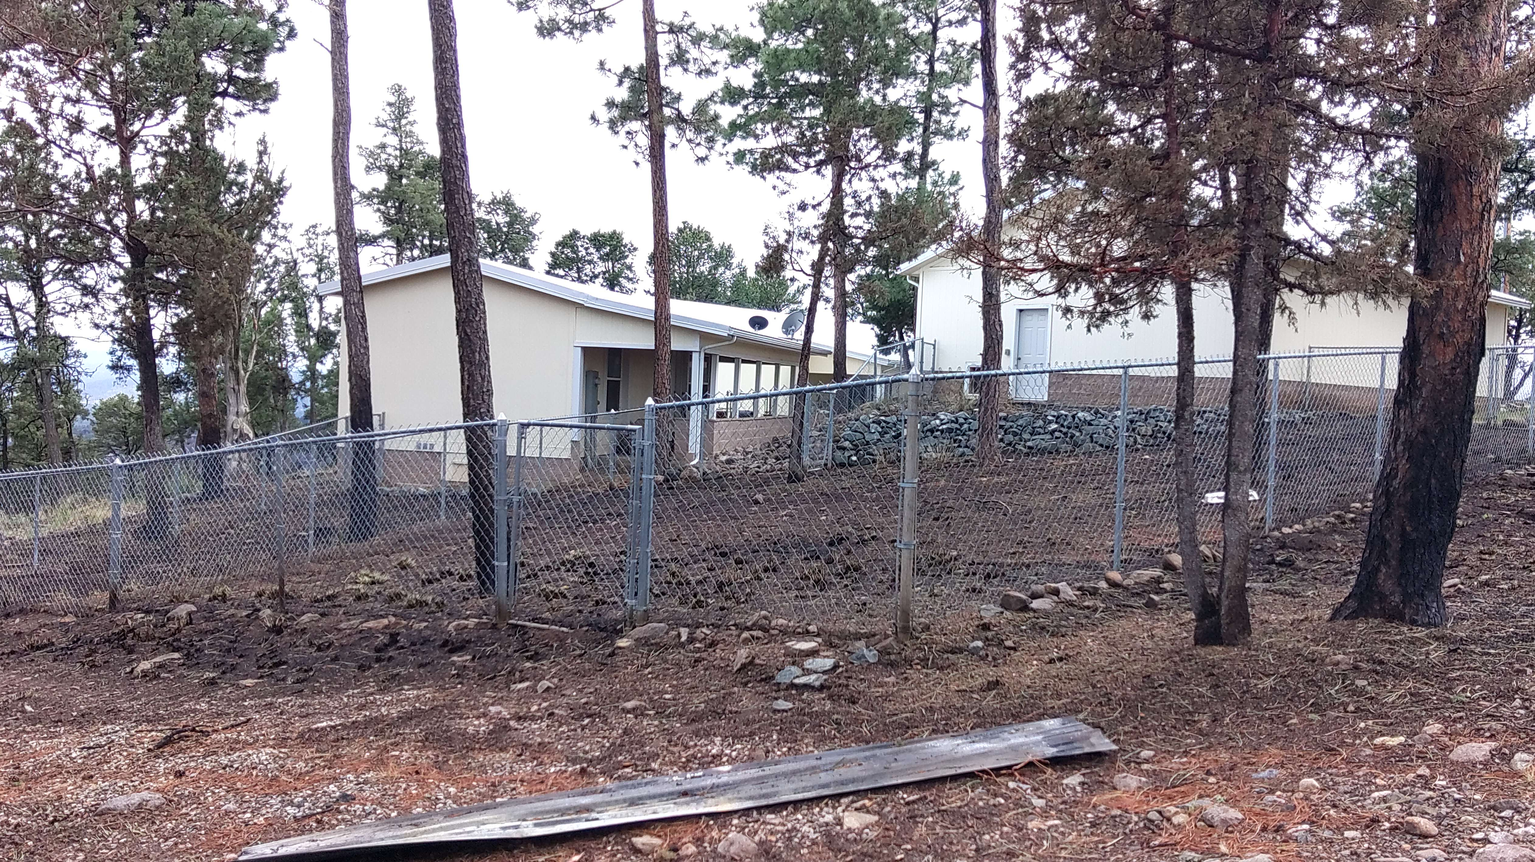
Proper treatmtne + Defensible space.

Slide 19
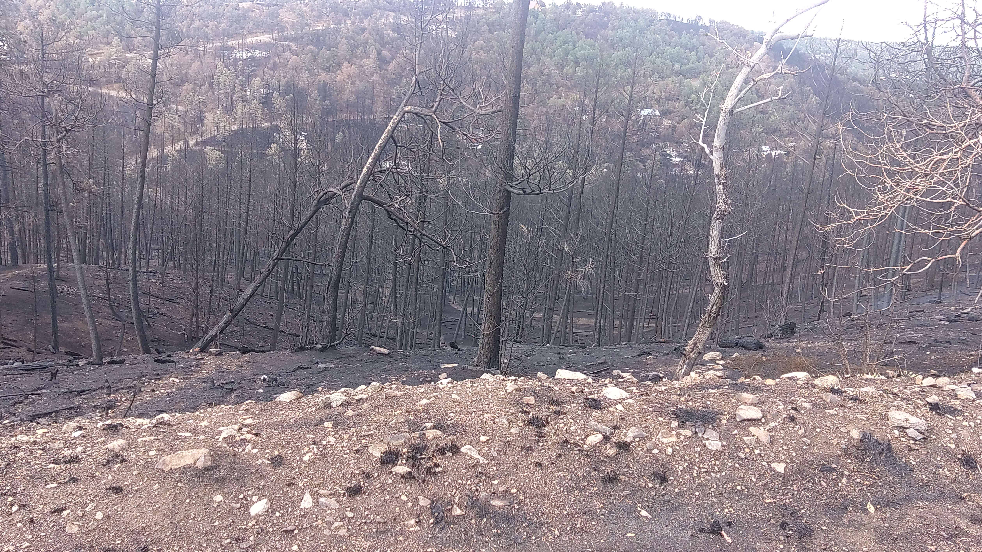
Unthinned (County)

Slide 20
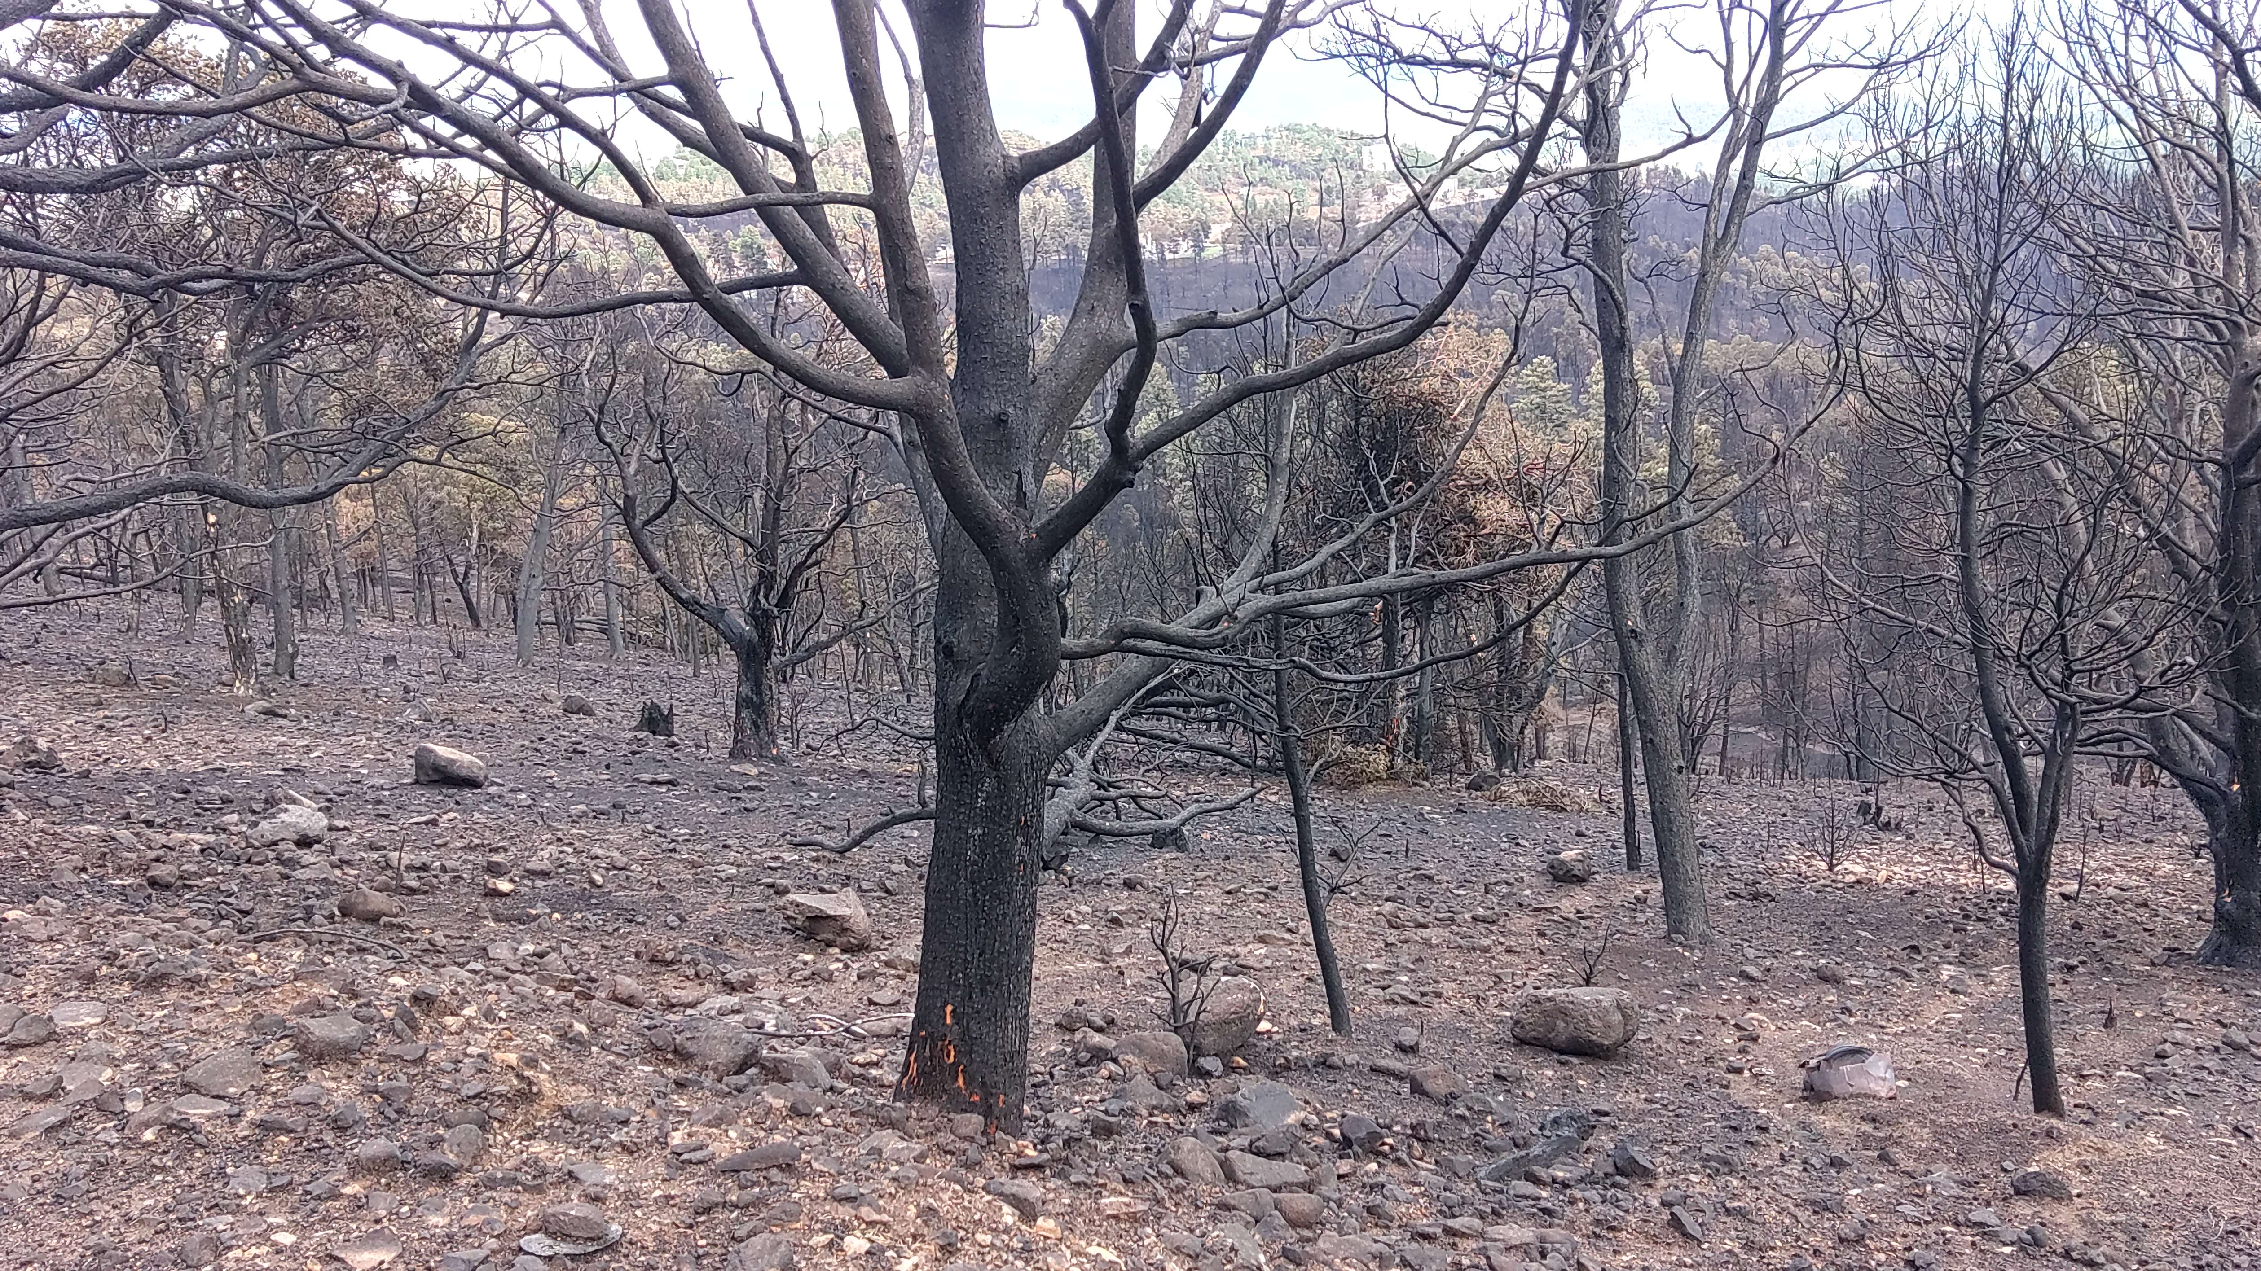
Need for Maintenance- 7 to 10 years
Thinned 11 years ago (Village)

Slide 21
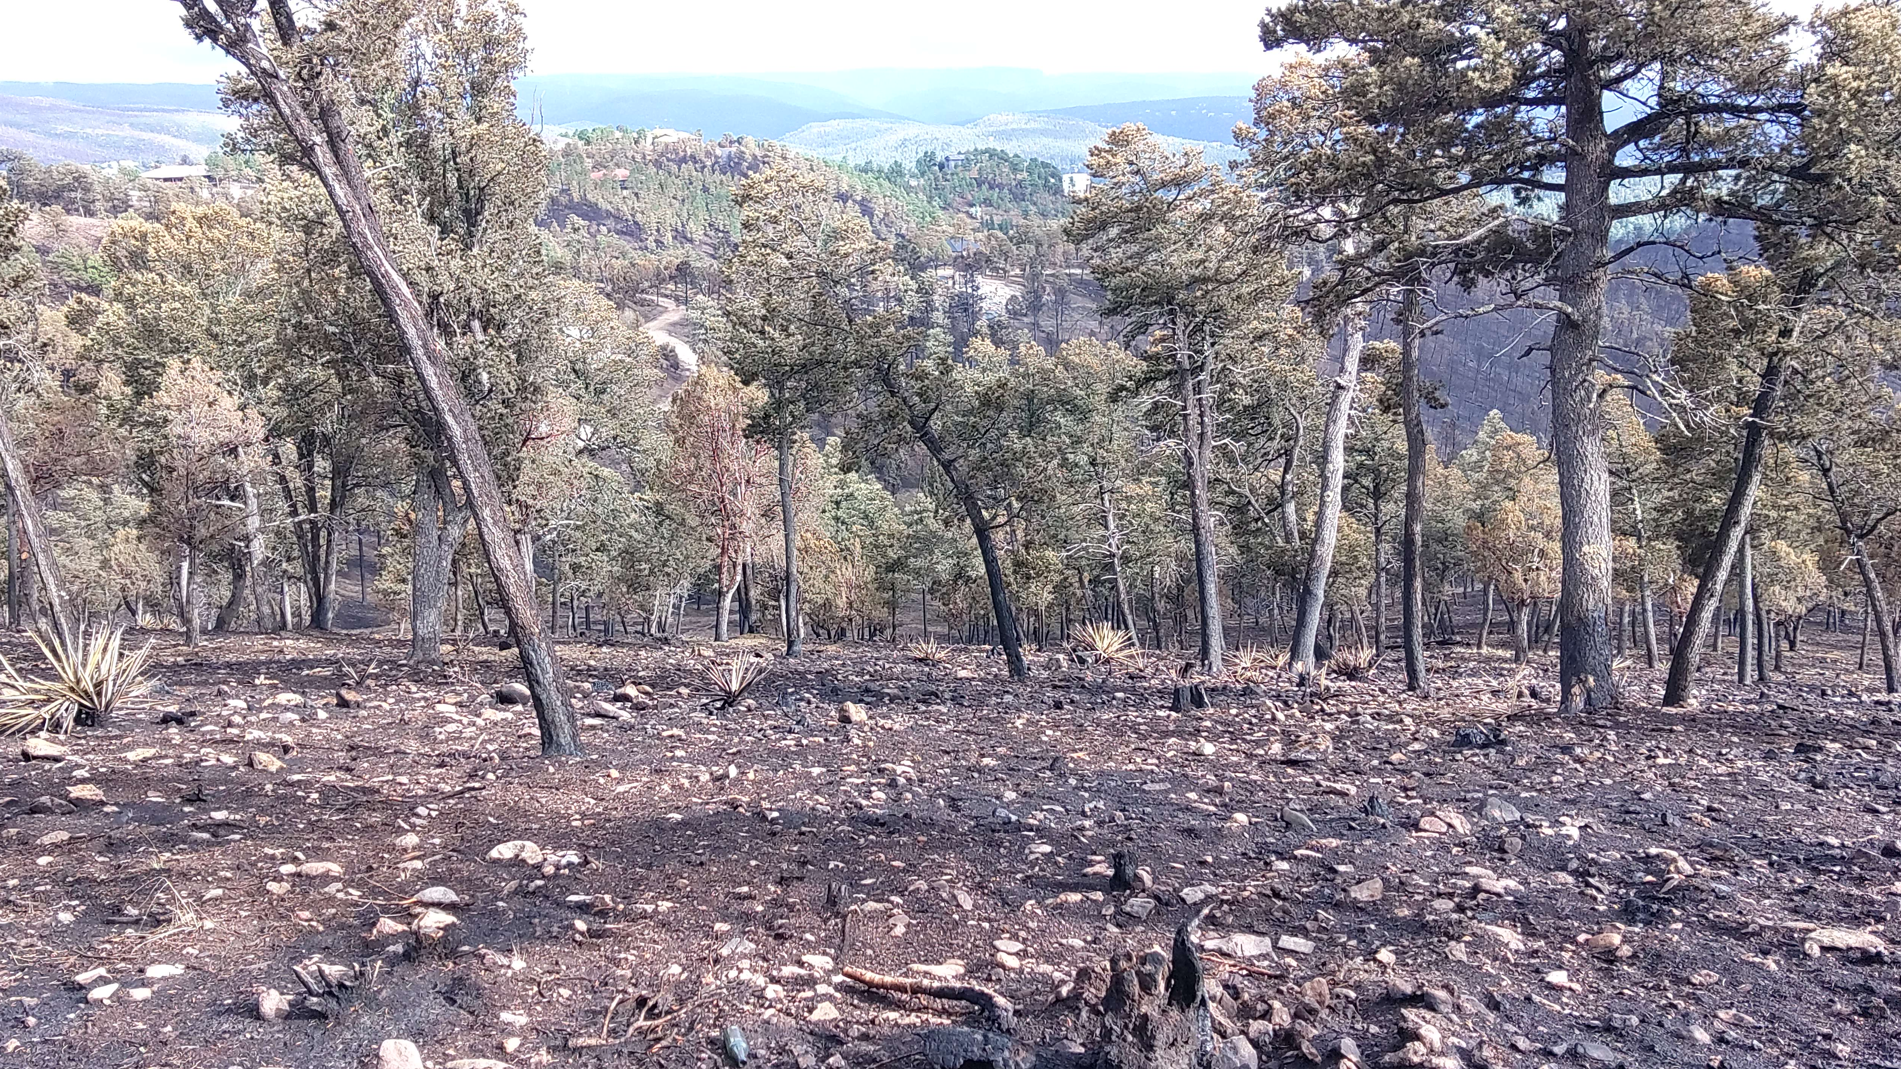
Recent Thinning (Village)

Slide 22
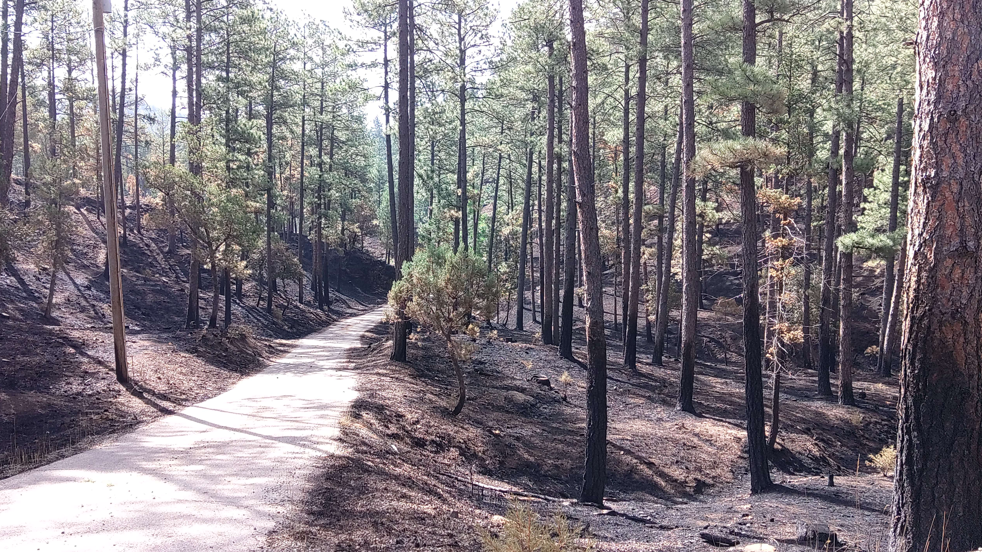
Forest Survived – Thinned 5 years
Ago, no ladder fuels.

Slide 23
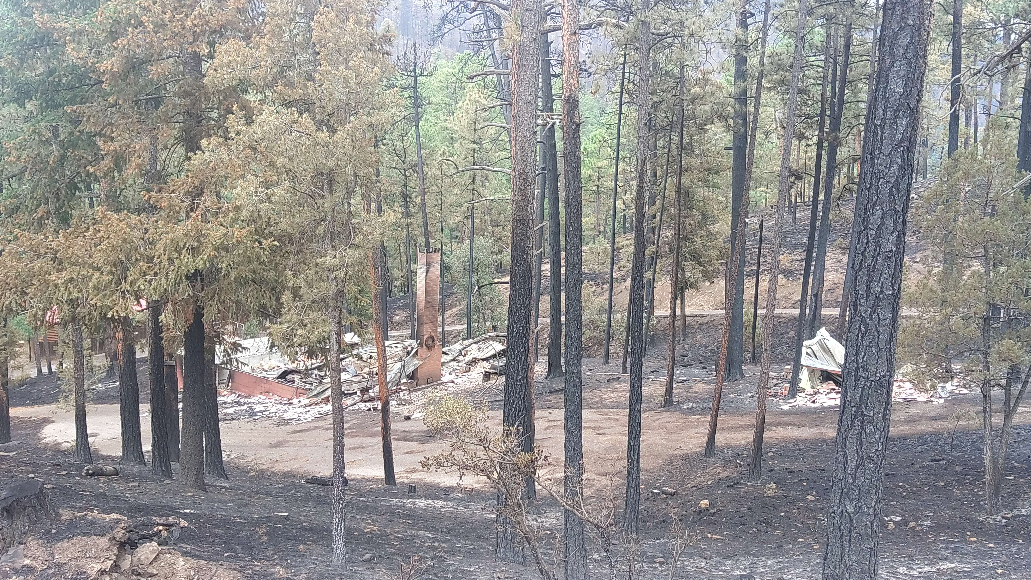
Ground Fire house burned

Slide 24
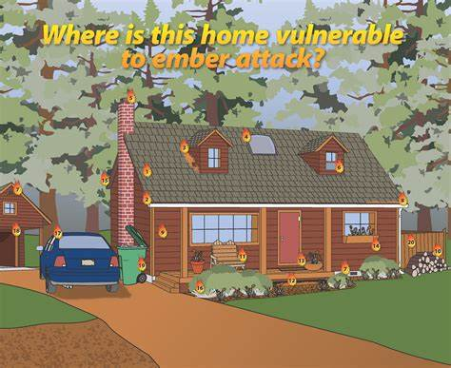

Slide 25
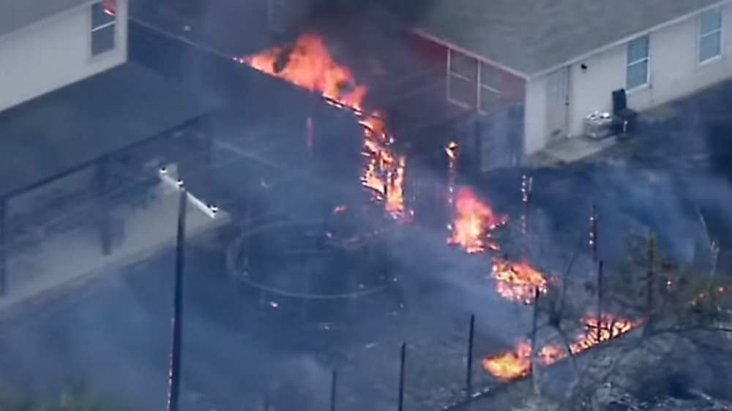

Slide 26
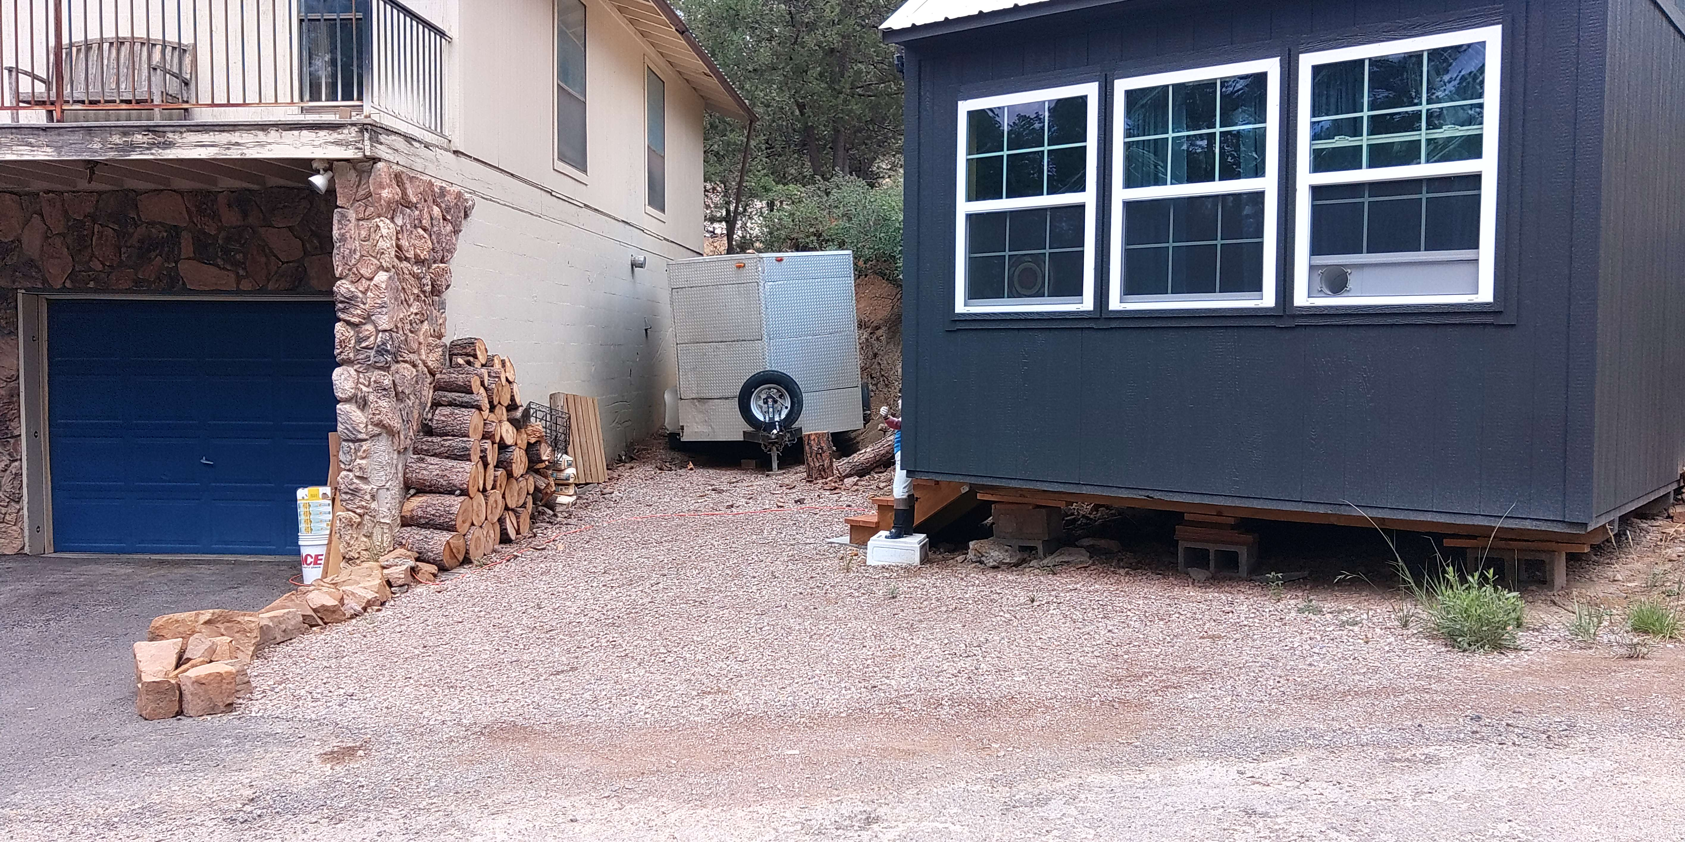

Slide 27
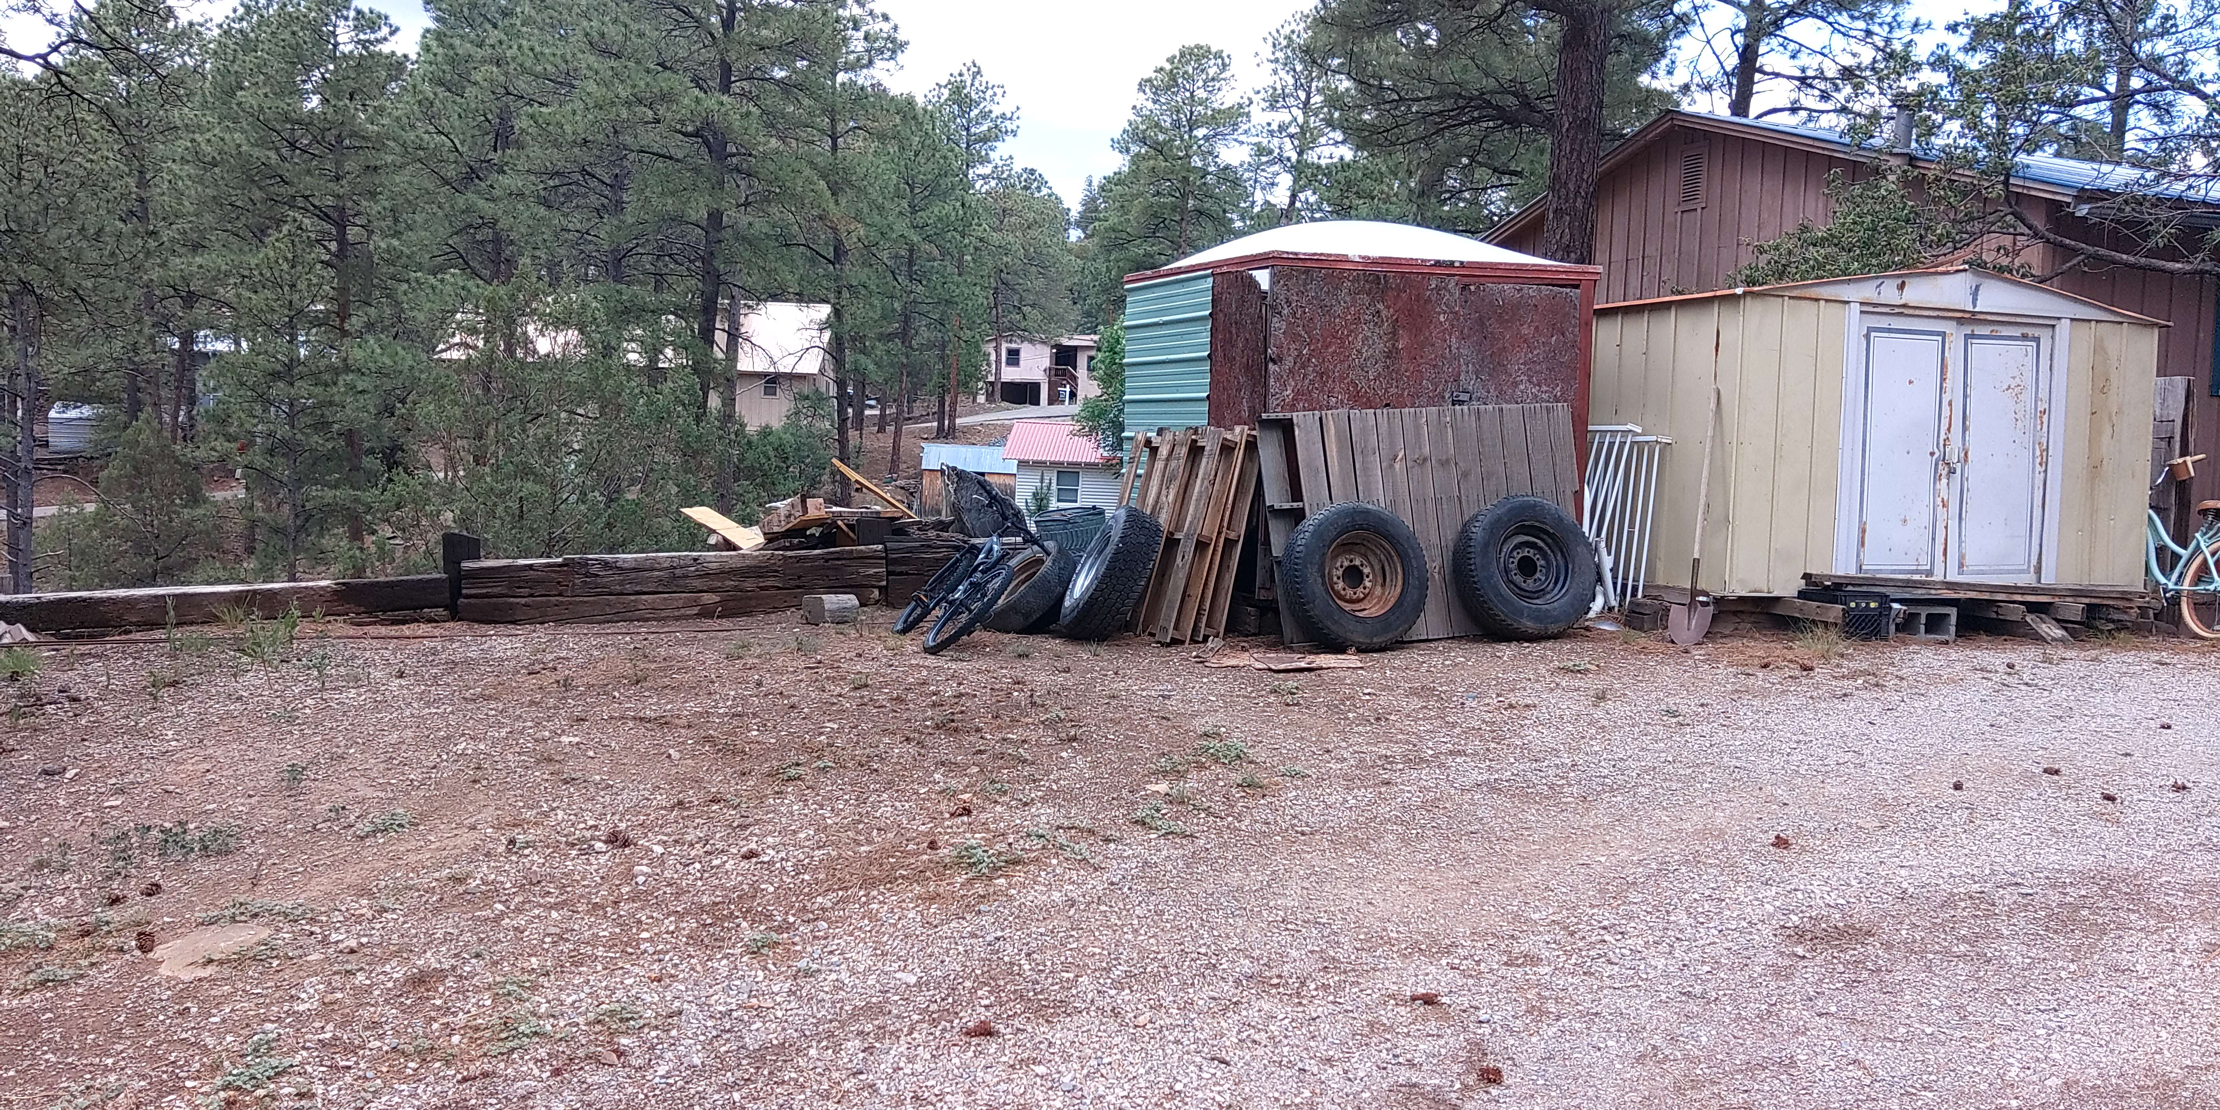

Slide 28
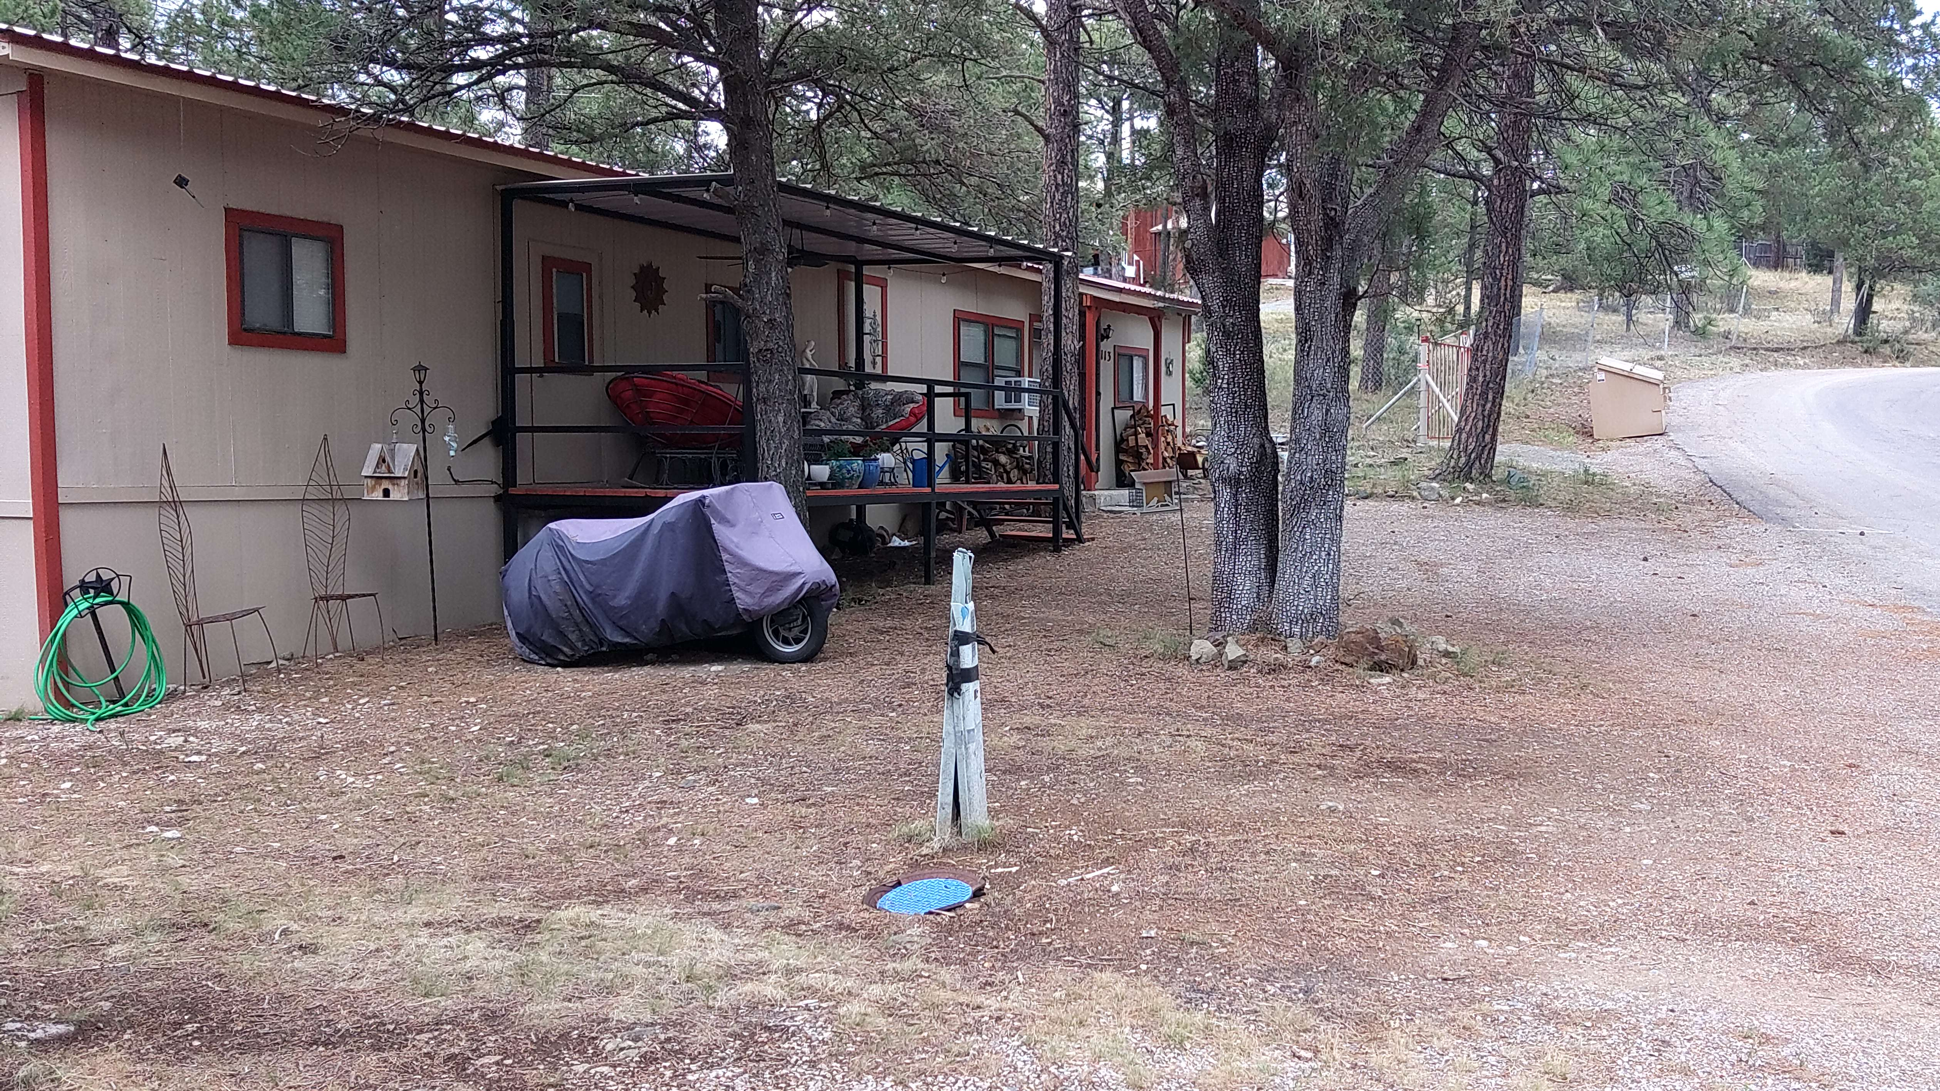

Slide 29
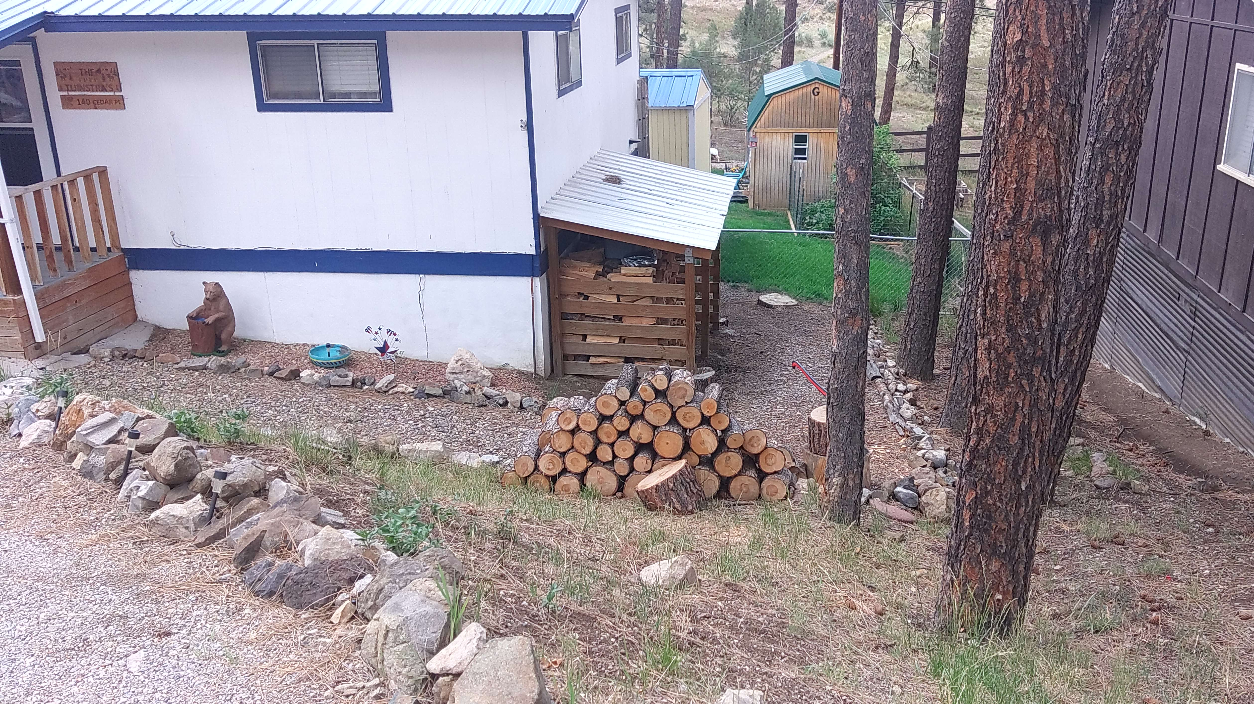

Slide 30
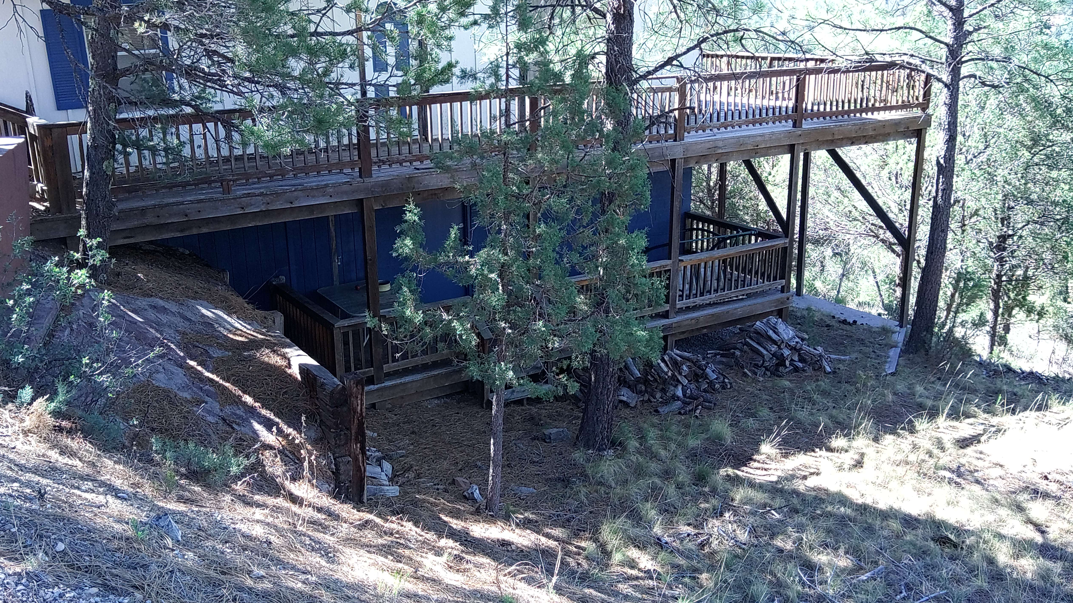

Slide 32
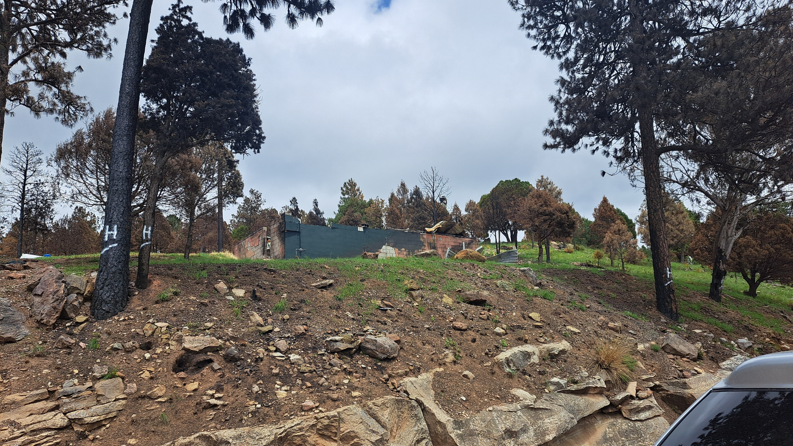

Slide 33
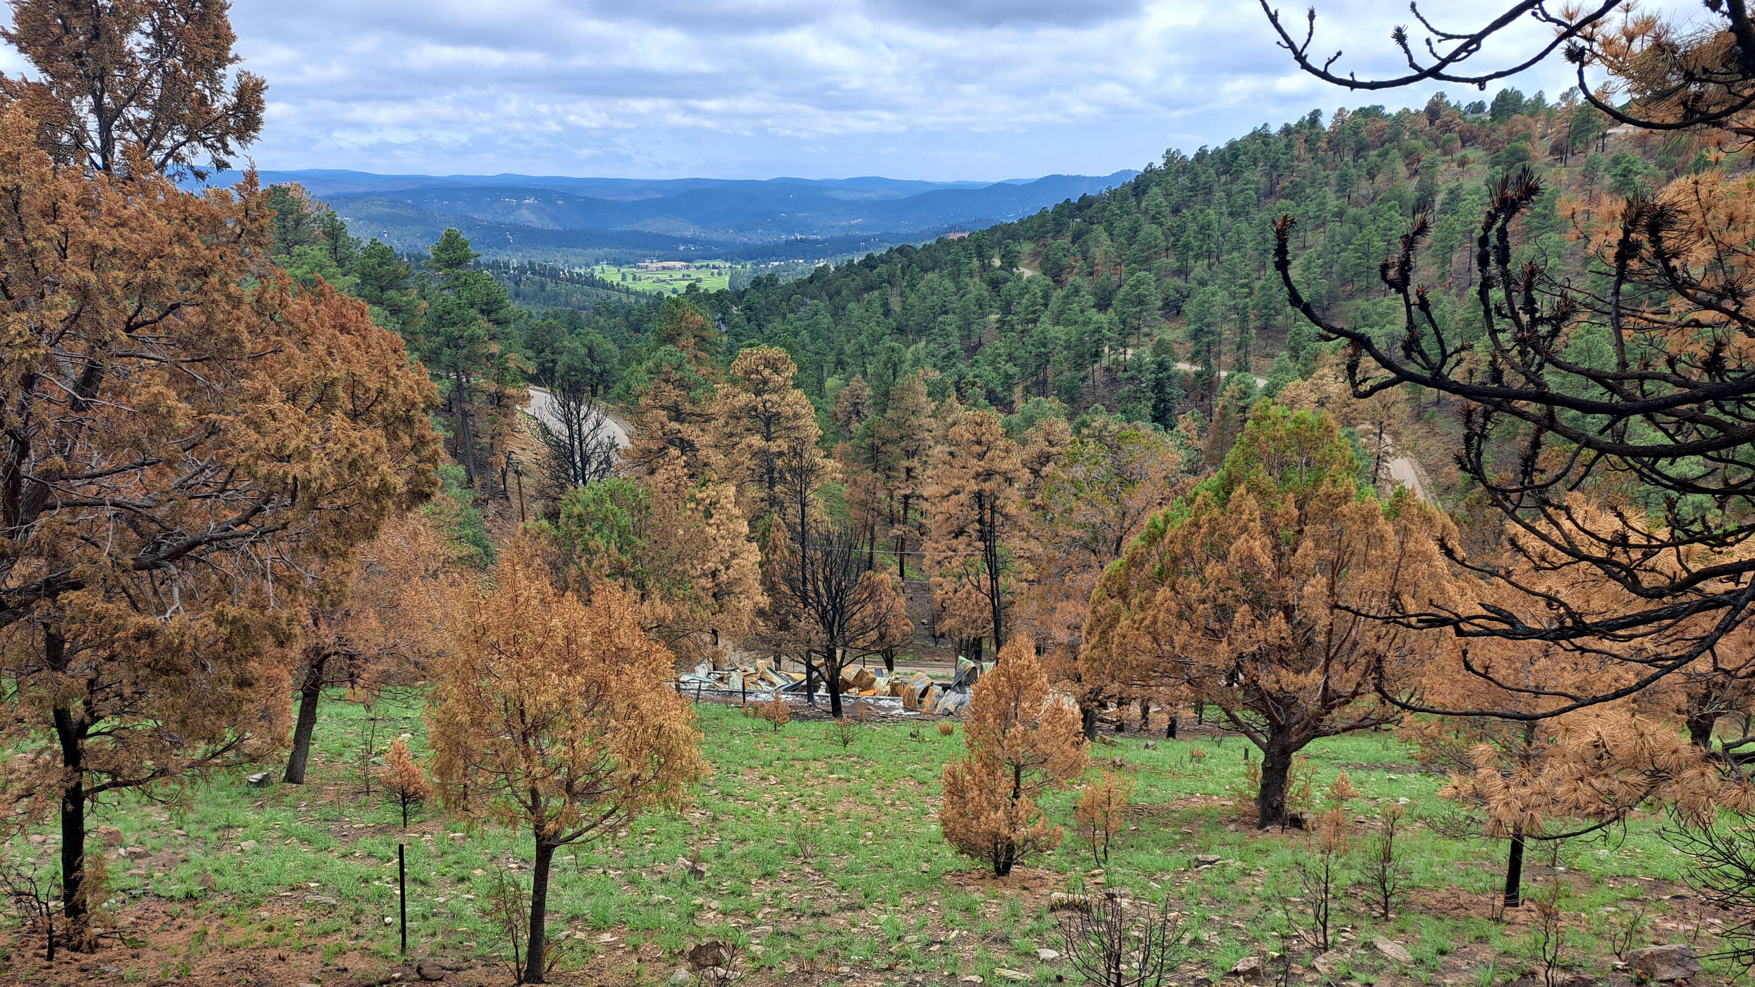

Slide 34
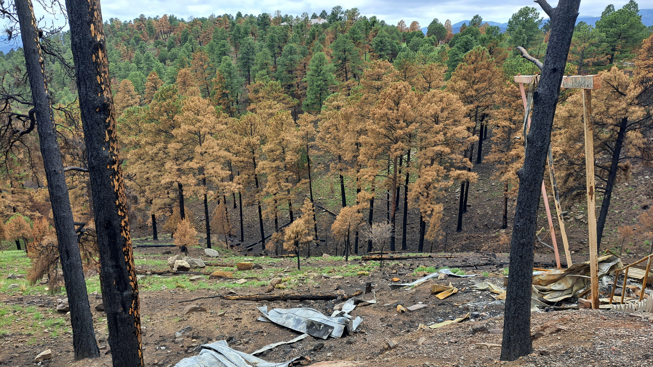

Slide 35
Village of Ruidoso Fire Mitigation Strategy
Thin the Vegetation on property to keep a wildfire on the ground. (allows firefighters to make direct attack)
Separate Fuels to prevent Crown to Crown ignition. (minimizes long range ember showers and excessive heat)
Prune Trees from the ground up to eliminate ladder fuels.
Eliminate vegetation next to combustible parts of the structures. (Windows, door, decks, vents)
Educate landowners on the merits of maintaining tree density, eliminating ladder fuels, mitigating connections between the fire and the home. (firewood, porch furniture, wood fencing, screened vents, railroad ties etc.)

Slide 36
3 Part Attack for protection.
1. Fuels Management with adequate spacing both Vertical and Horizontal.
2. Home Hardening to reduce the opportunity for ignition between the vegetation, ember wash and the structure.
Maintenance of both Fuels Management and Home Hardening to maintain protective character.

