Slide 1
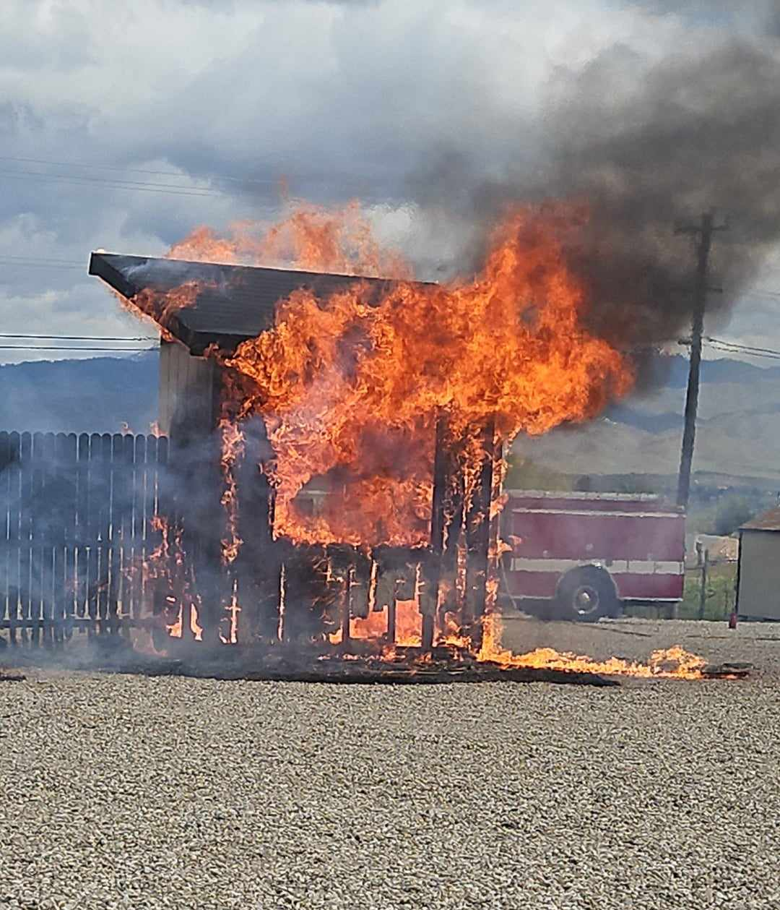

Wildfire reduction of risk
Lou Macias Bureau Chief of Consumer Assistance and Civil Investigations
Melissa Robertson Bureau Chief of Property and Casualty

Slide 2
Agenda
Introduction
Rates
Mitigation
Fair Plan
Final tips & takeaways

Slide 3





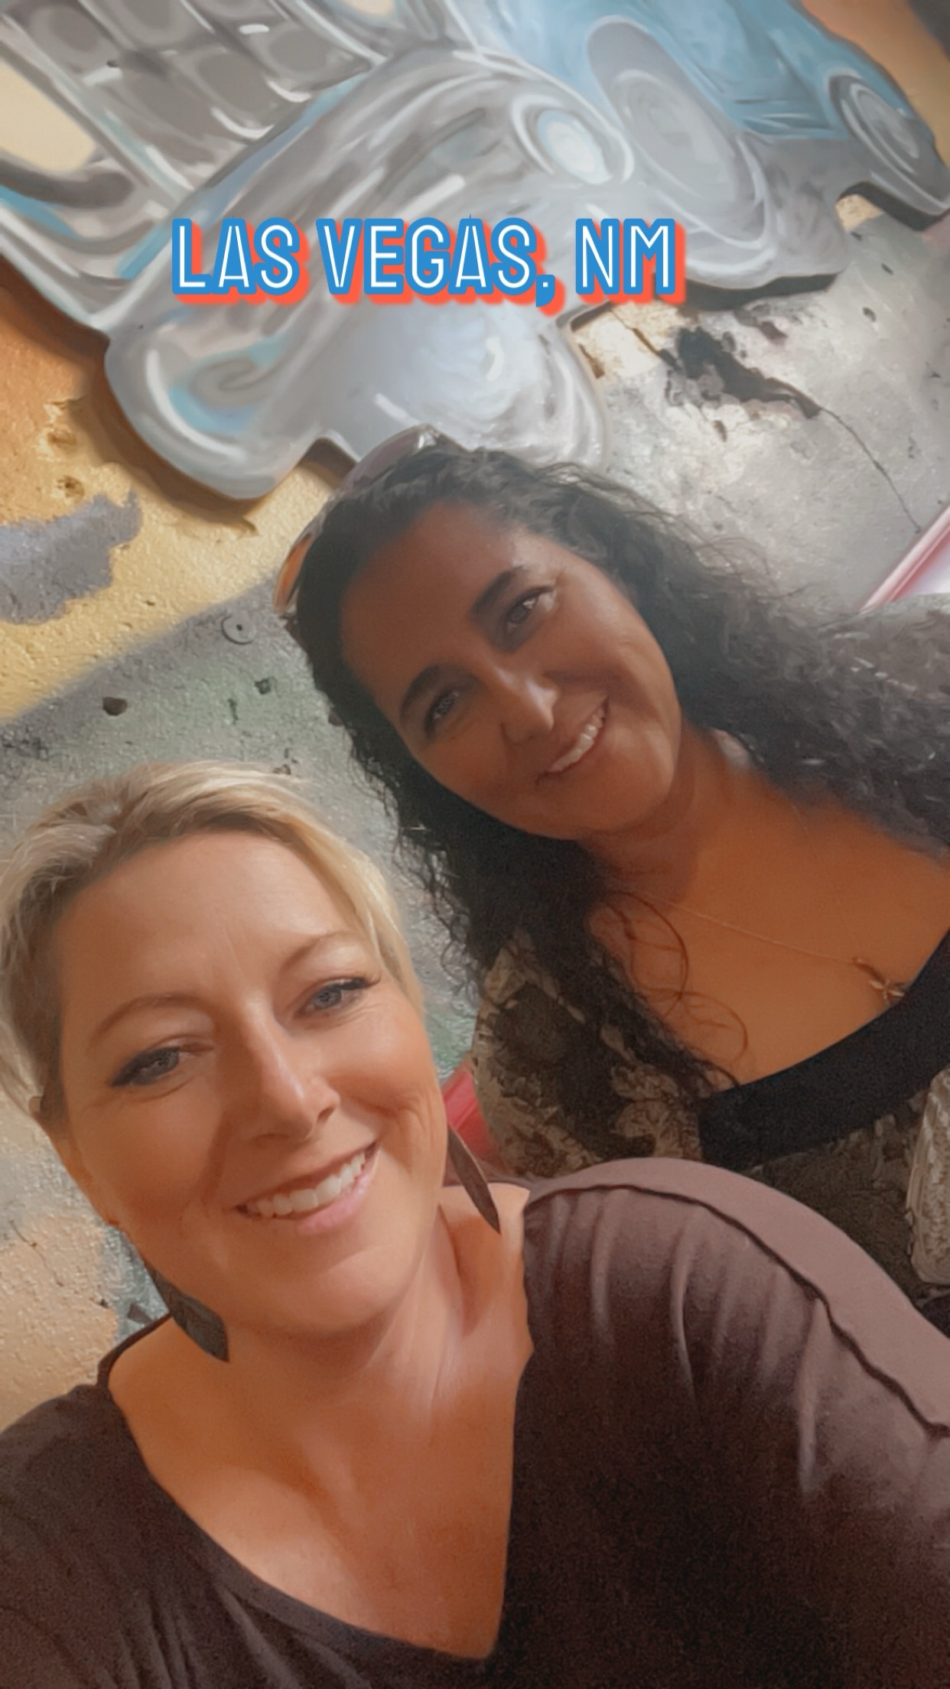
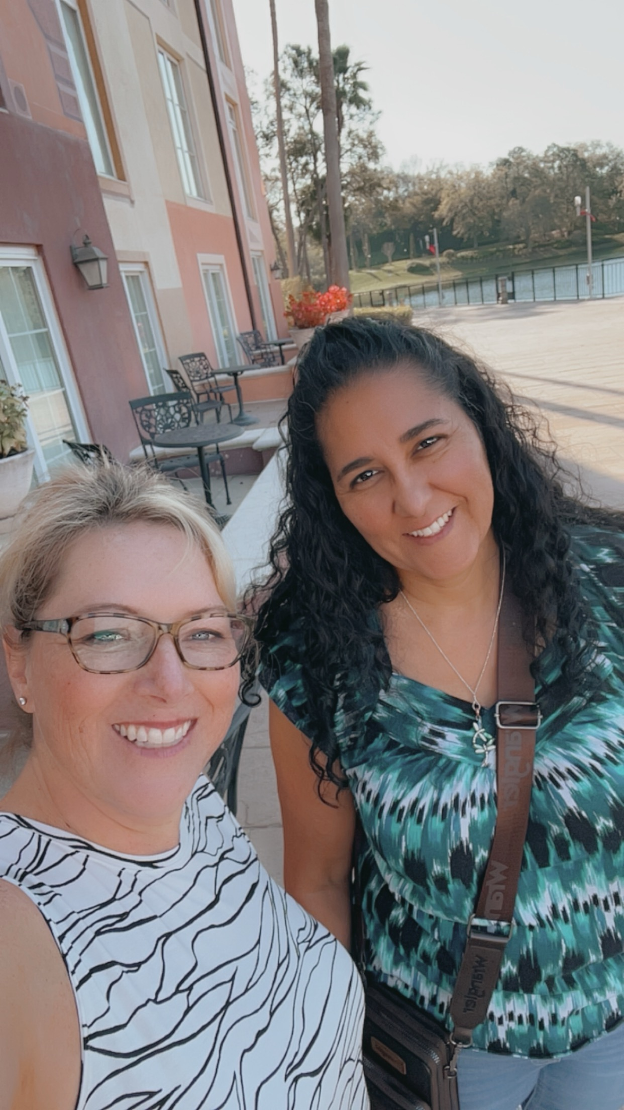
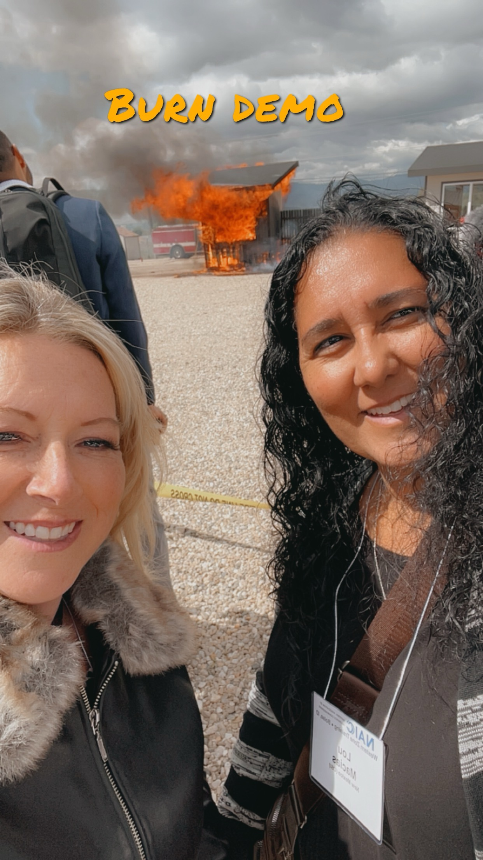

The Power of
Communication
Boise, ID
Orlando,FL

Slide 4

Home Characteristic
Inflation
Mitigation
What
Drives
Rates
This Photo by Unknown Author is licensed under CC BY

Slide 5


Overcoming
Prepare and Protect your home from Wildfire
*Prepare your home
*Clean Gutters and Roofs
*Create Defensible Space 5ft to 30ft
Nervousness
*Protect your Finances
*Complete a Home Inventory
*Have an Evacuation Plan
*After the fire be on the lookout for Fraud
*OSI ZMag

Slide 6
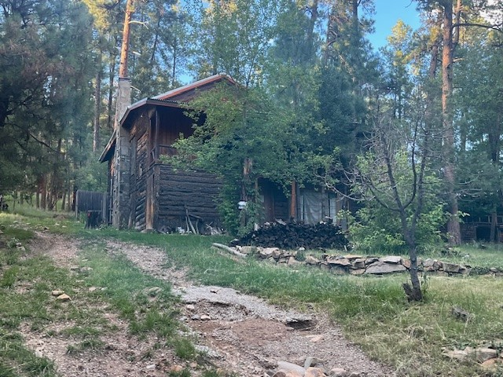
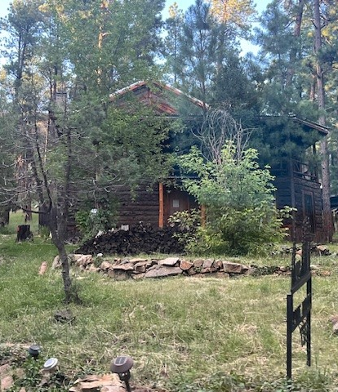
Creating Defensible Space

Slide 7
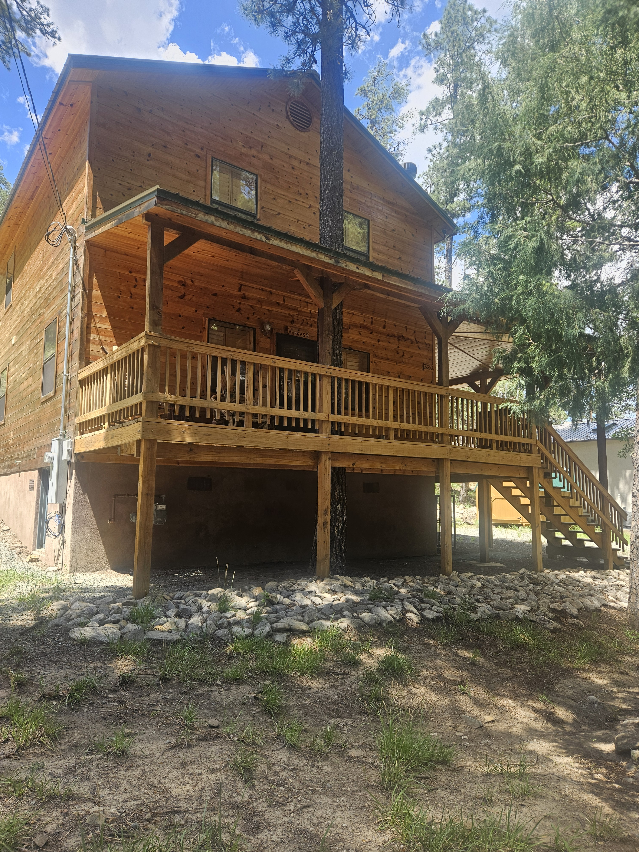
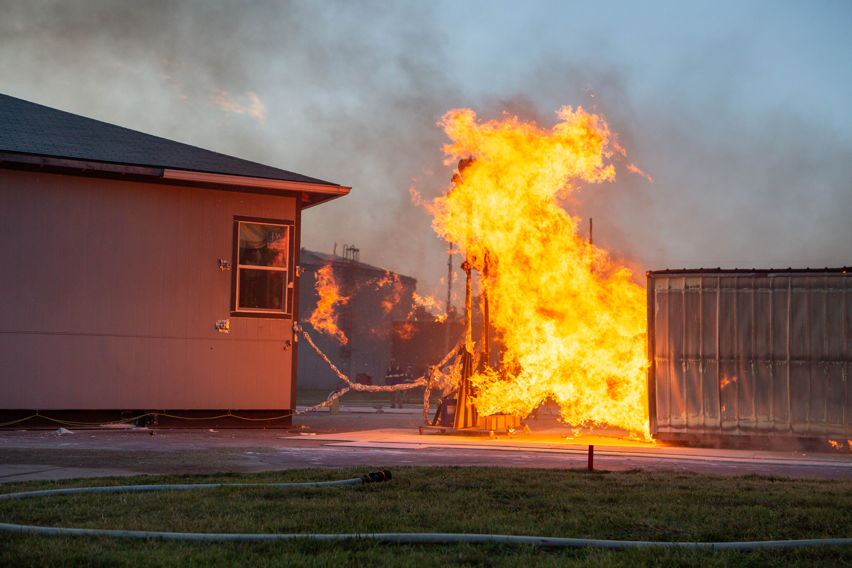
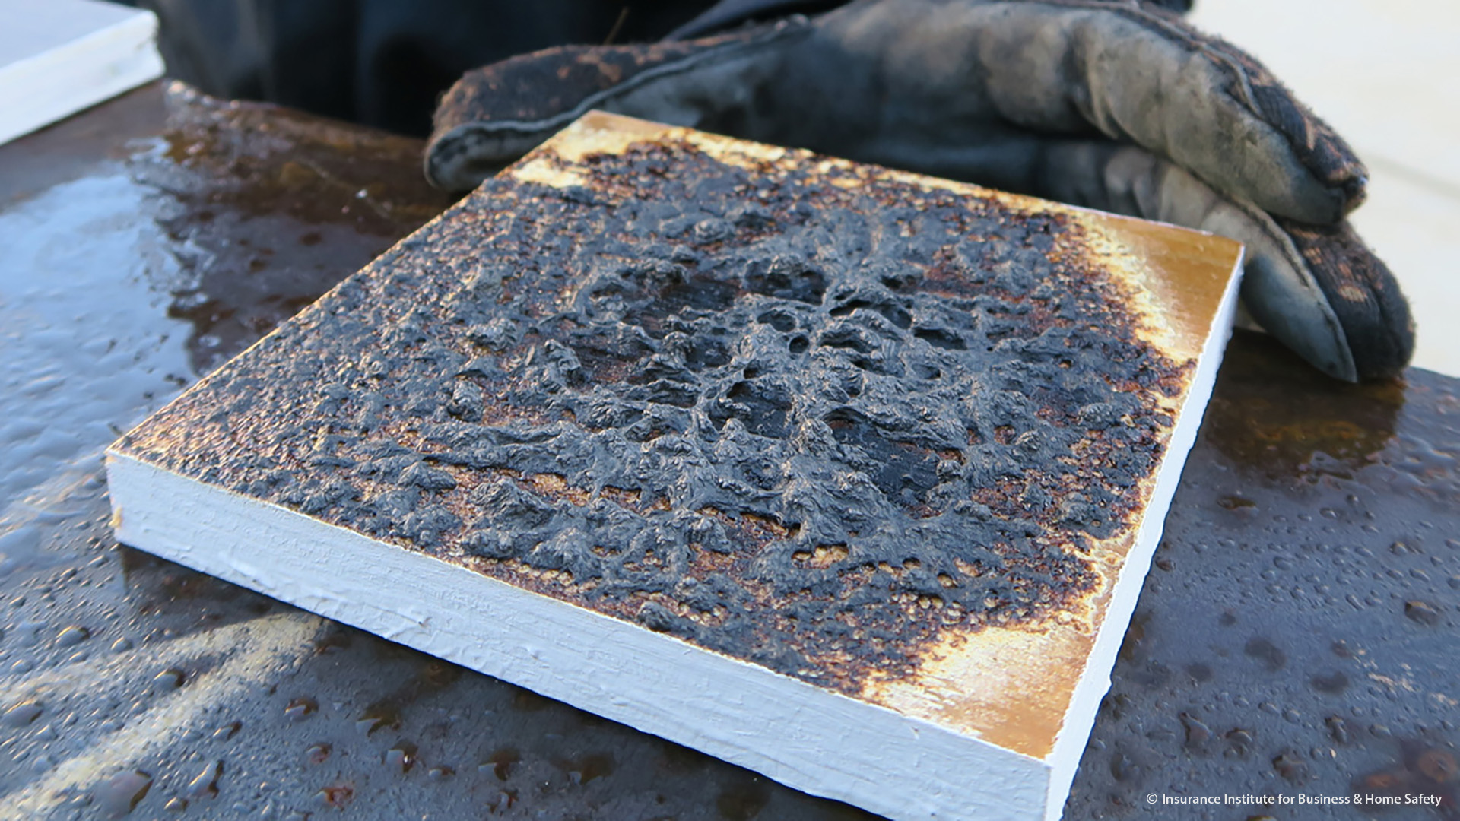
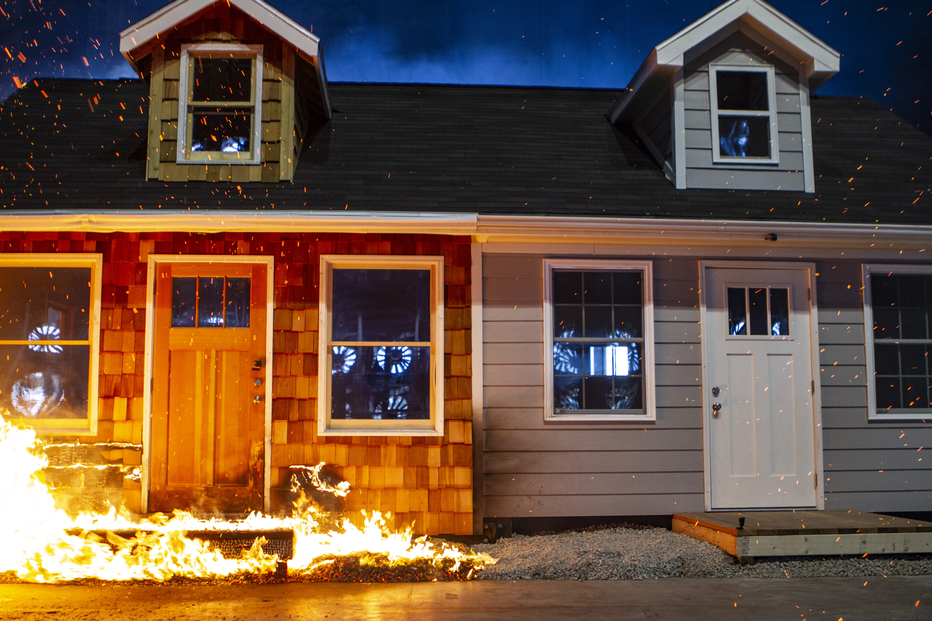
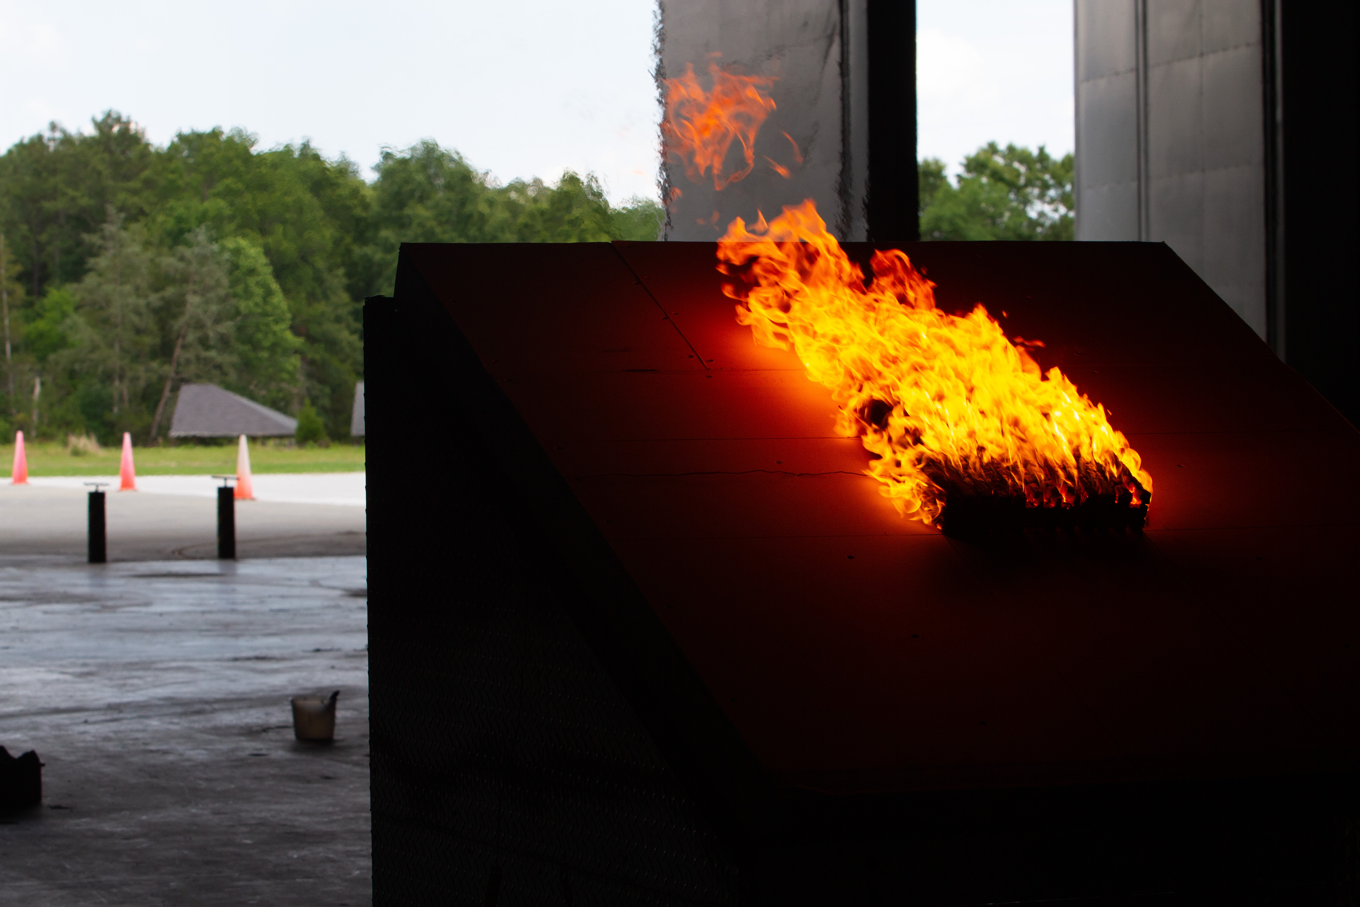




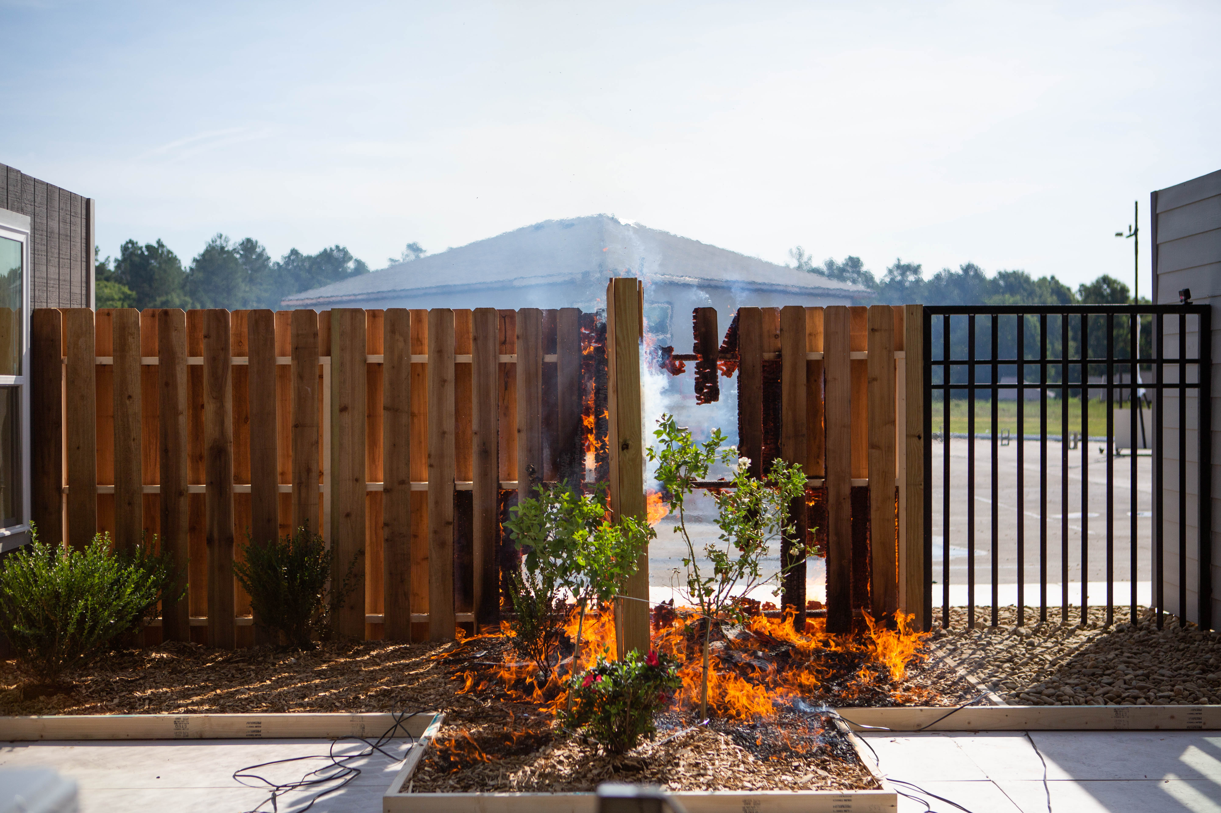
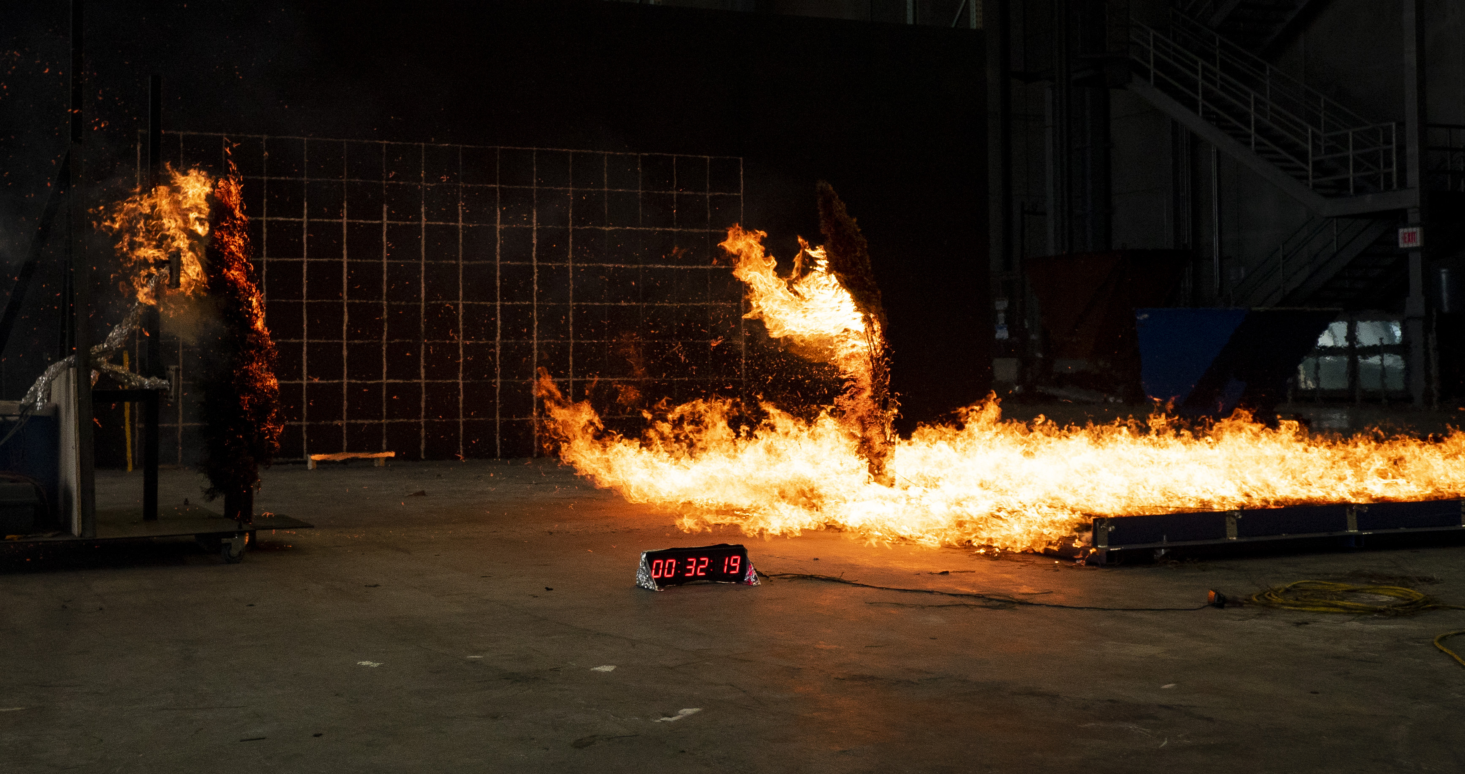
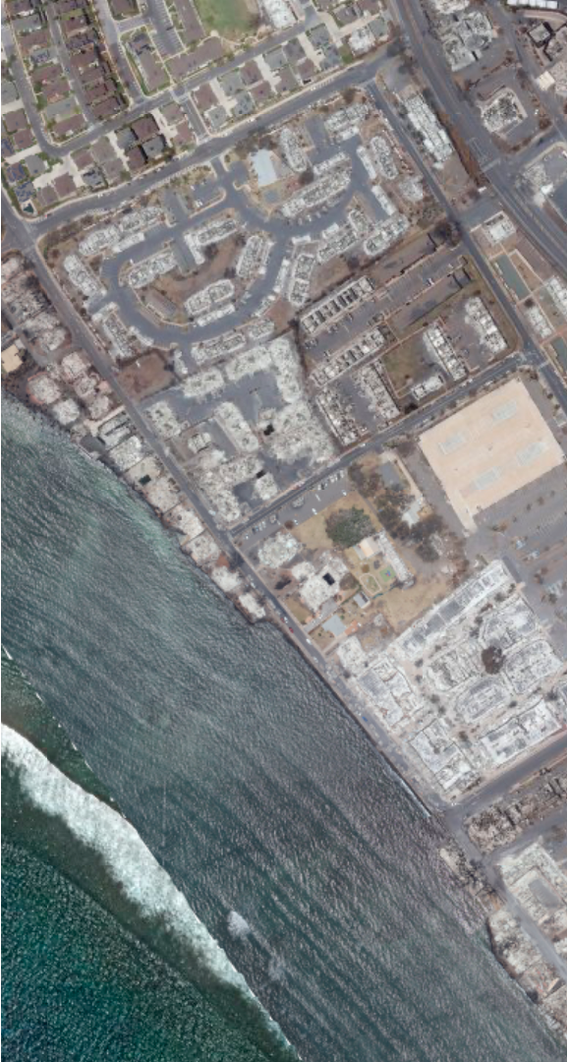

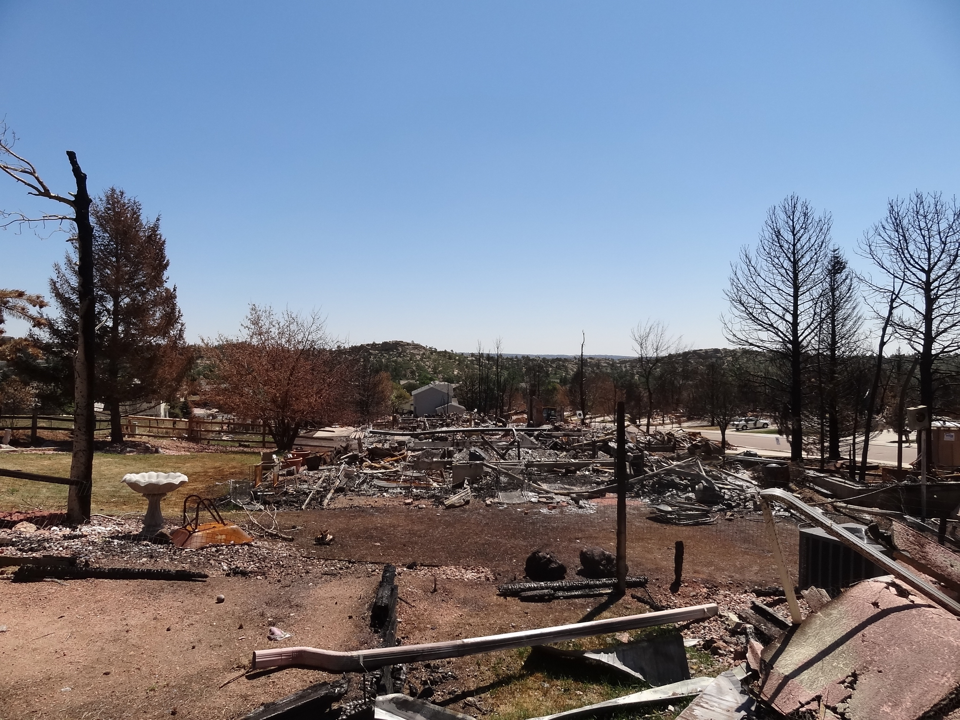


SCIENCE IS CATCHING UP
Structure Separation &
Wind-driven Fire
Roof Cover
Performance
Coatings & Gels
Home Hardening
Maui Fire
Investigation
2019
2021
2022
2023
2017
2018
2020
Marshall Fire
Investigation
Home Ignition Zone
Fuel Breaks
Wine Country Fires & Camp Fire Investigations

Slide 8
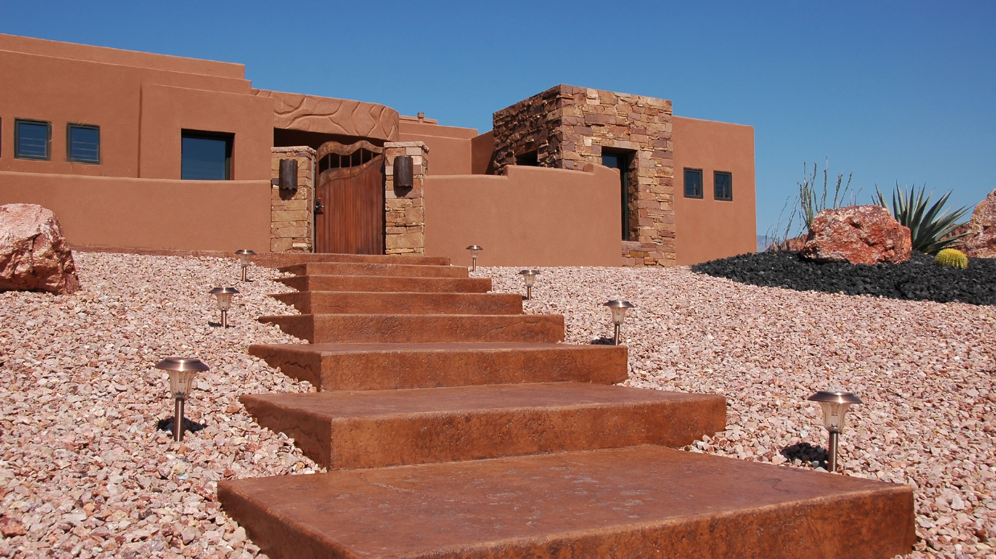


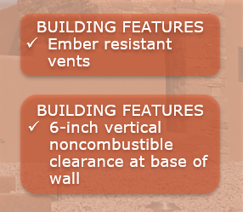
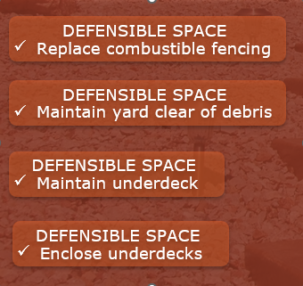
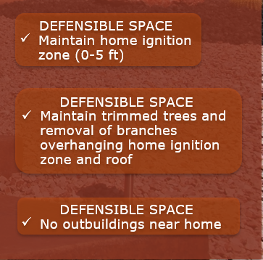

Slide 9

The Plan was established under Chapter 238 and approved on April 3, 1969 by the New Mexico Legislature. The last law was changed and approved under Chapter 59A, the Insurance Code, effective April 1, 1985 as 59A-29-1 to 59A-29-11.
State Pool
Last Resort Insurance
Limited Coverage
Minimal Premium
2201 San Pedro NE Bldg 20
Albuquerque, NM 87110
Phone: (505) 878-9563
Fax: (505) 878-9566

Slide 10
Final Tips and Takeaways
Meet with Agent yearly
Contact OSI with Questions and
Complaints
Go Kit
Take Video of belongings in home
Protect Your home
Protect your community
Be Prepared
Have an evacuation plan

Slide 11
THANK YOU
Lou Macias and Melissa Robertson
Consumer Assistance 855-427-5674

